Slide 1
The single-cell transcriptome landscape in human tissues
12/27/2019
Notes:
大家好，今天我总结一下目前的一些进展。

Slide 2
Content
Part1: Overview of GeACT
Part2: Cell type identification and annotation
Part3: Transcriptional regulation across cell-types
Part4: Co-expression modules within each cell type
Part5: The spatial - specific expression
Notes:
Figure tissues:
Figure 96-well plate:
Figure NGS: https://coursesandconferences.wellcomegenomecampus.org/our-events/next-generation-sequencing-2019/

Slide 3


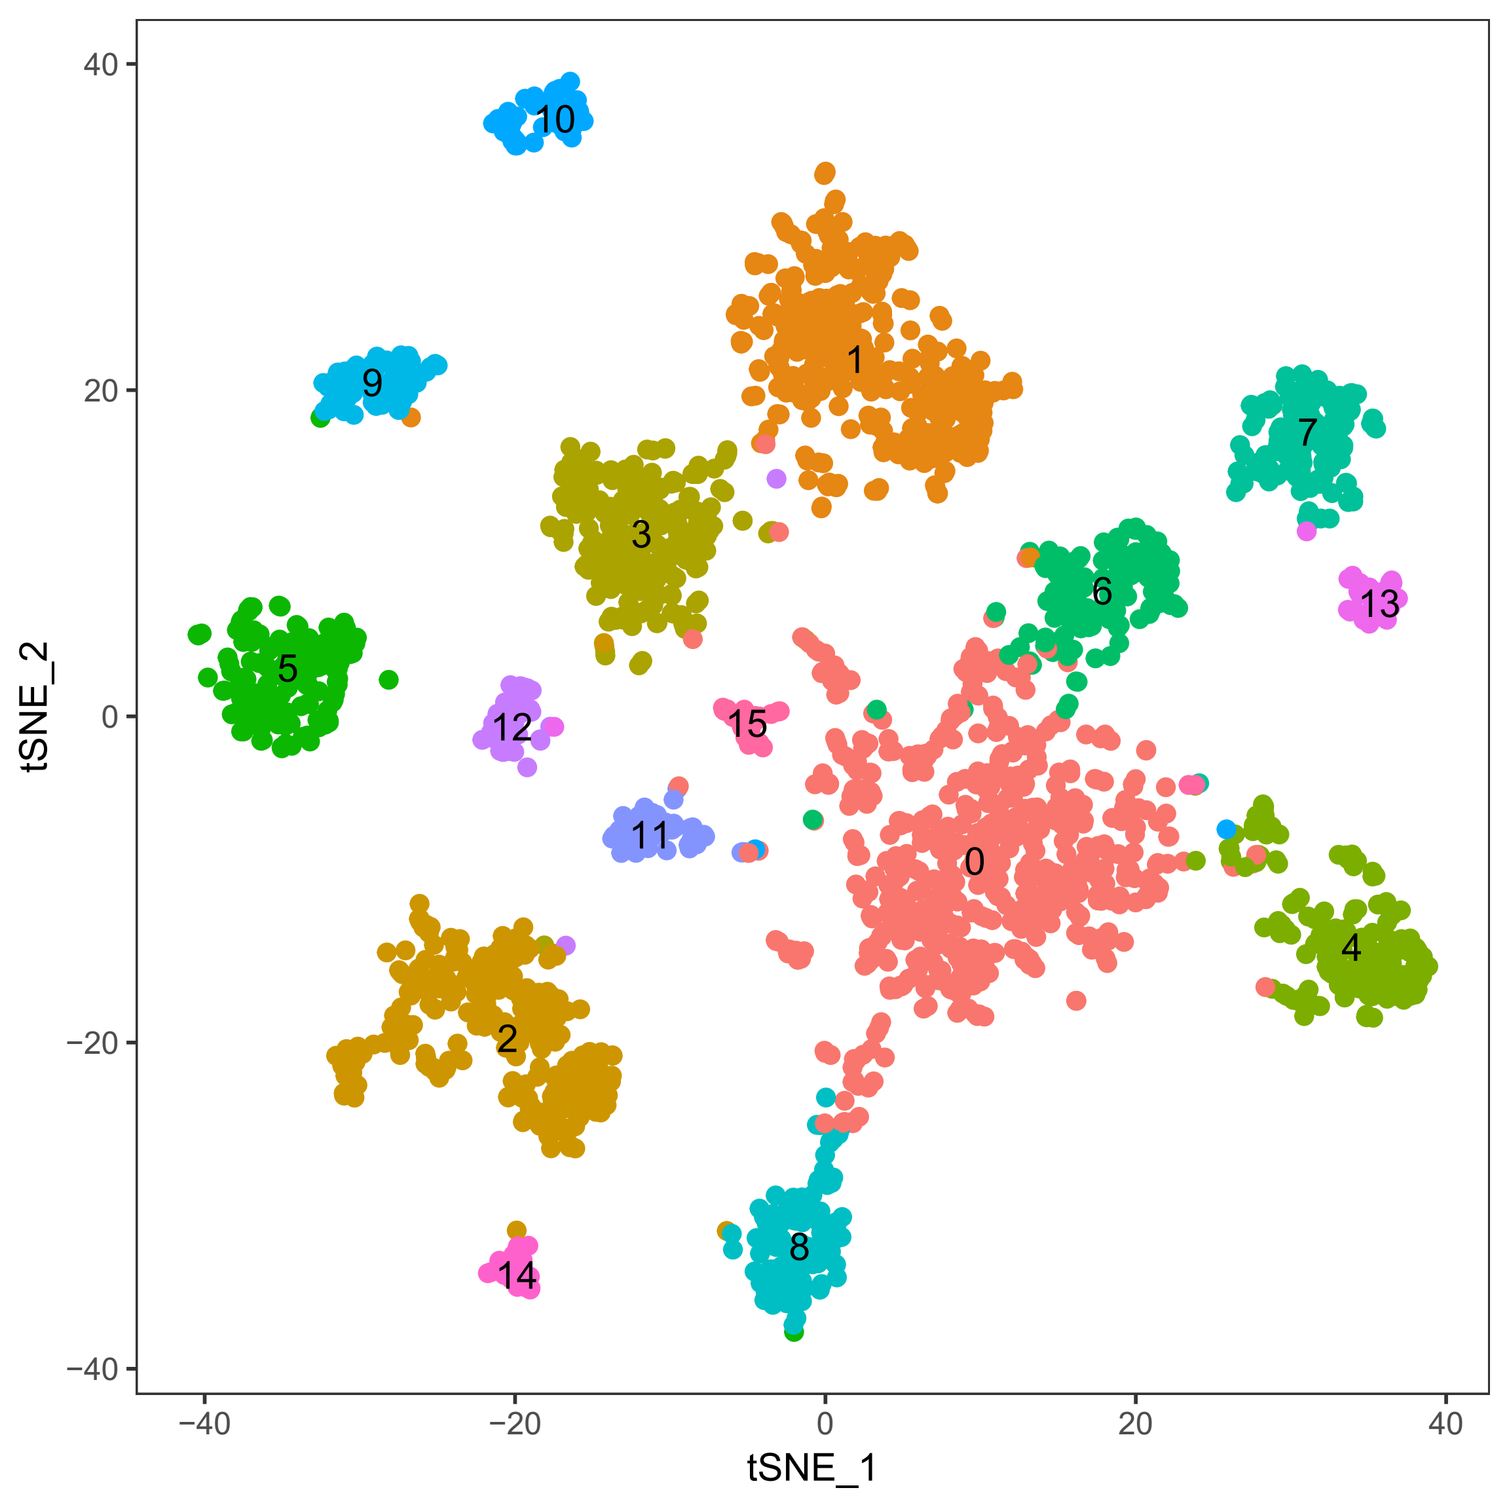

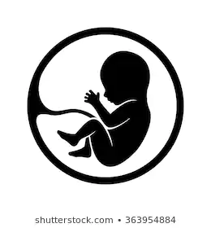






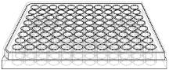
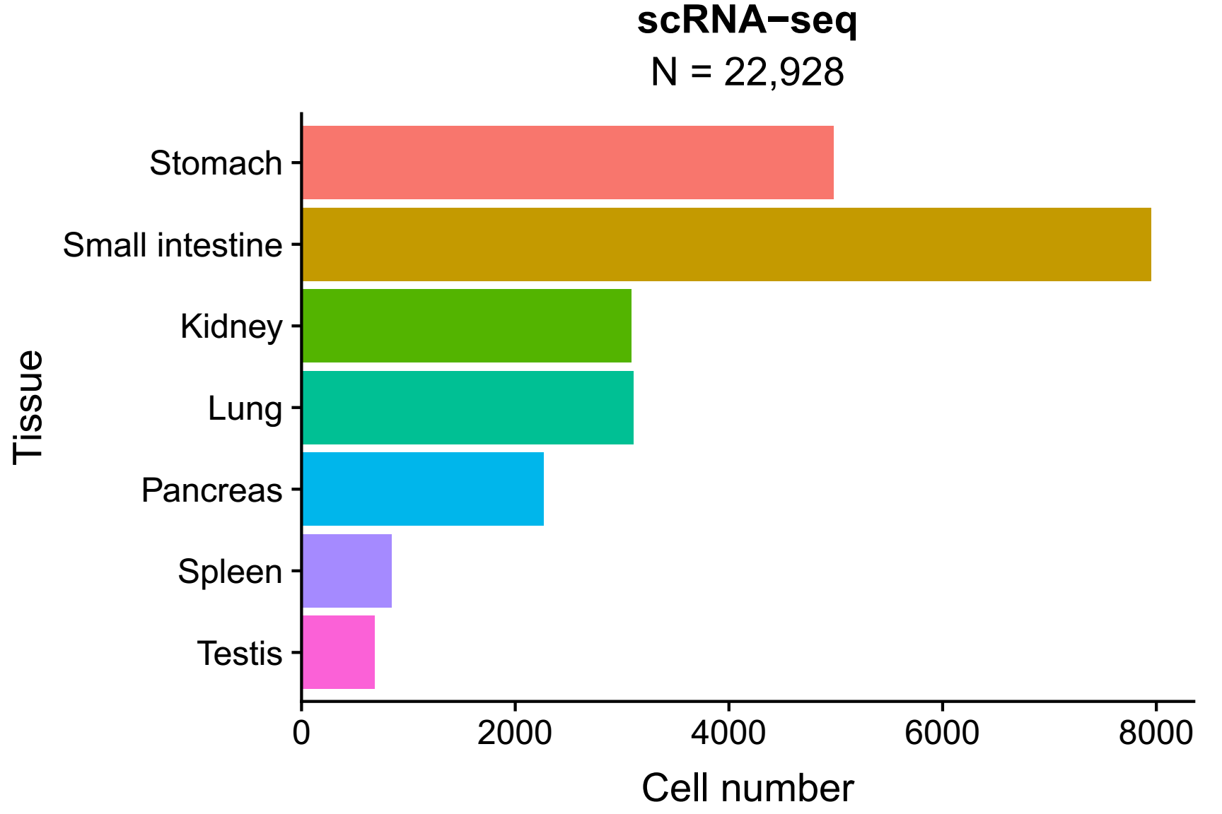
Overview of GeACT
A
Sampling
FACS sorting
Sequencing
Data analysis
B
C
The landscape covered 105 cell types from 14 sampling positions in 7 tissues.
Notes:
31,392 cells (327 plate)
Figure tissues:
Fetal: https://www.google.com.hk/imgres?imgurl=https%3A%2F%2Fimage.shutterstock.com%2Fimage-vector%2Ffetus-icon-isolated-on-white-260nw-363954884.jpg&imgrefurl=https%3A%2F%2Fwww.shutterstock.com%2Fsearch%2Ffetus%2Bicon&tbnid=Cq6mCP3U-dWppM&vet=12ahUKEwiW86P4mInlAhUC25QKHQF9CF0QMygAegQIARAr..i&docid=ZAwkagmo_JS0WM&w=260&h=280&q=human%20fetal%20icon&hl=zh-cn&safe=strict&ved=2ahUKEwiW86P4mInlAhUC25QKHQF9CF0QMygAegQIARAr
Stomach: PPT
Small intestinal: https://www.google.com.hk/search?q=small+intestine+icon&tbm=isch&ved=2ahUKEwi0mur_nYnlAhWPDt4KHdyaDD0Q2-cCegQIABAA&oq=small+intestine+icon&gs_l=img.3..35i39.63803.64205..64581...0.0..0.182.713.0j4......0....1..gws-wiz-img.......0i30.NJicx3SltVU&ei=trSaXbTnMY-d-AbctbLoAw&bih=937&biw=1920&safe=strict&hl=zh-cn#imgrc=07HieIZfCRS_gM
Kidney: PPT
Lung: PPT
Pancreas: ?
Spleen: https://adioma.com/icons/spleen-organ
Testis: https://www.iconfinder.com/icons/3958541/male_organ_reproductive_gland_scrotum_sperm_testicle_testis_icon
Ovary: https://thenounproject.com/term/ovary/131059/
Heart: PPT
Figure 96-well plate:
Figure NGS: https://coursesandconferences.wellcomegenomecampus.org/our-events/next-generation-sequencing-2019/

Slide 4
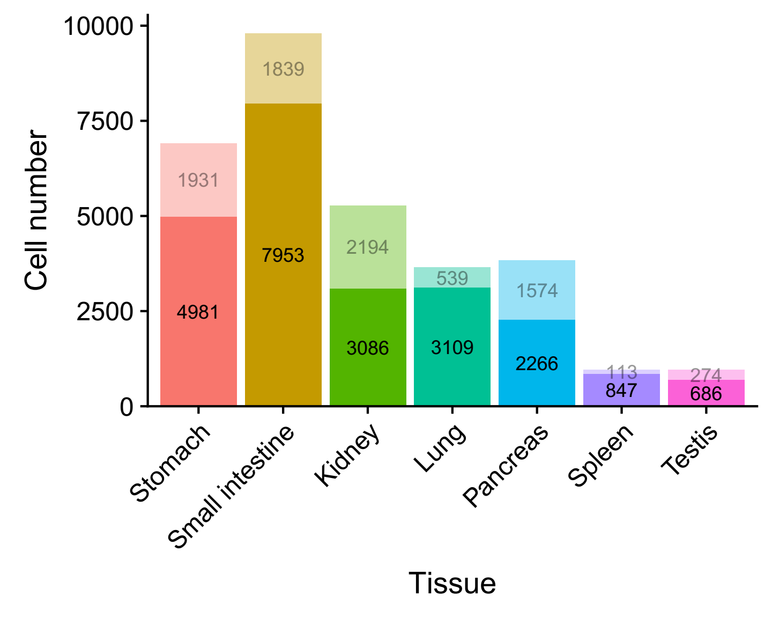
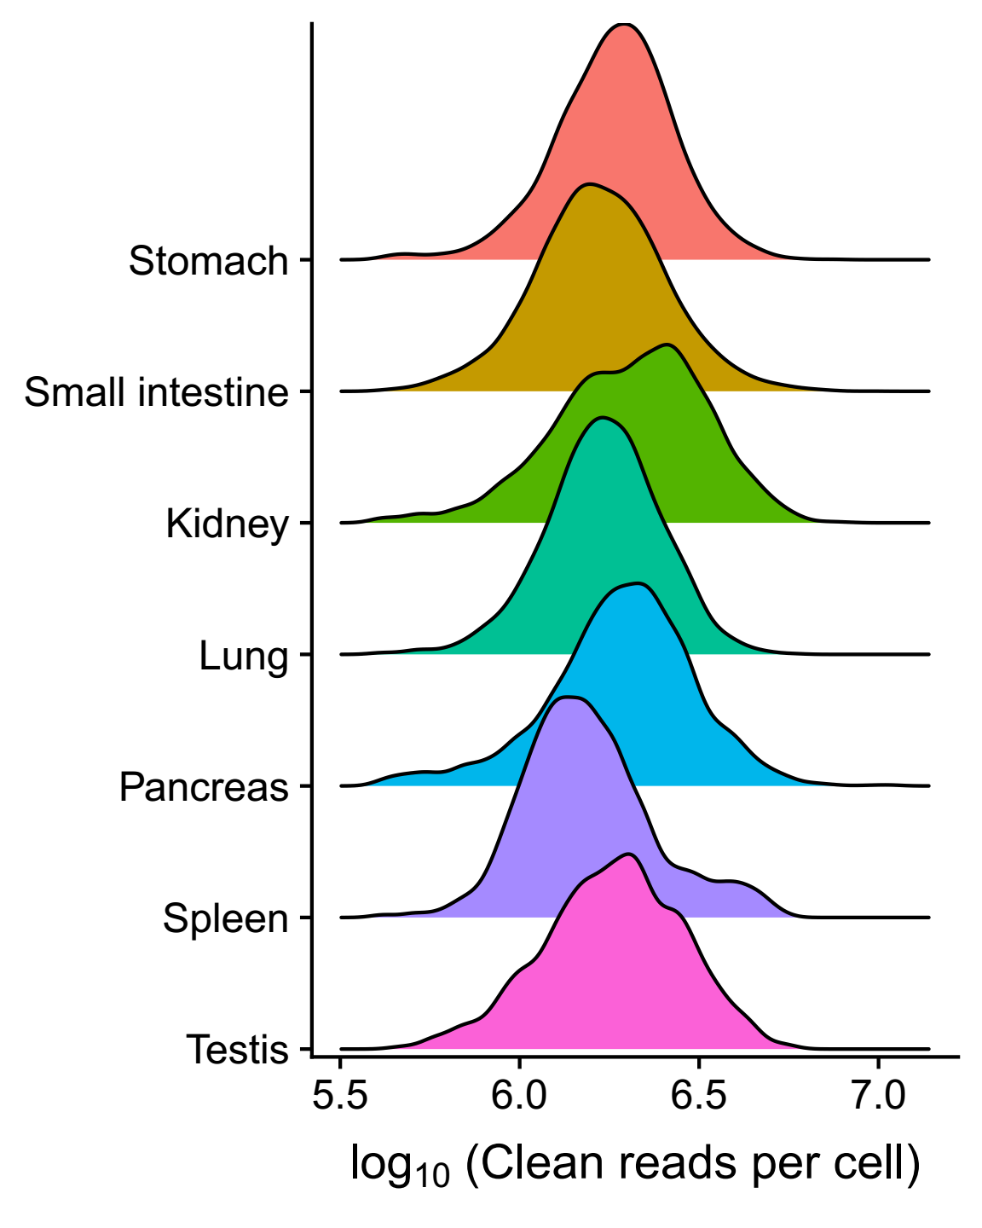
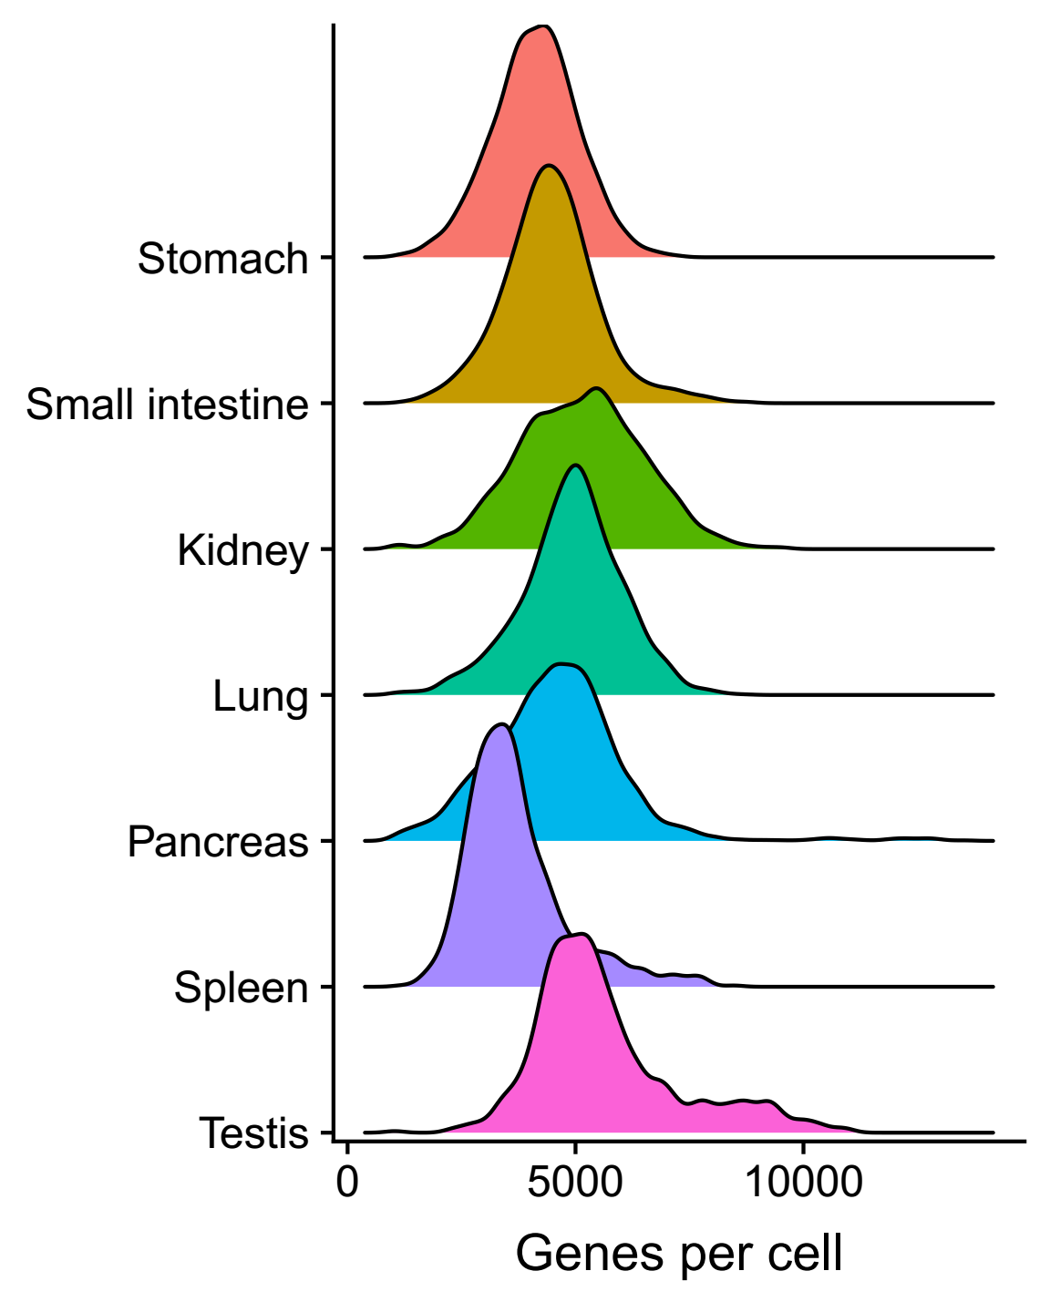
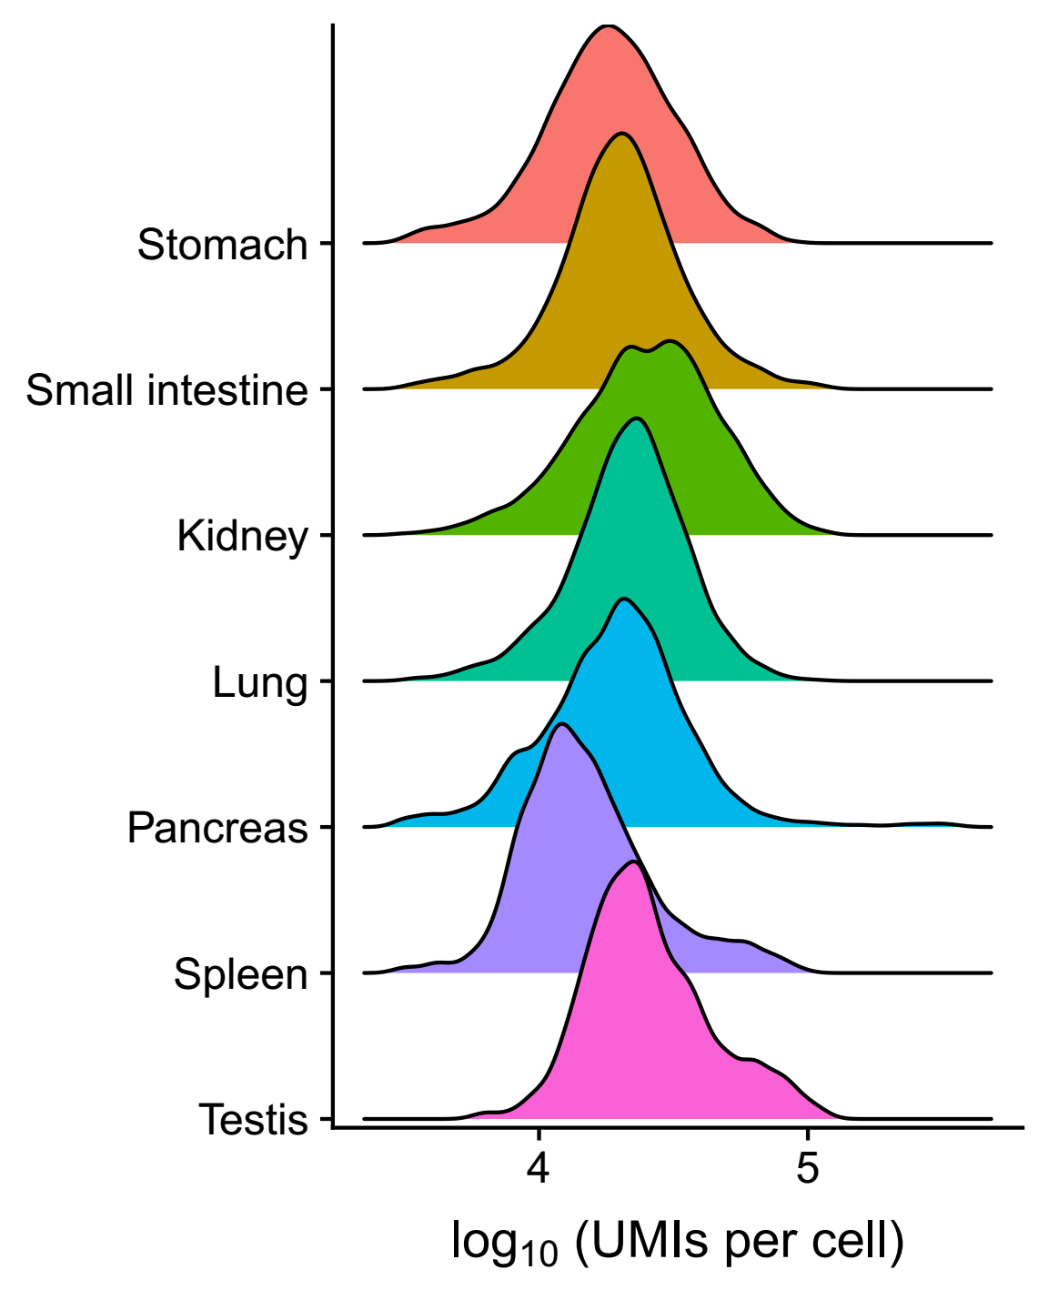
Overview of GeACT
A
B

Slide 5
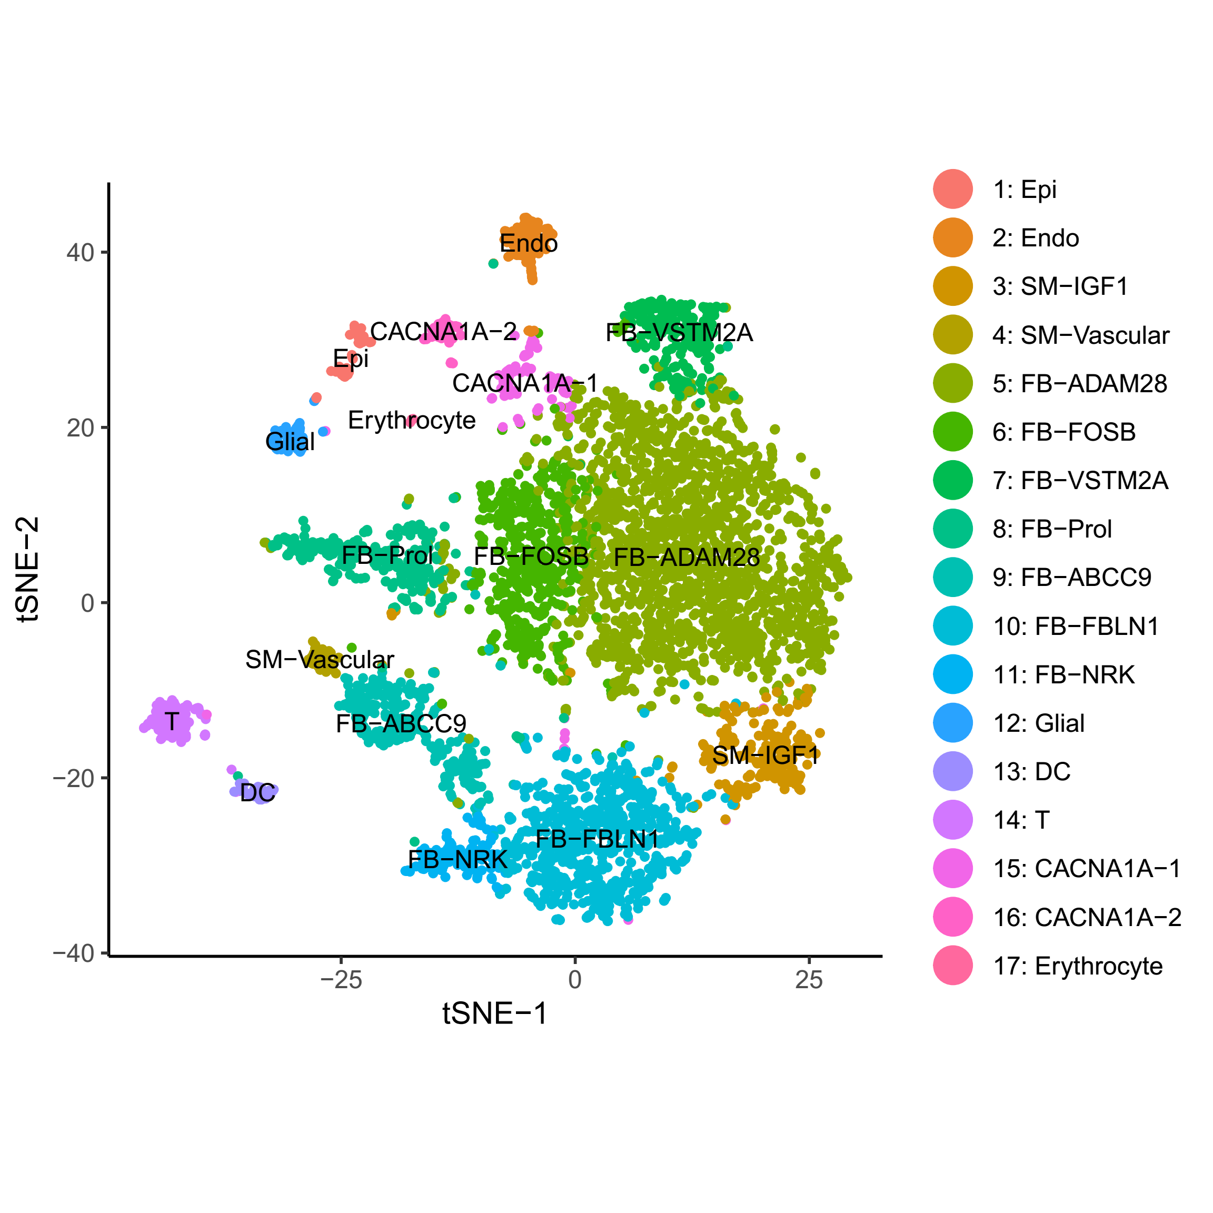
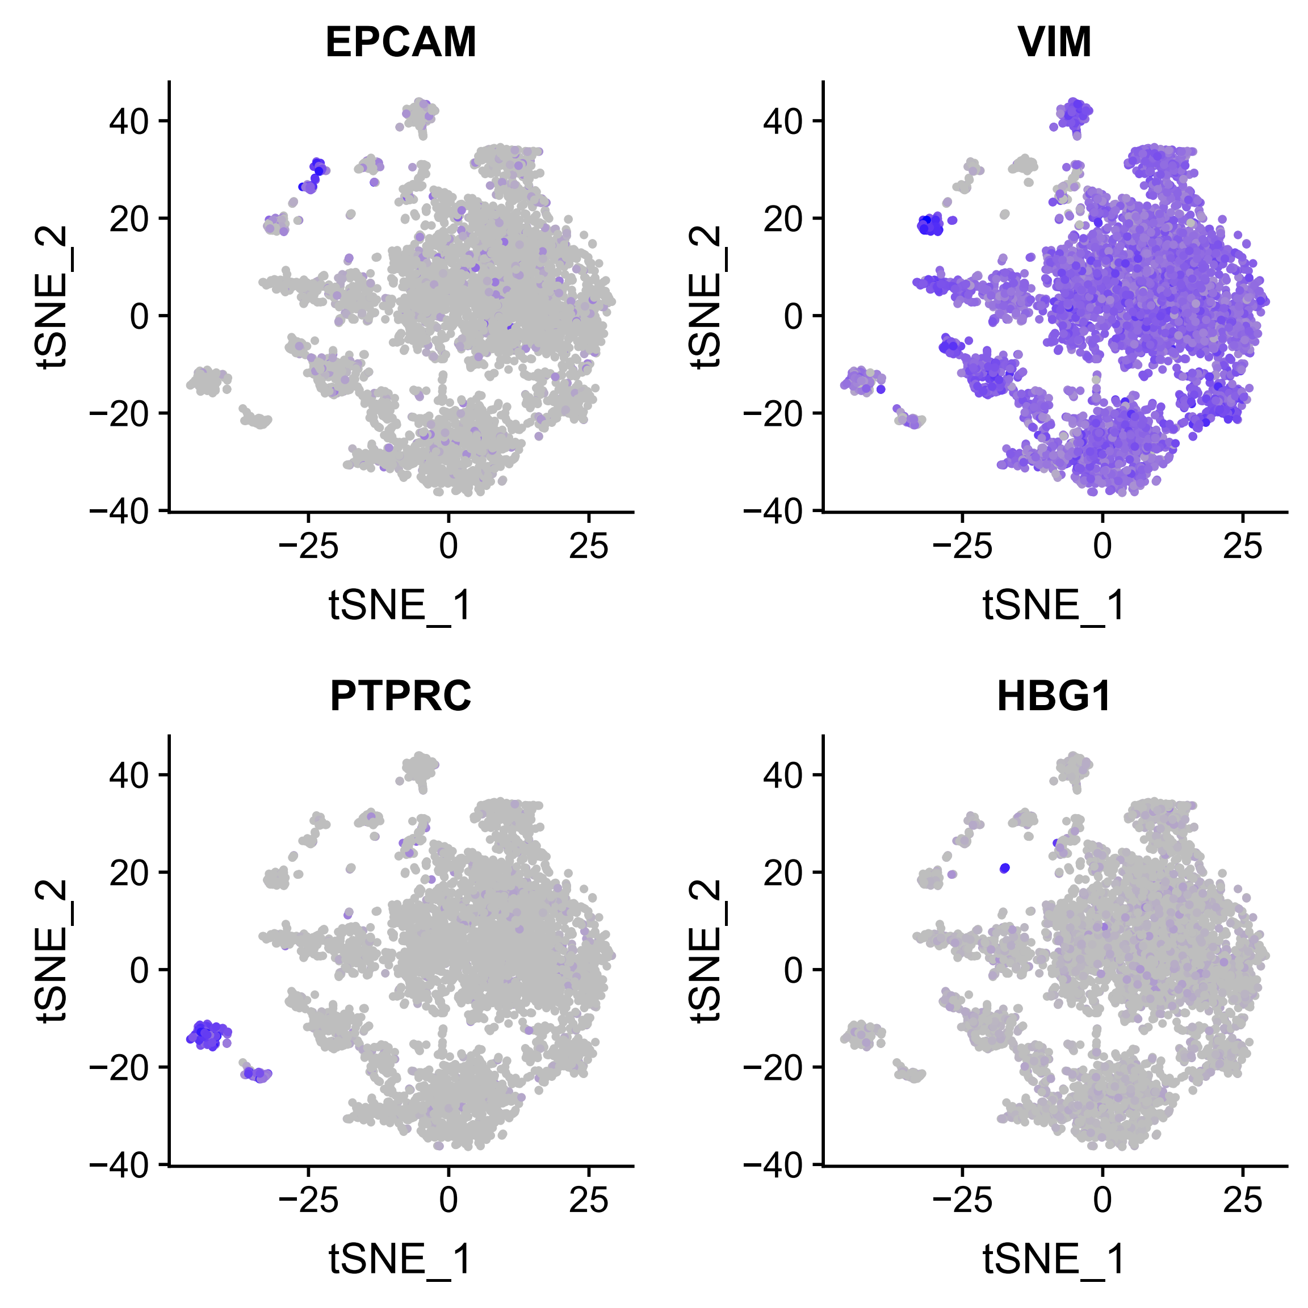
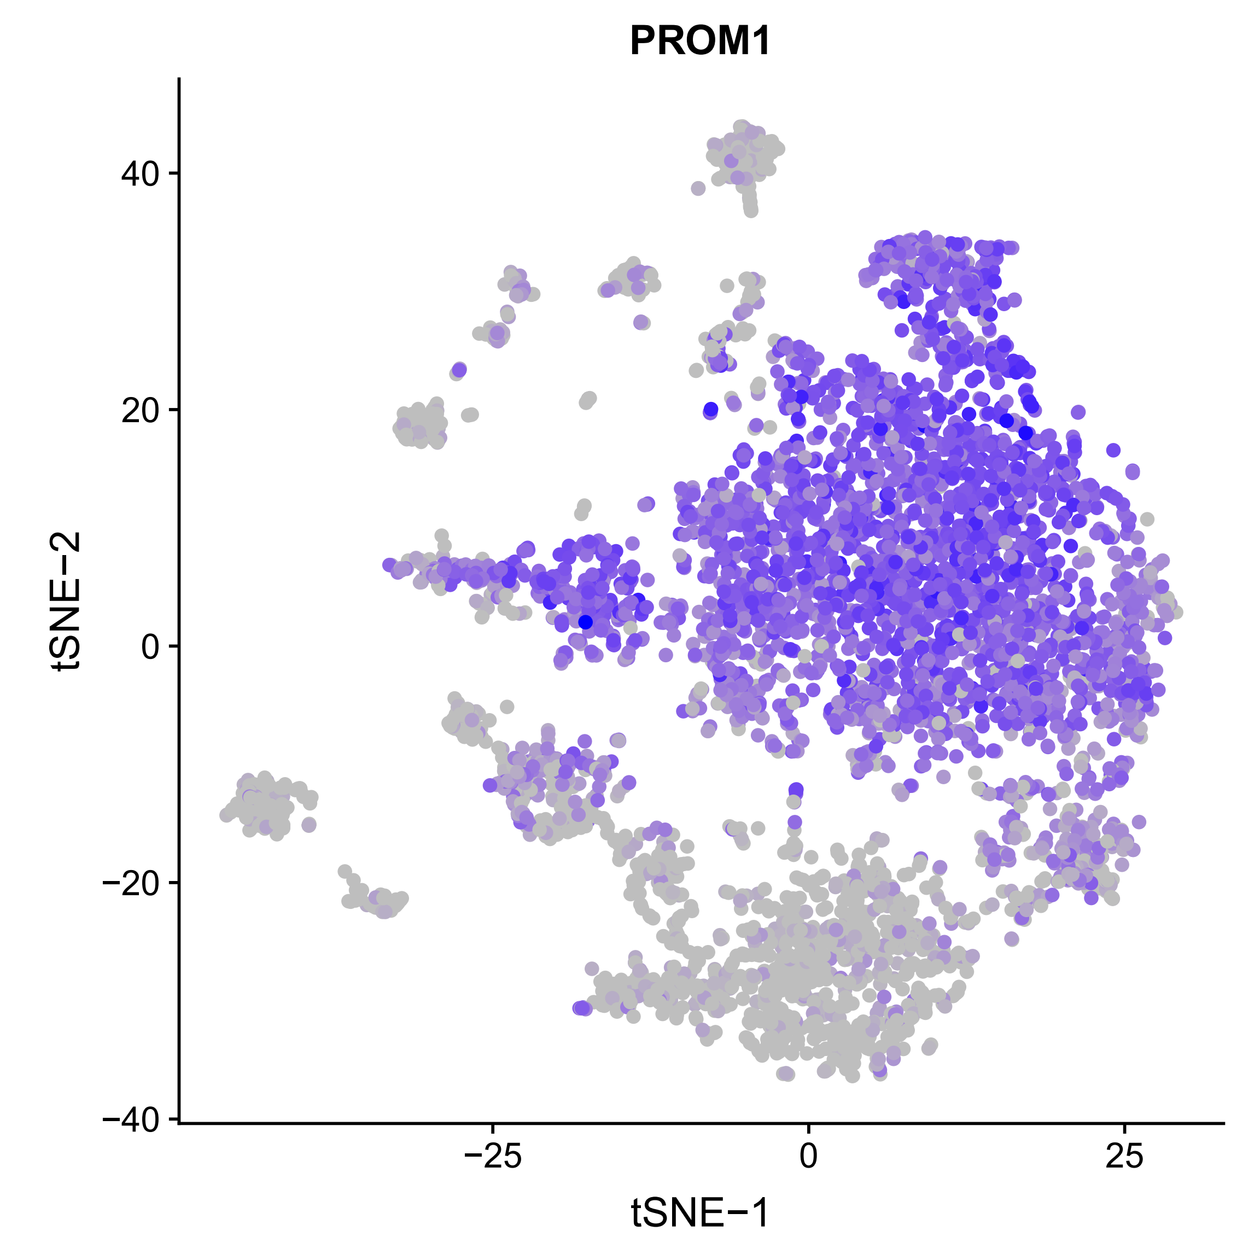
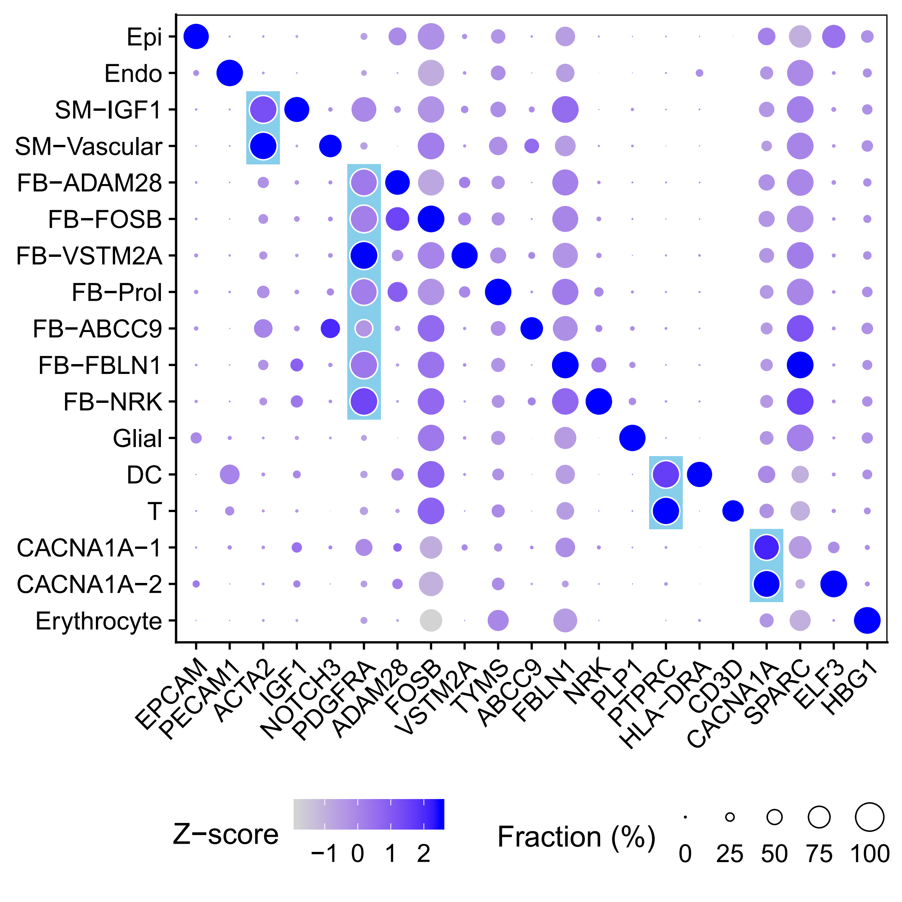
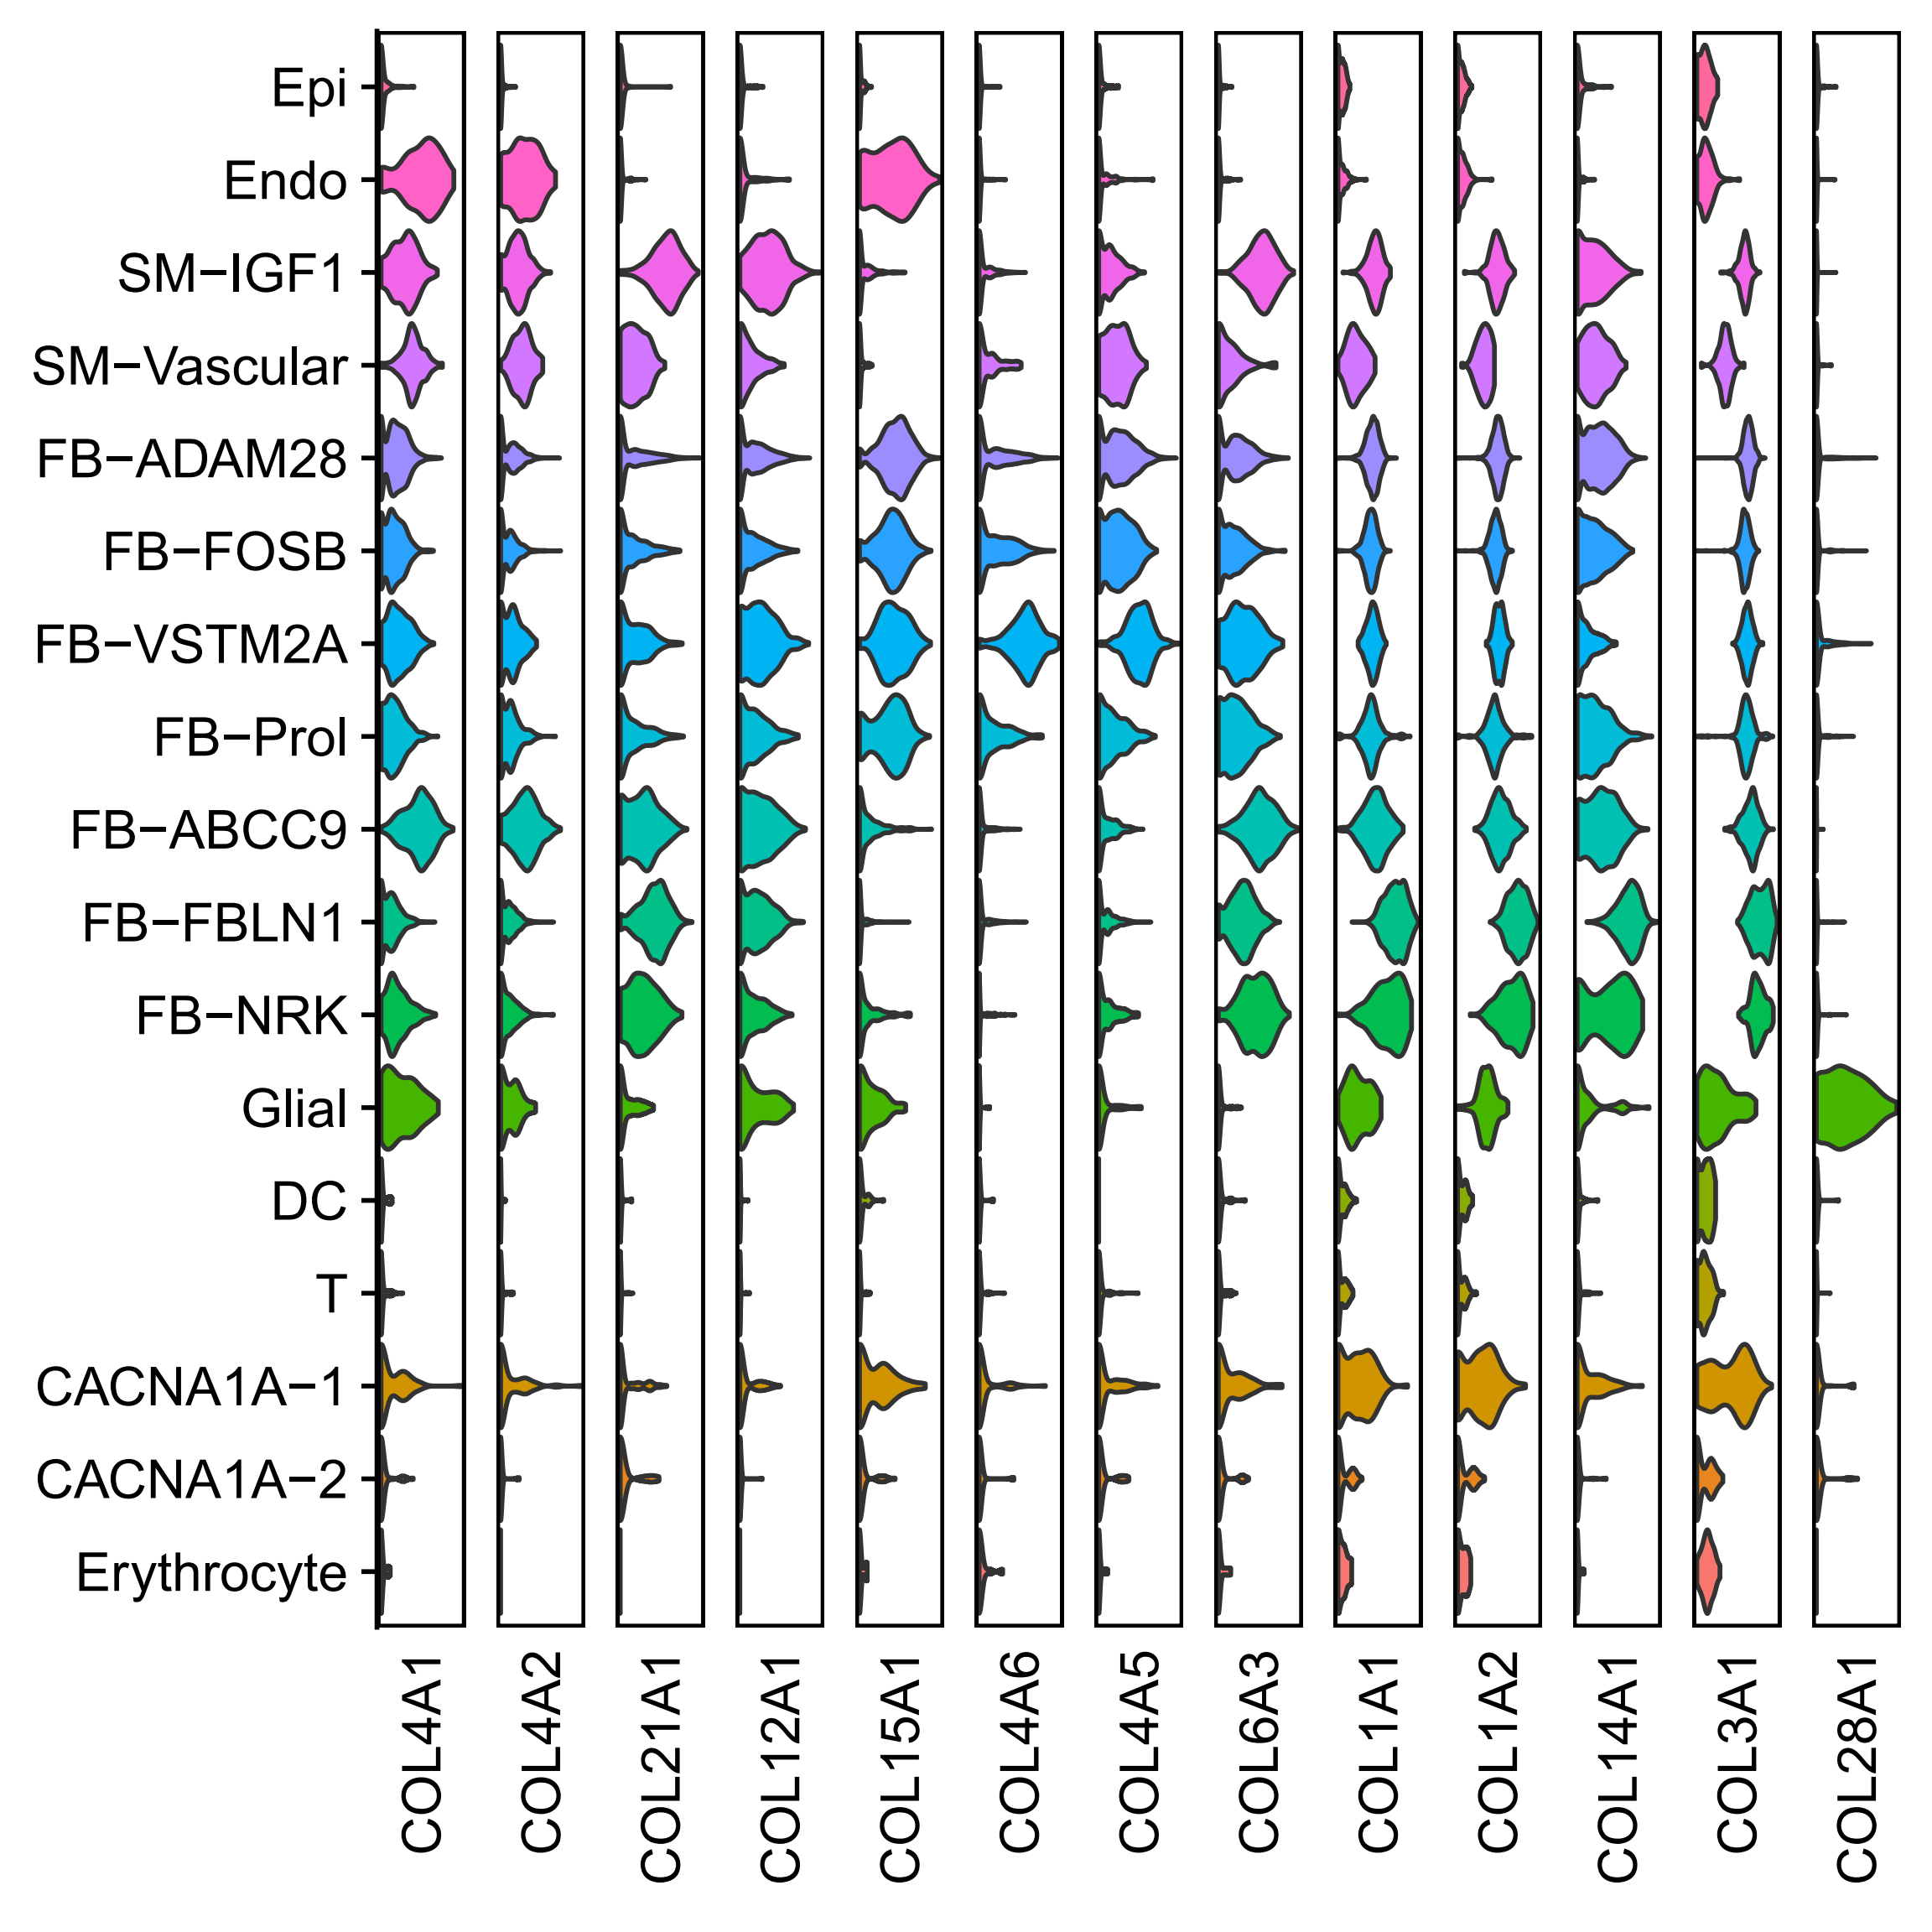
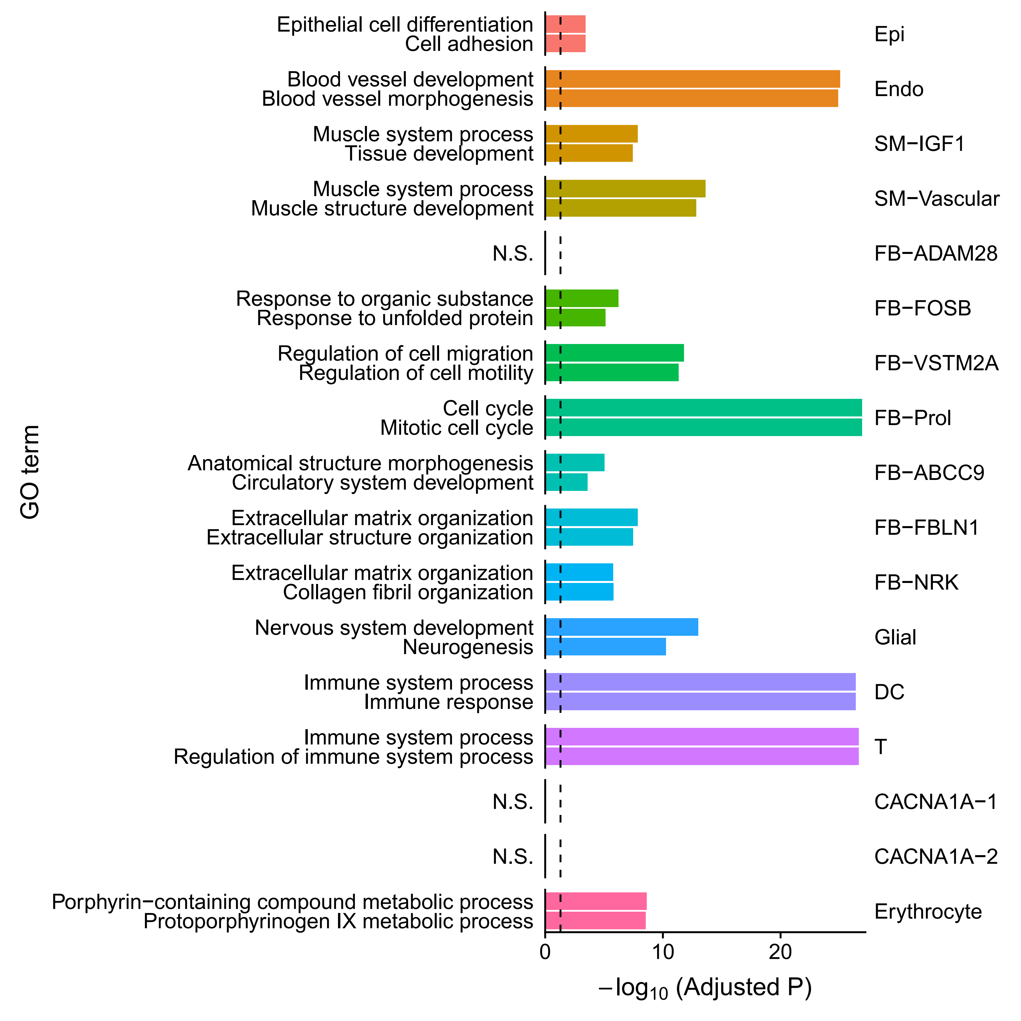
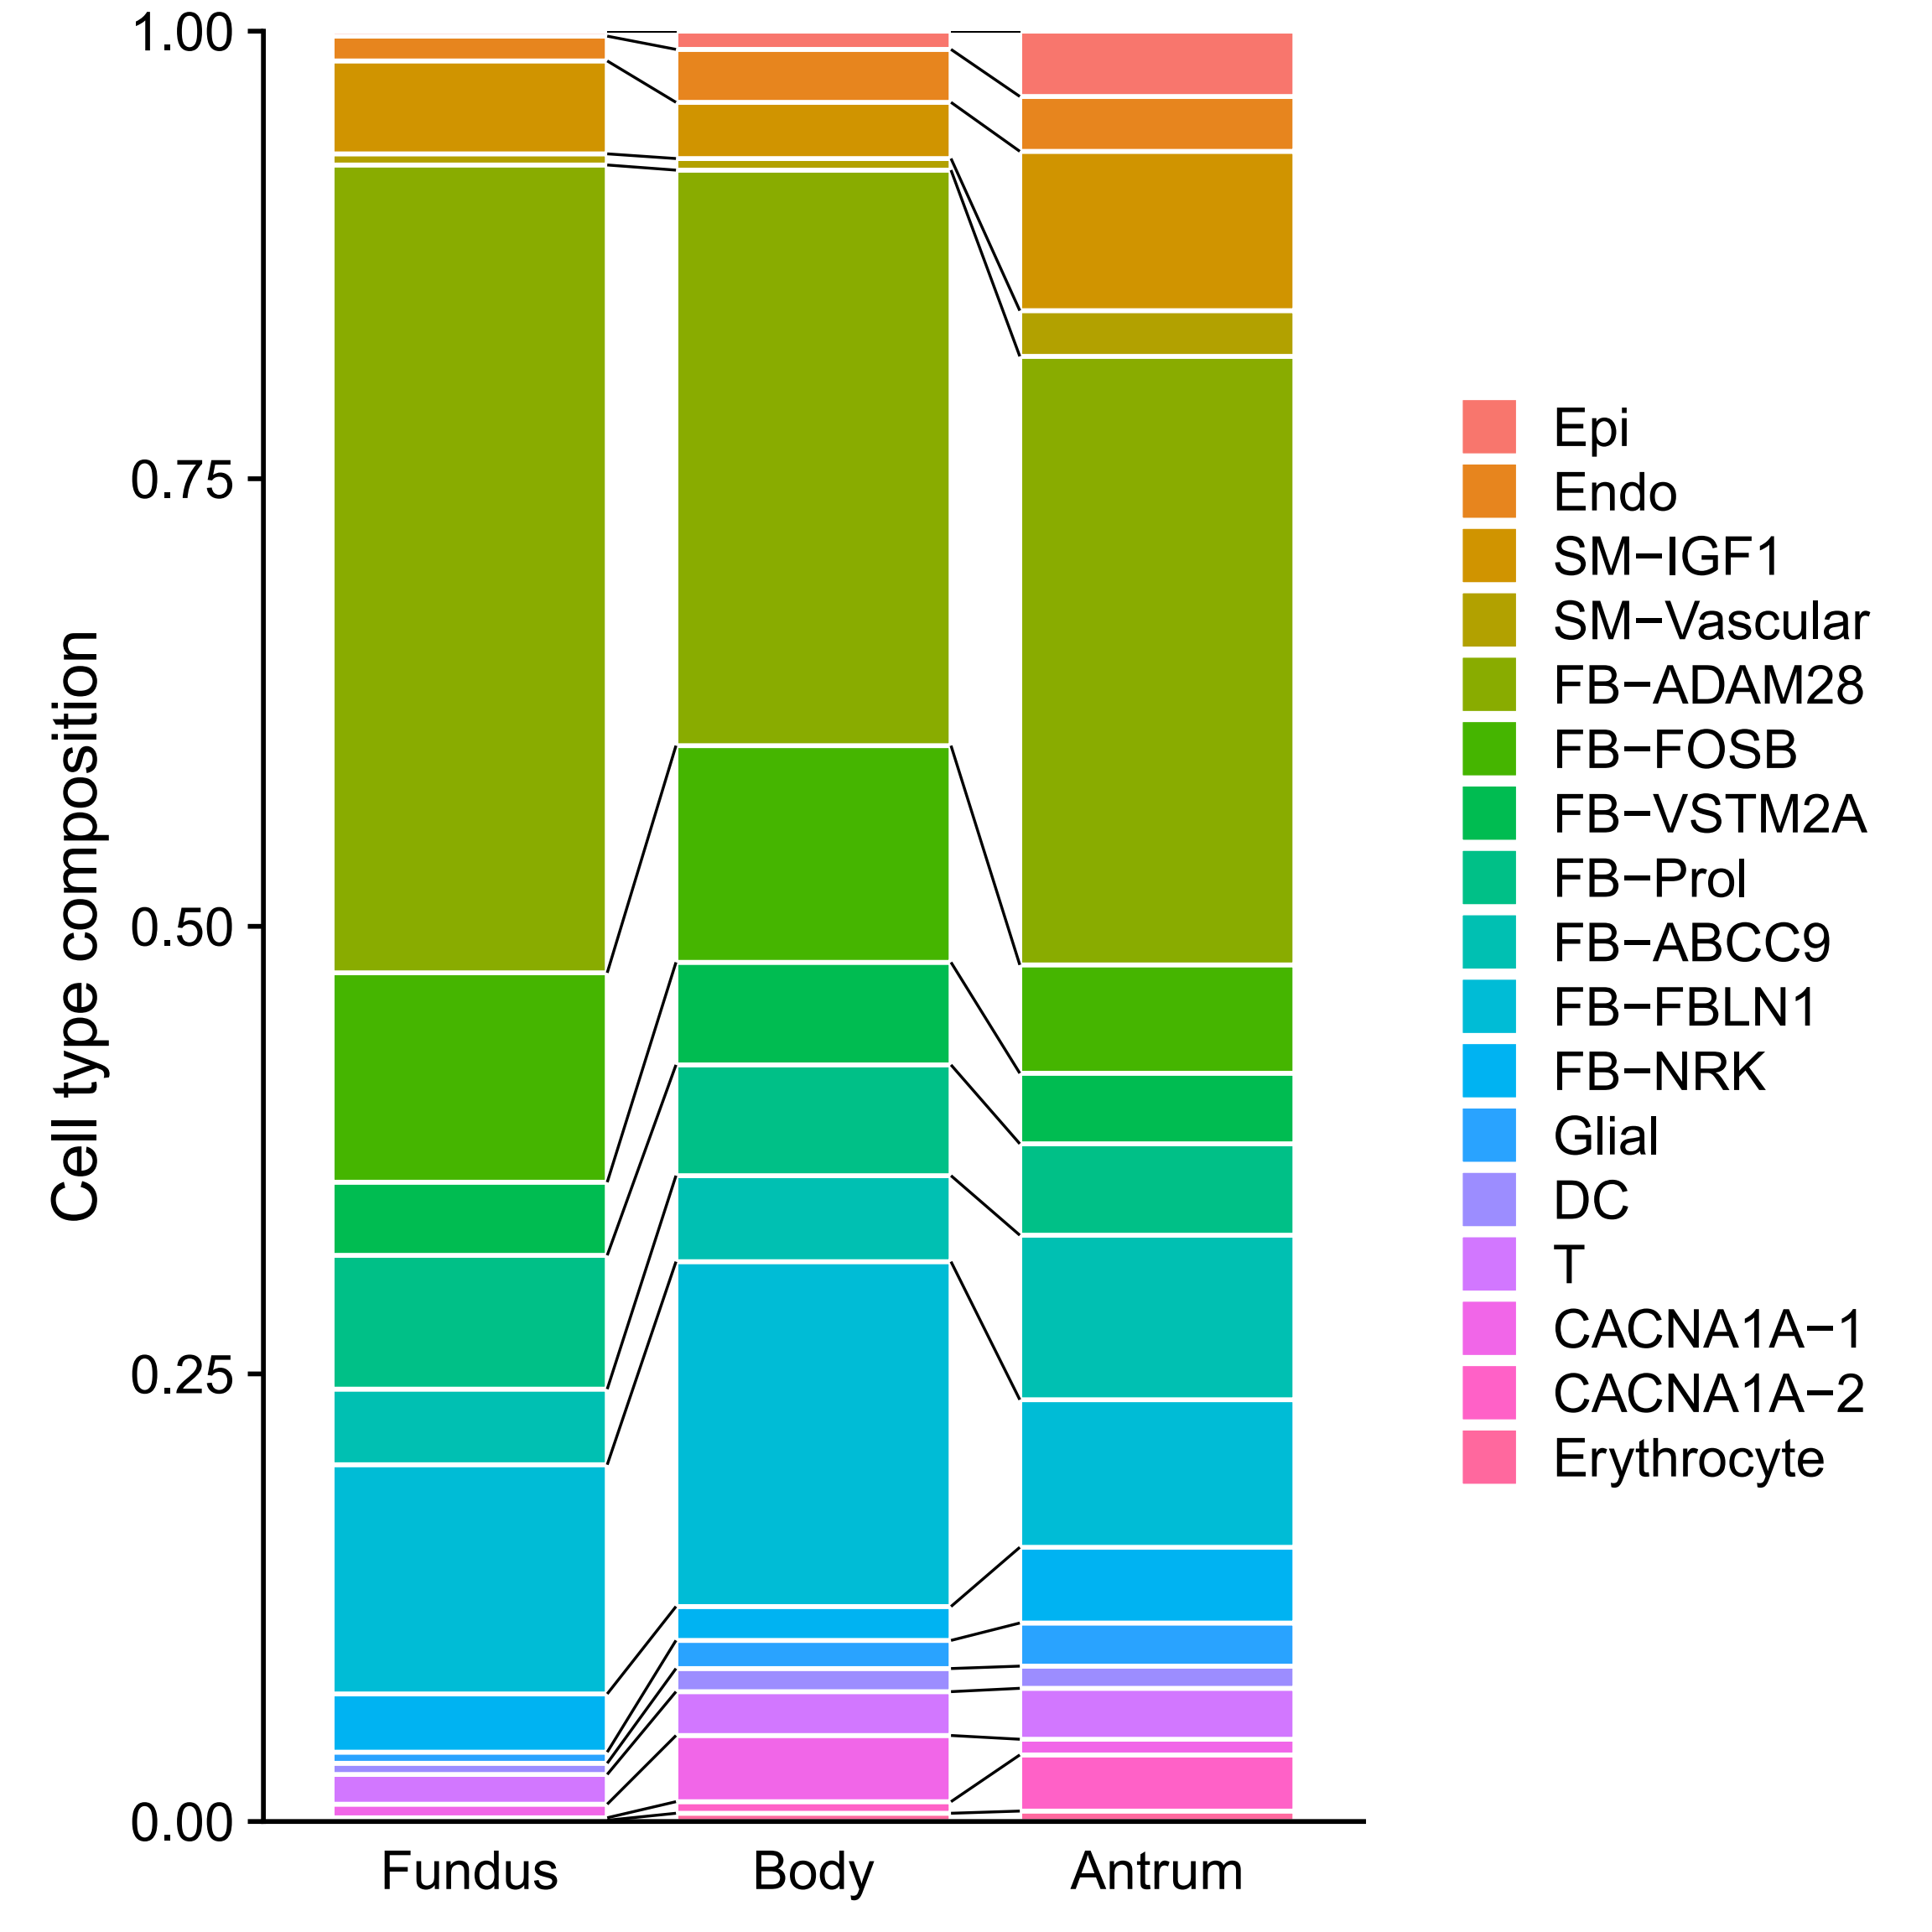
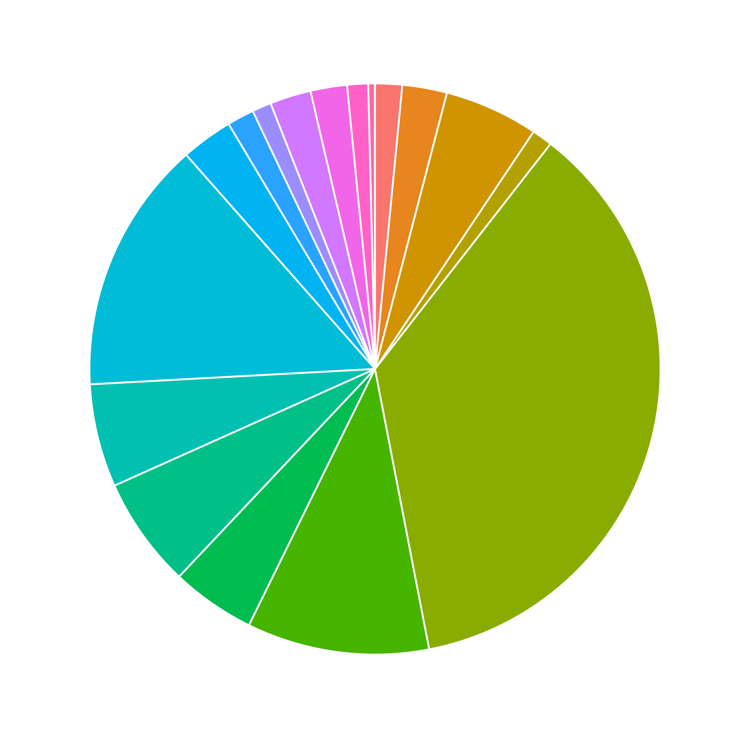
Stomach (4,981 cells)

Slide 6
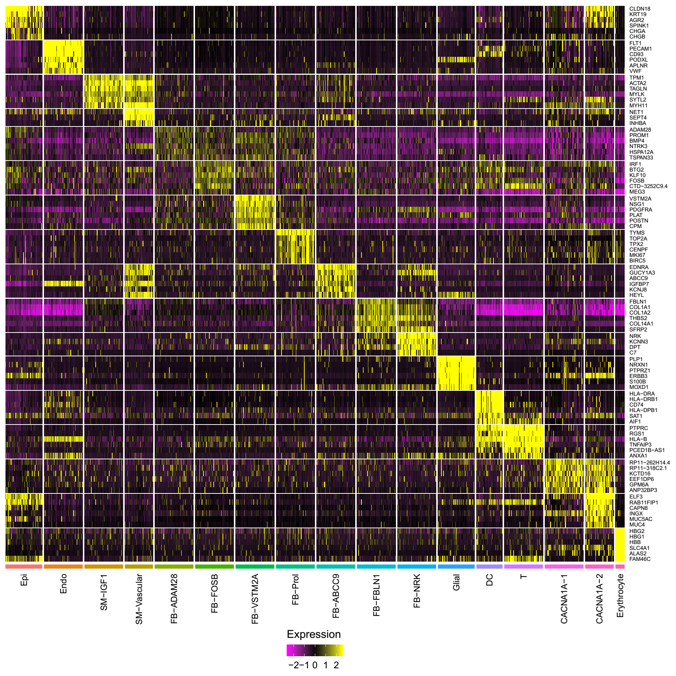
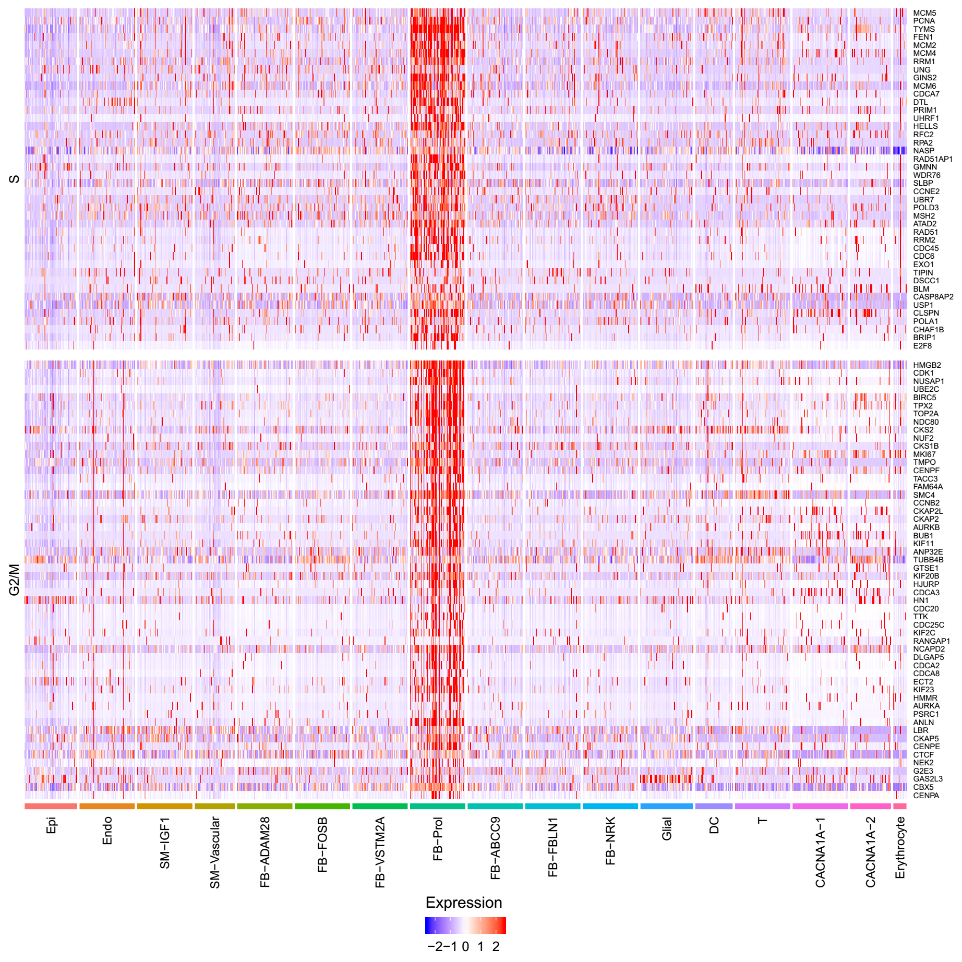
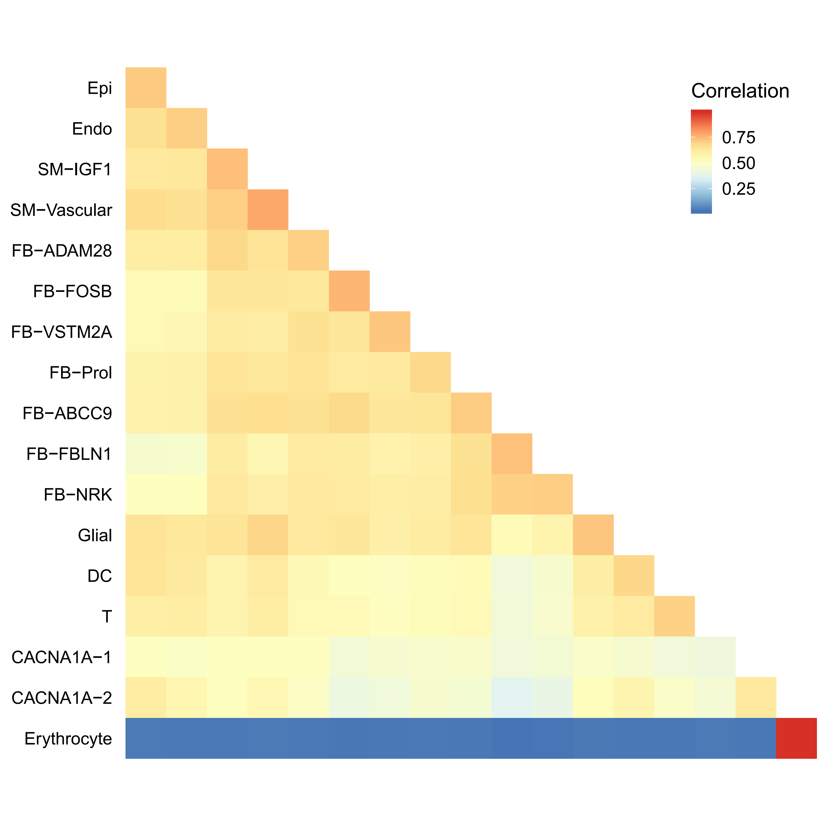
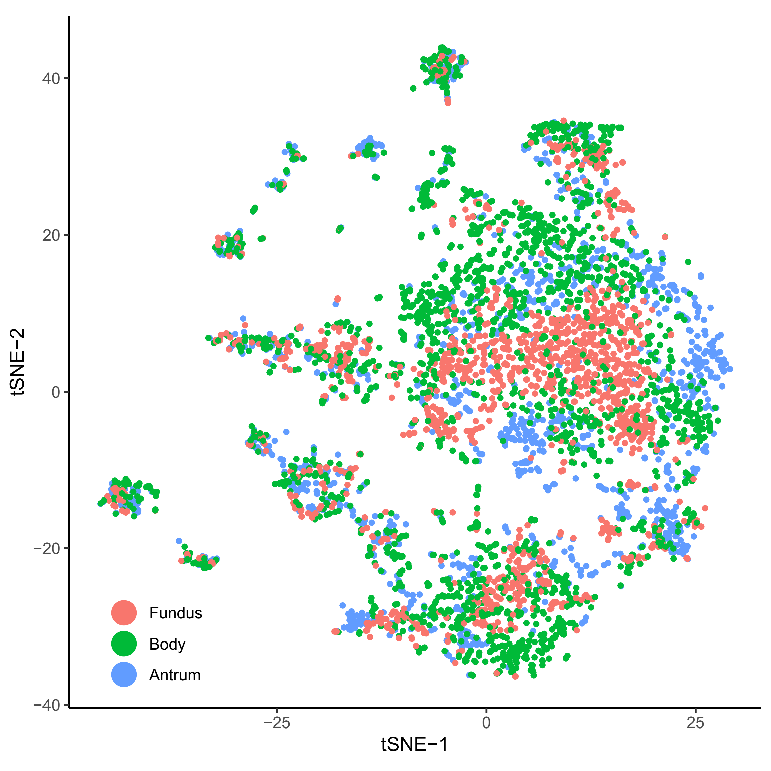
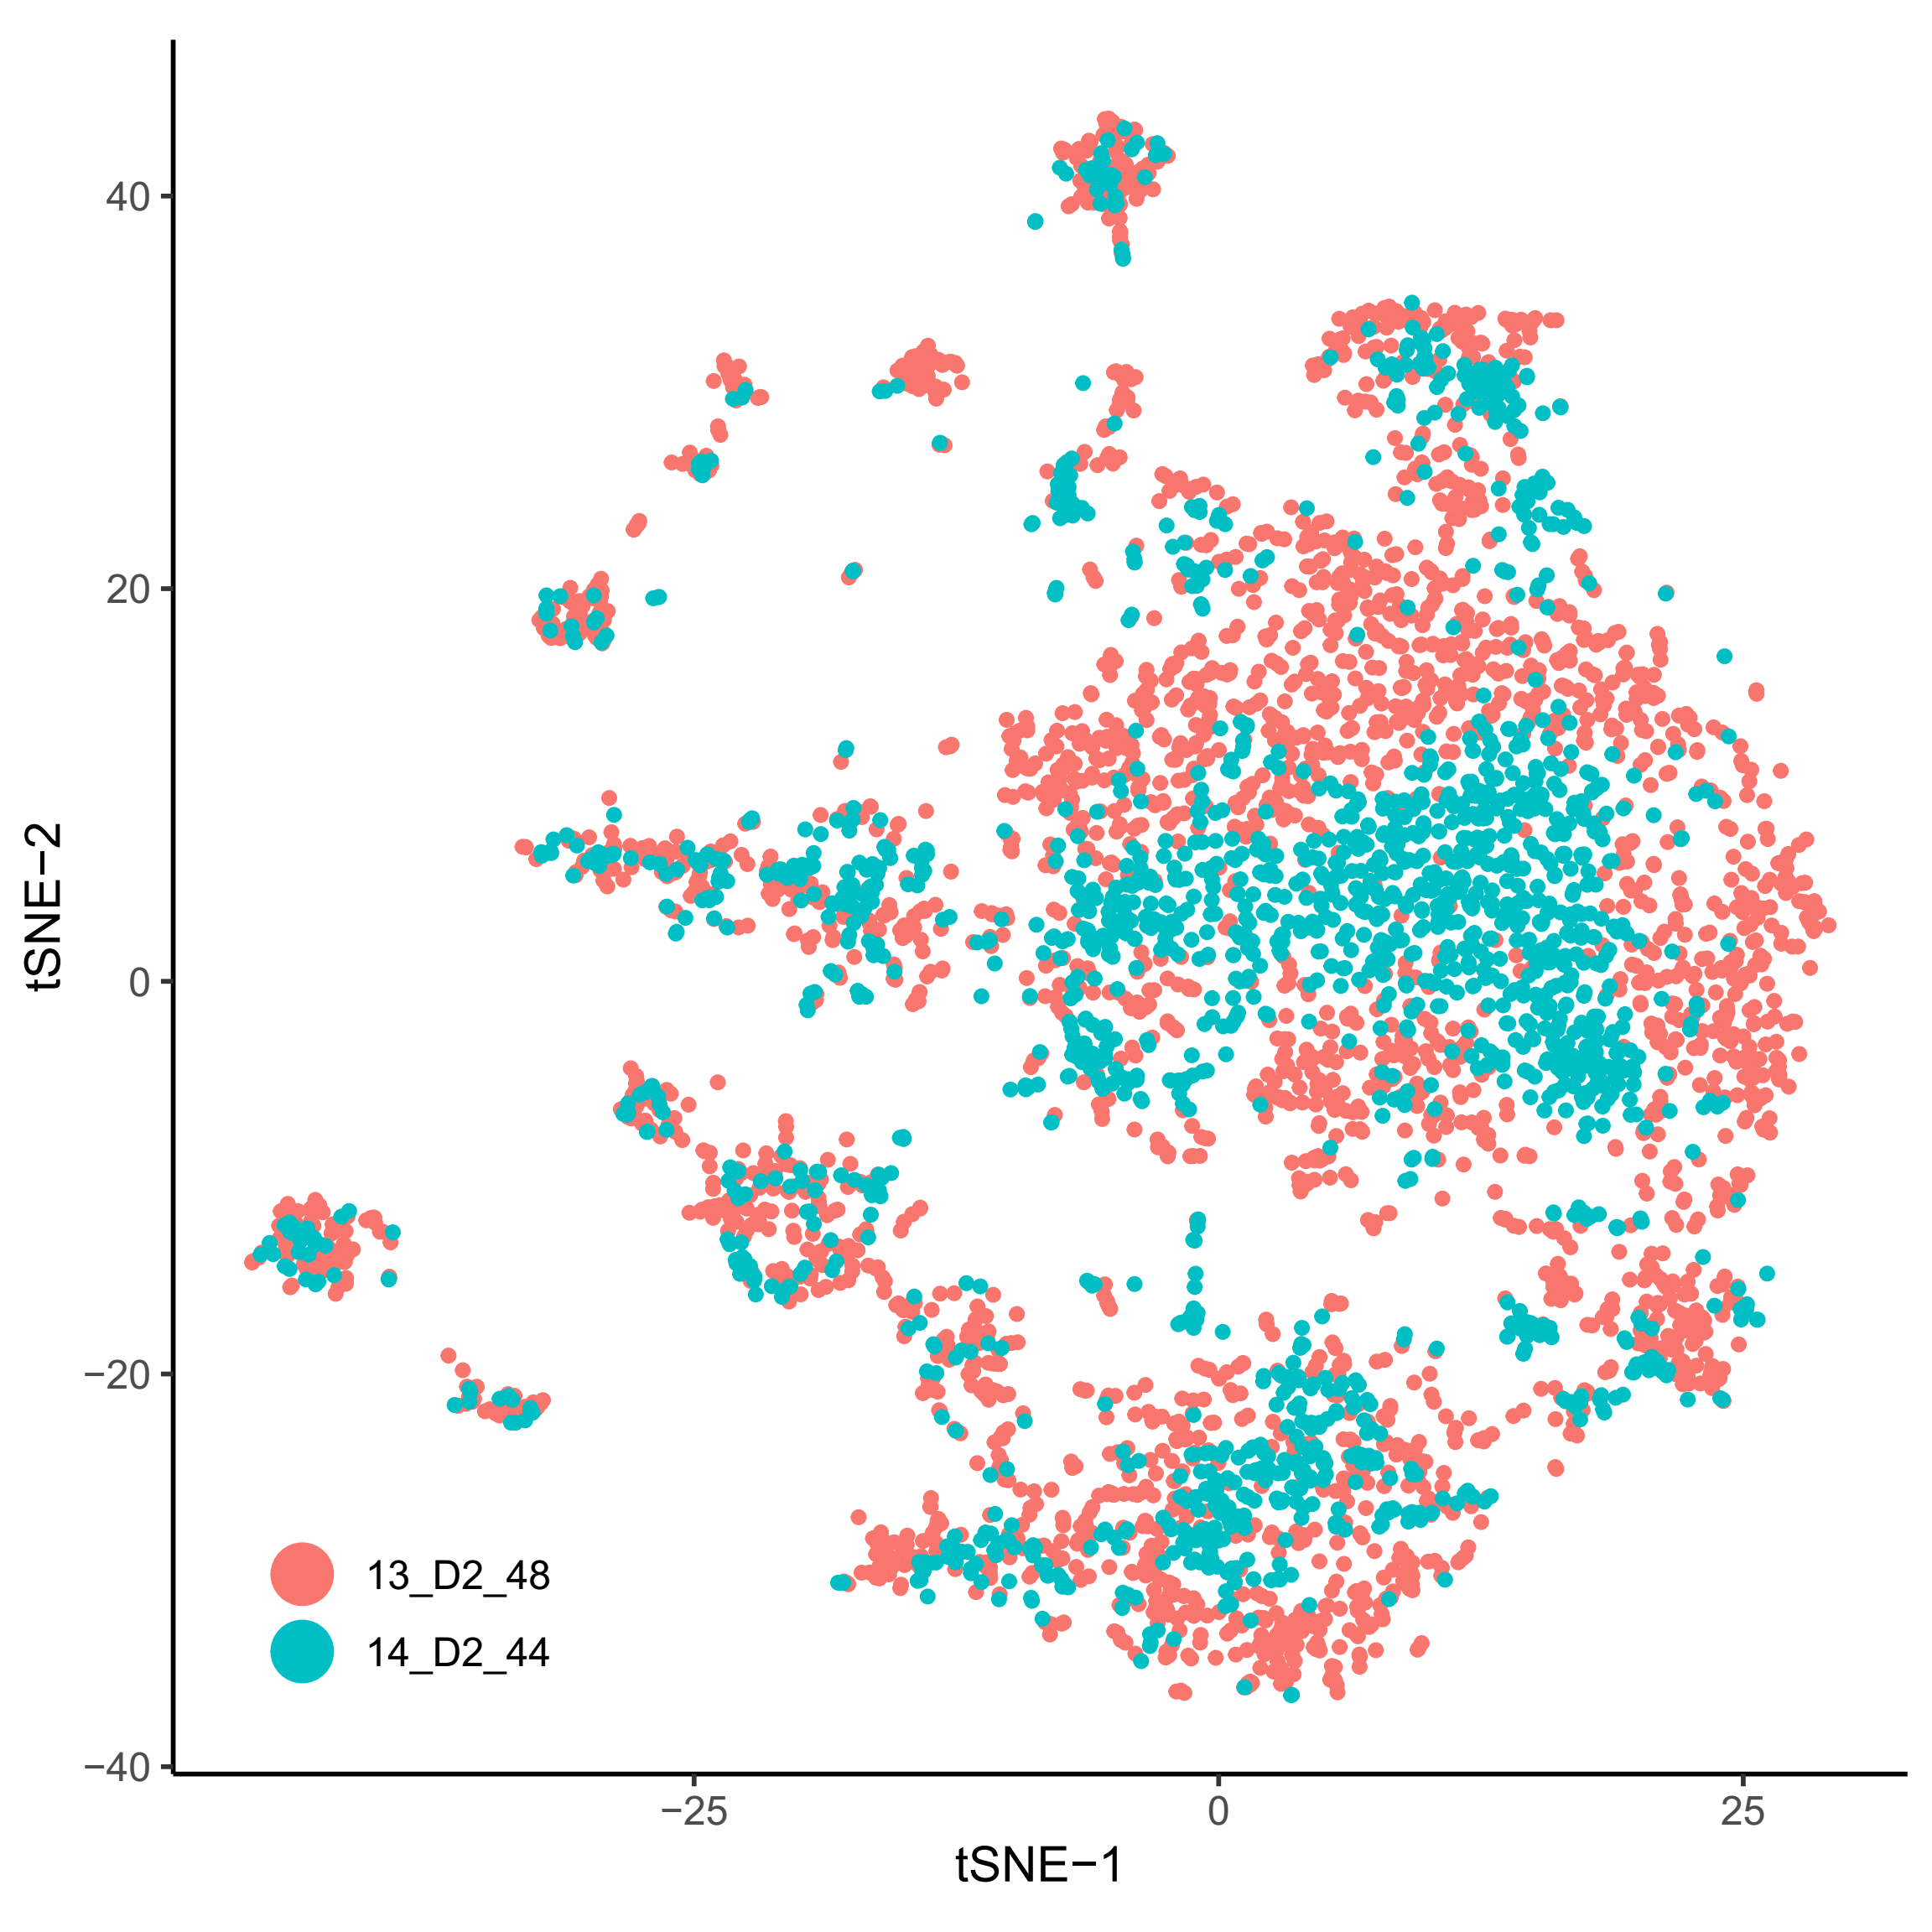
Stomach (Supp.)

Slide 7
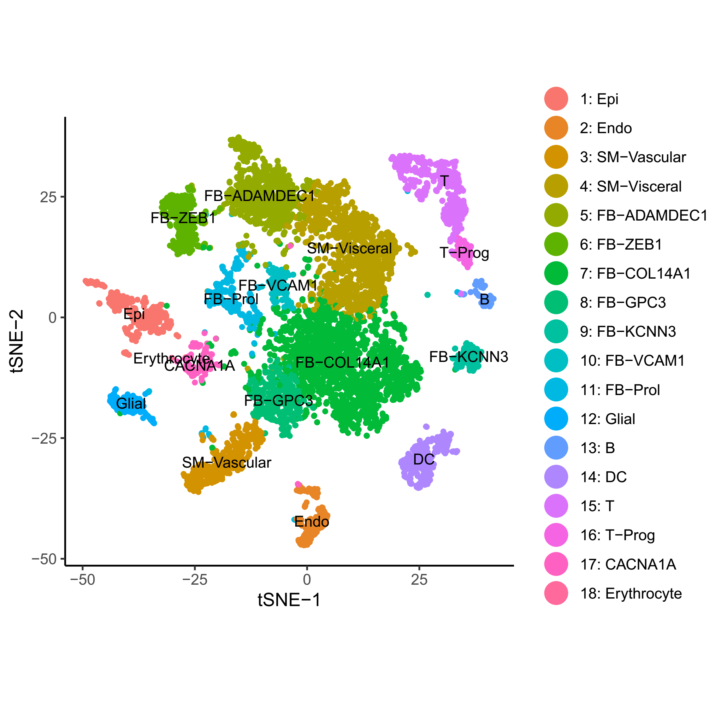
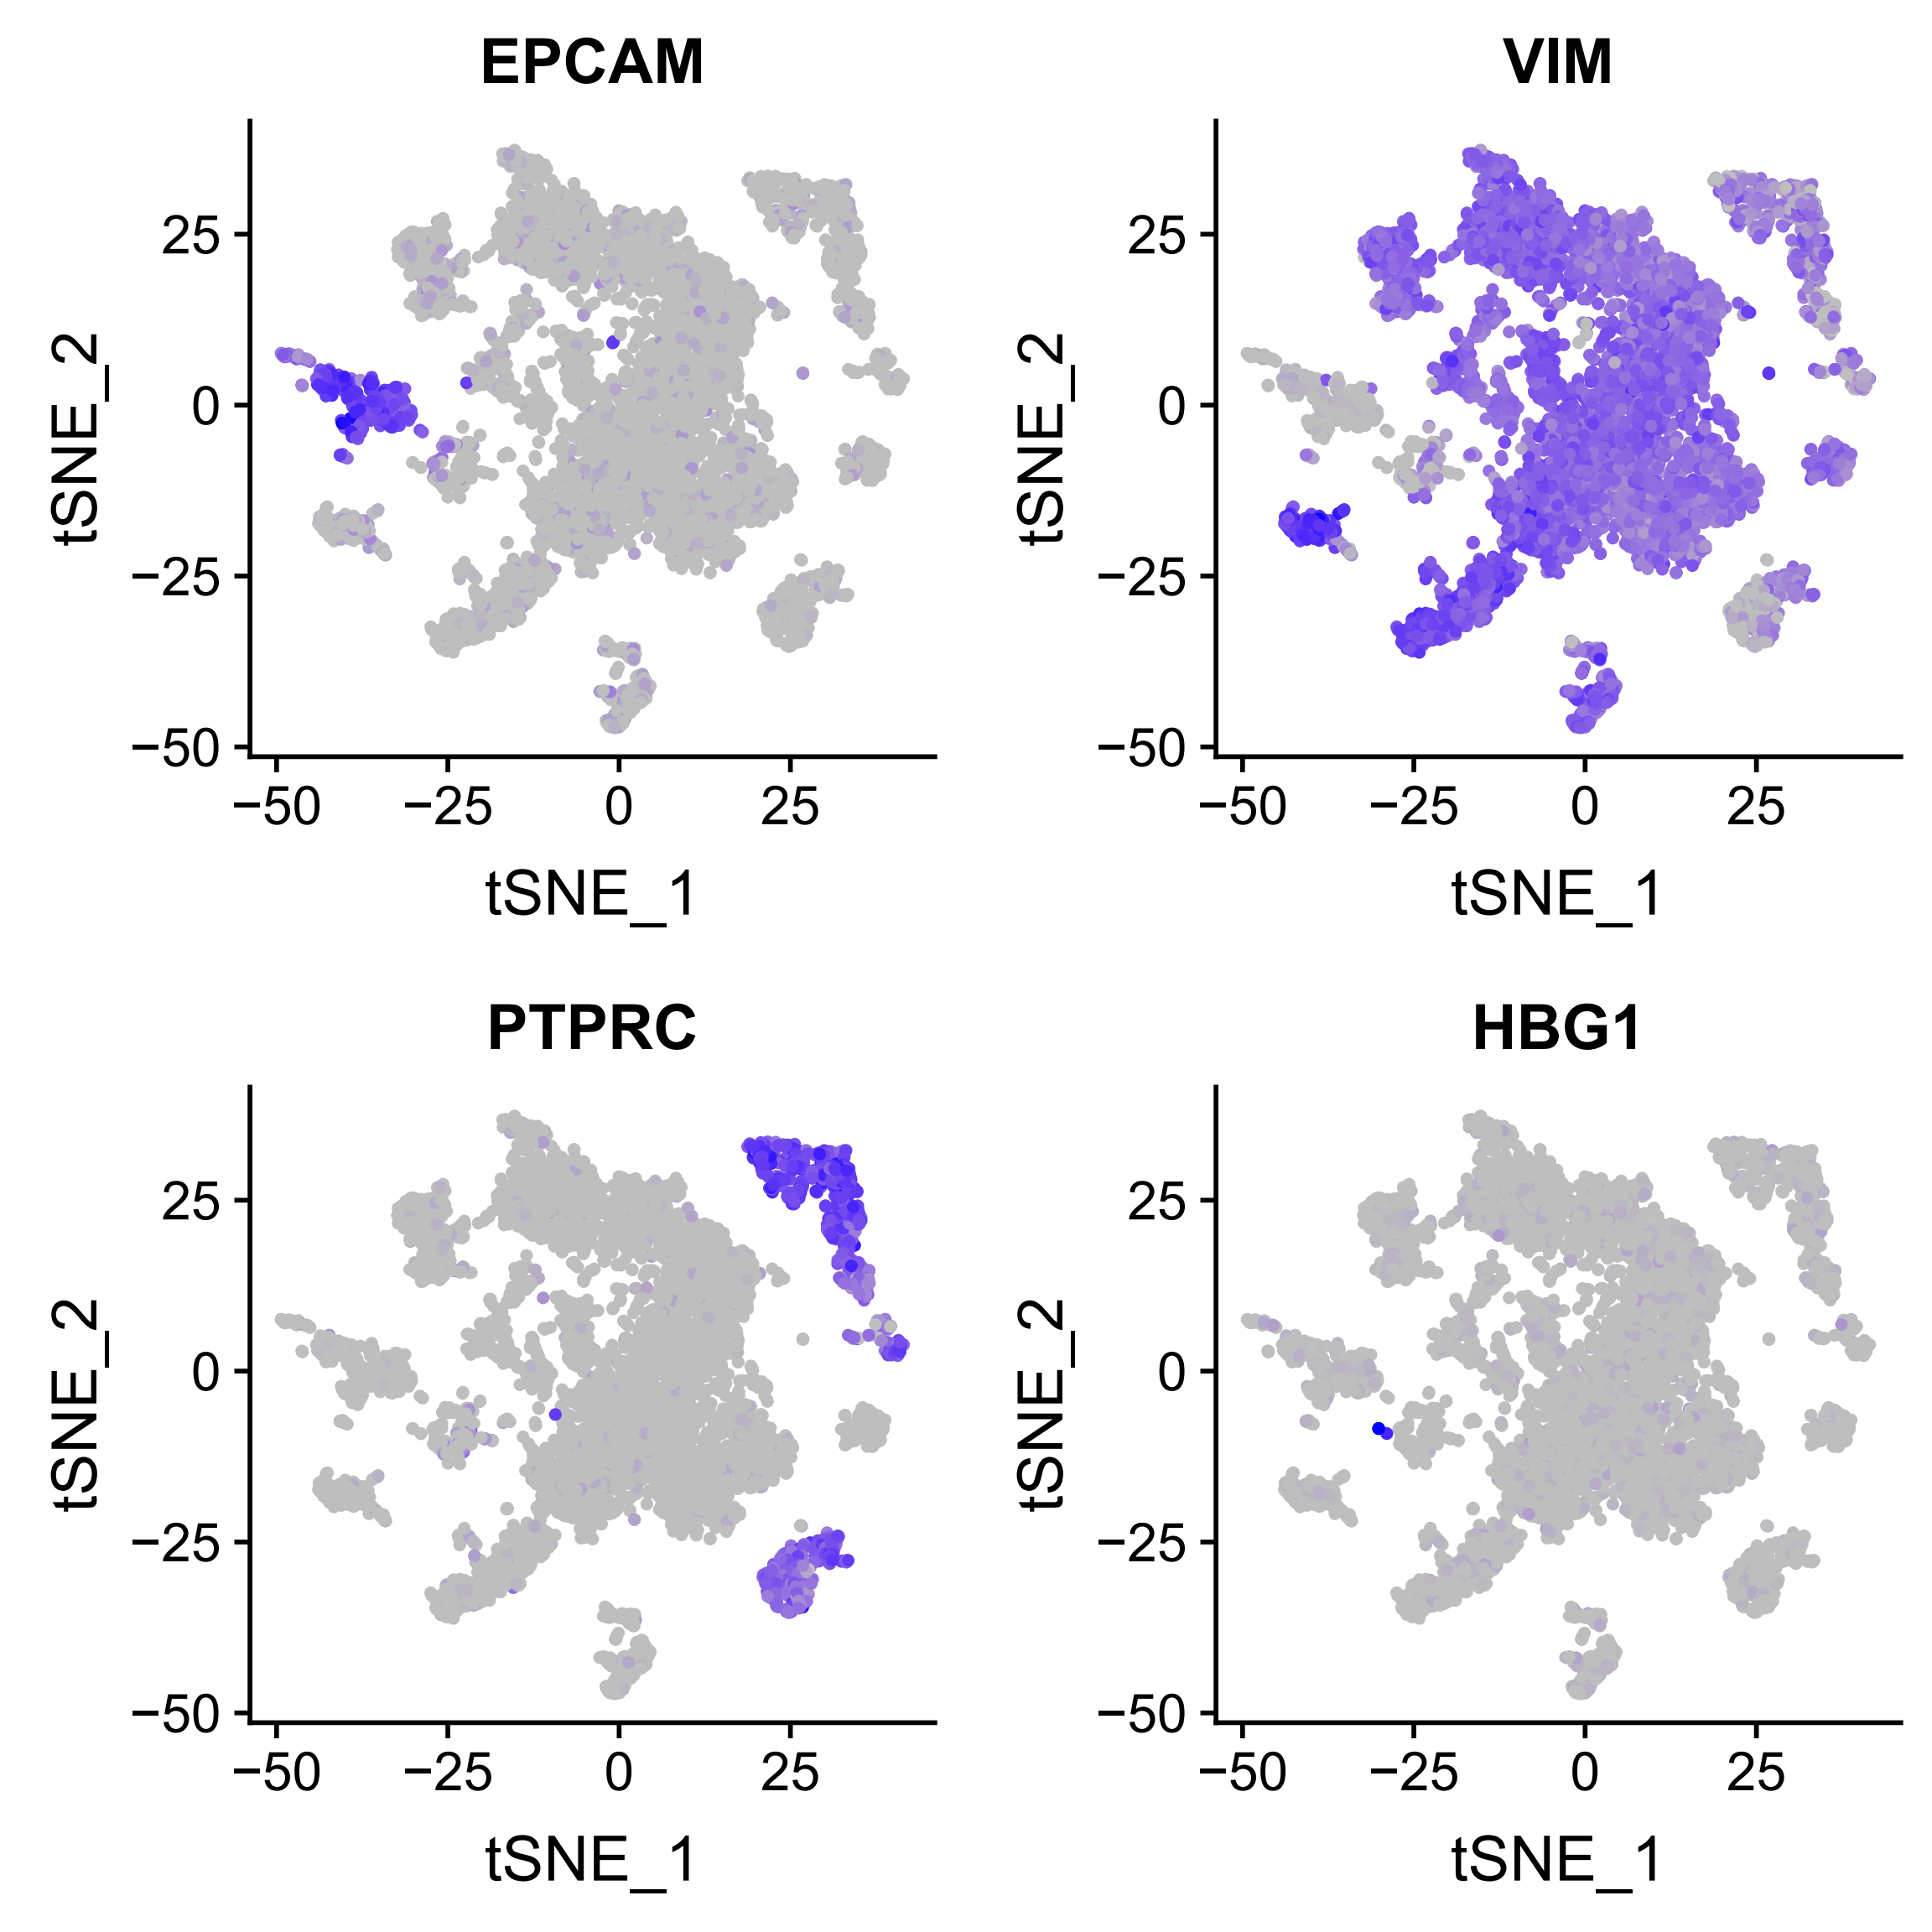
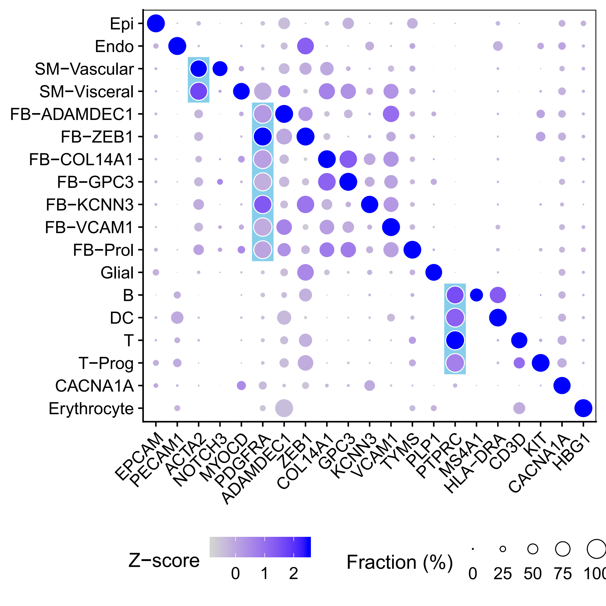
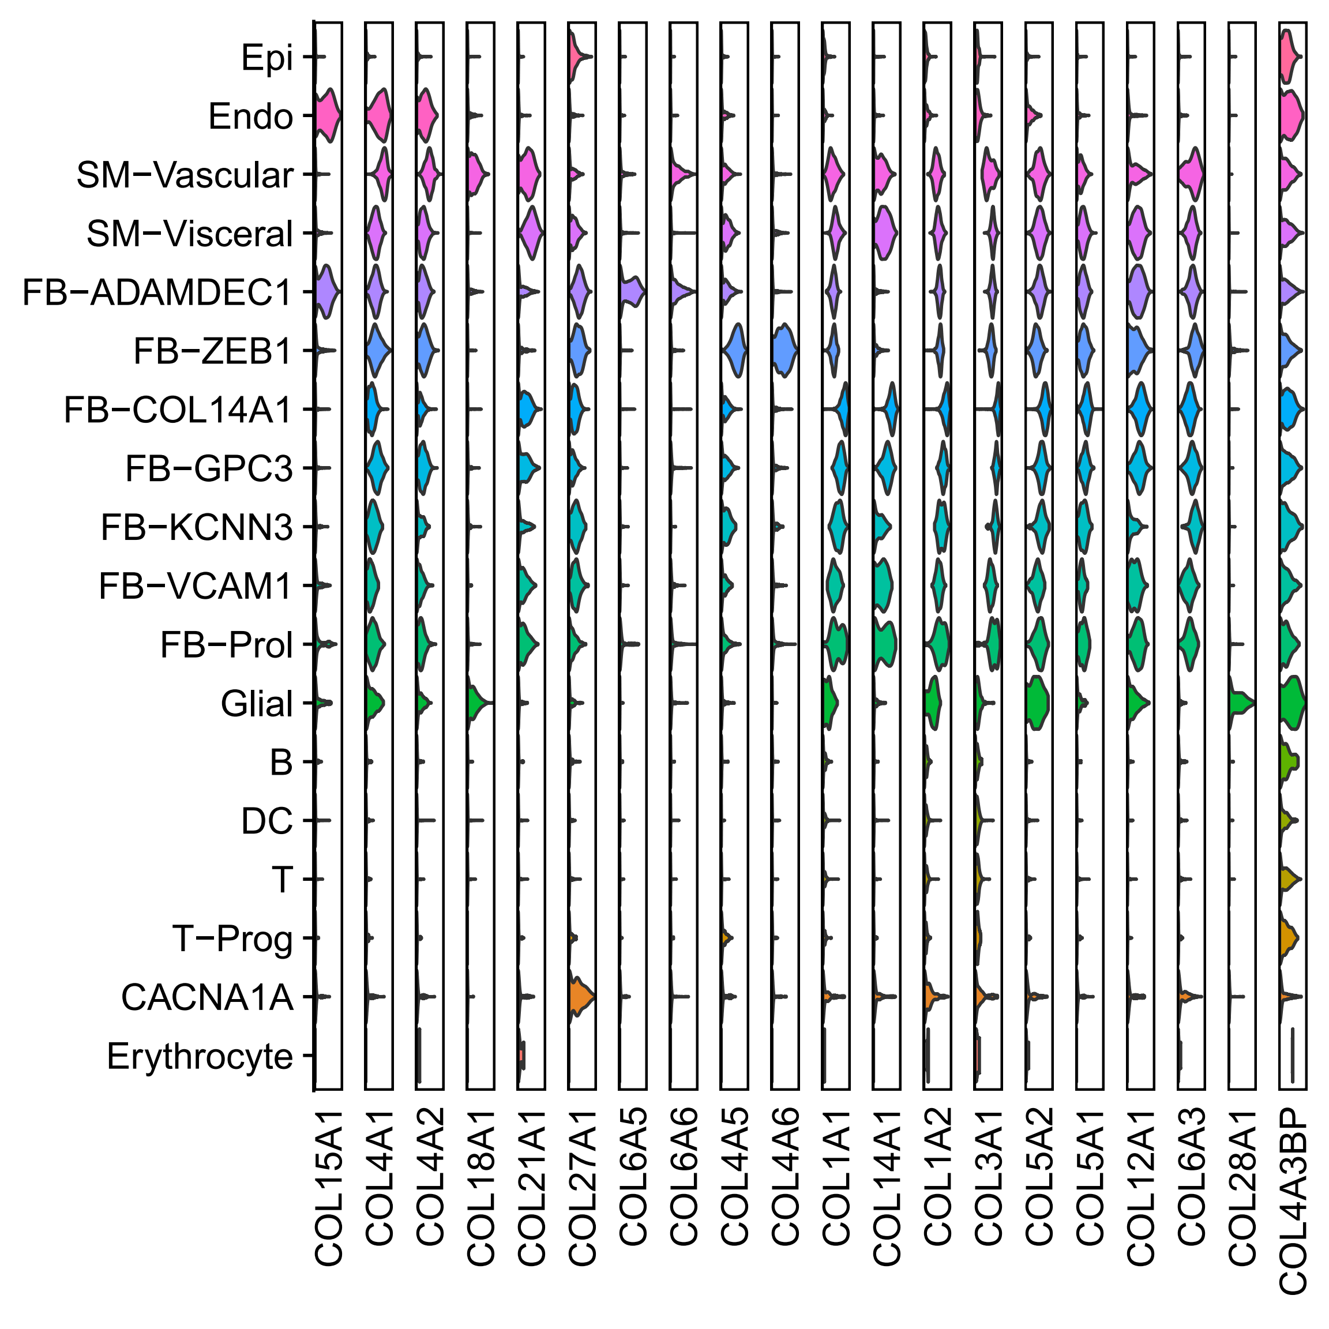
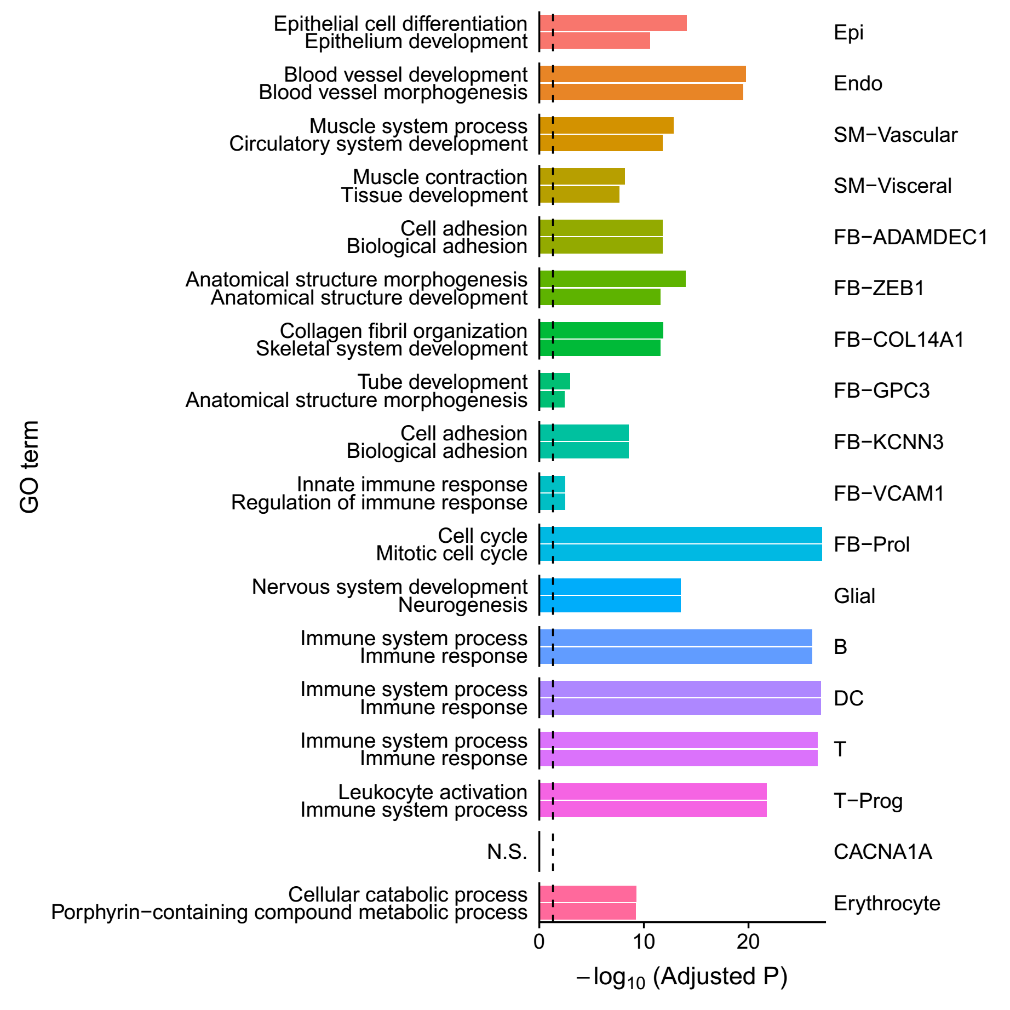
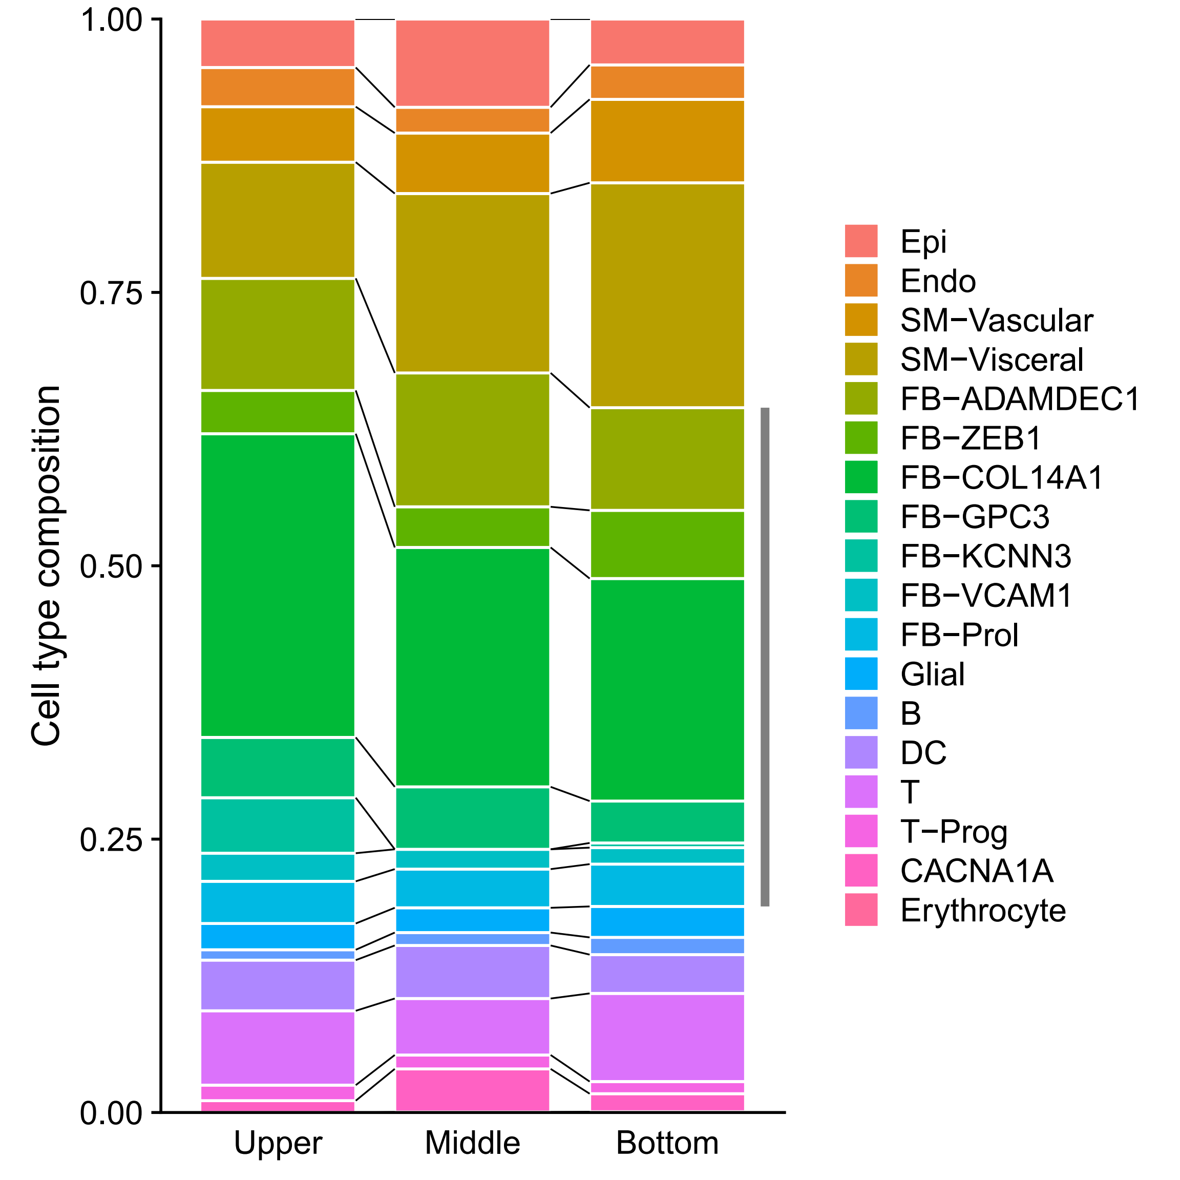
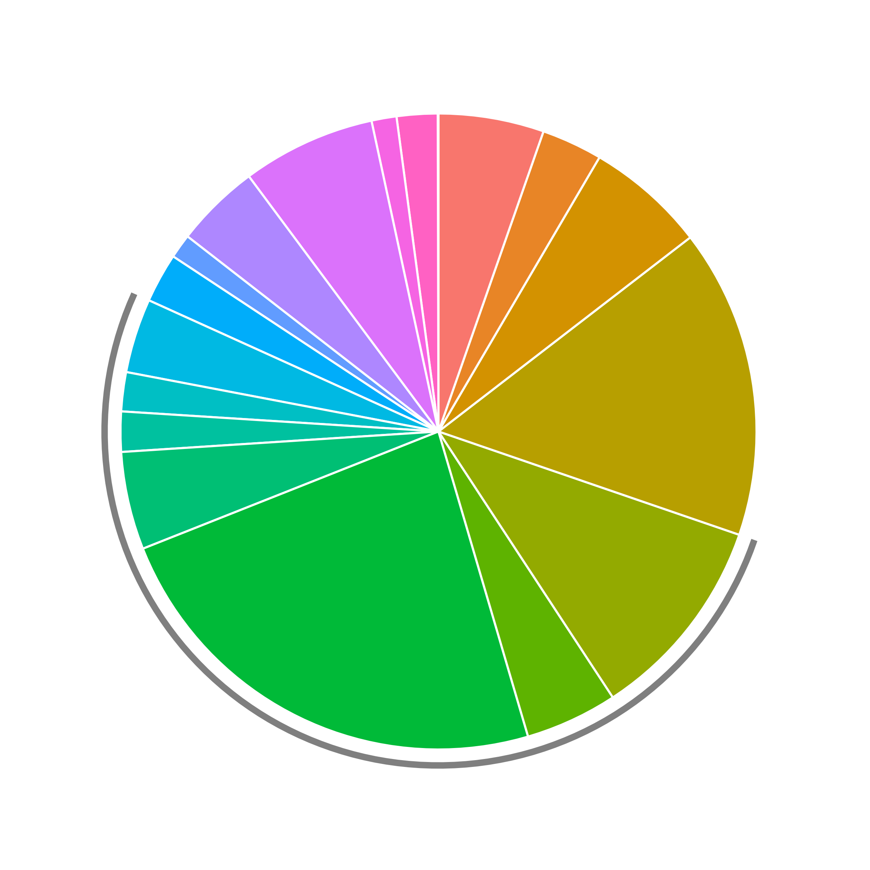
Small intestine (7,953 cells)

Slide 8
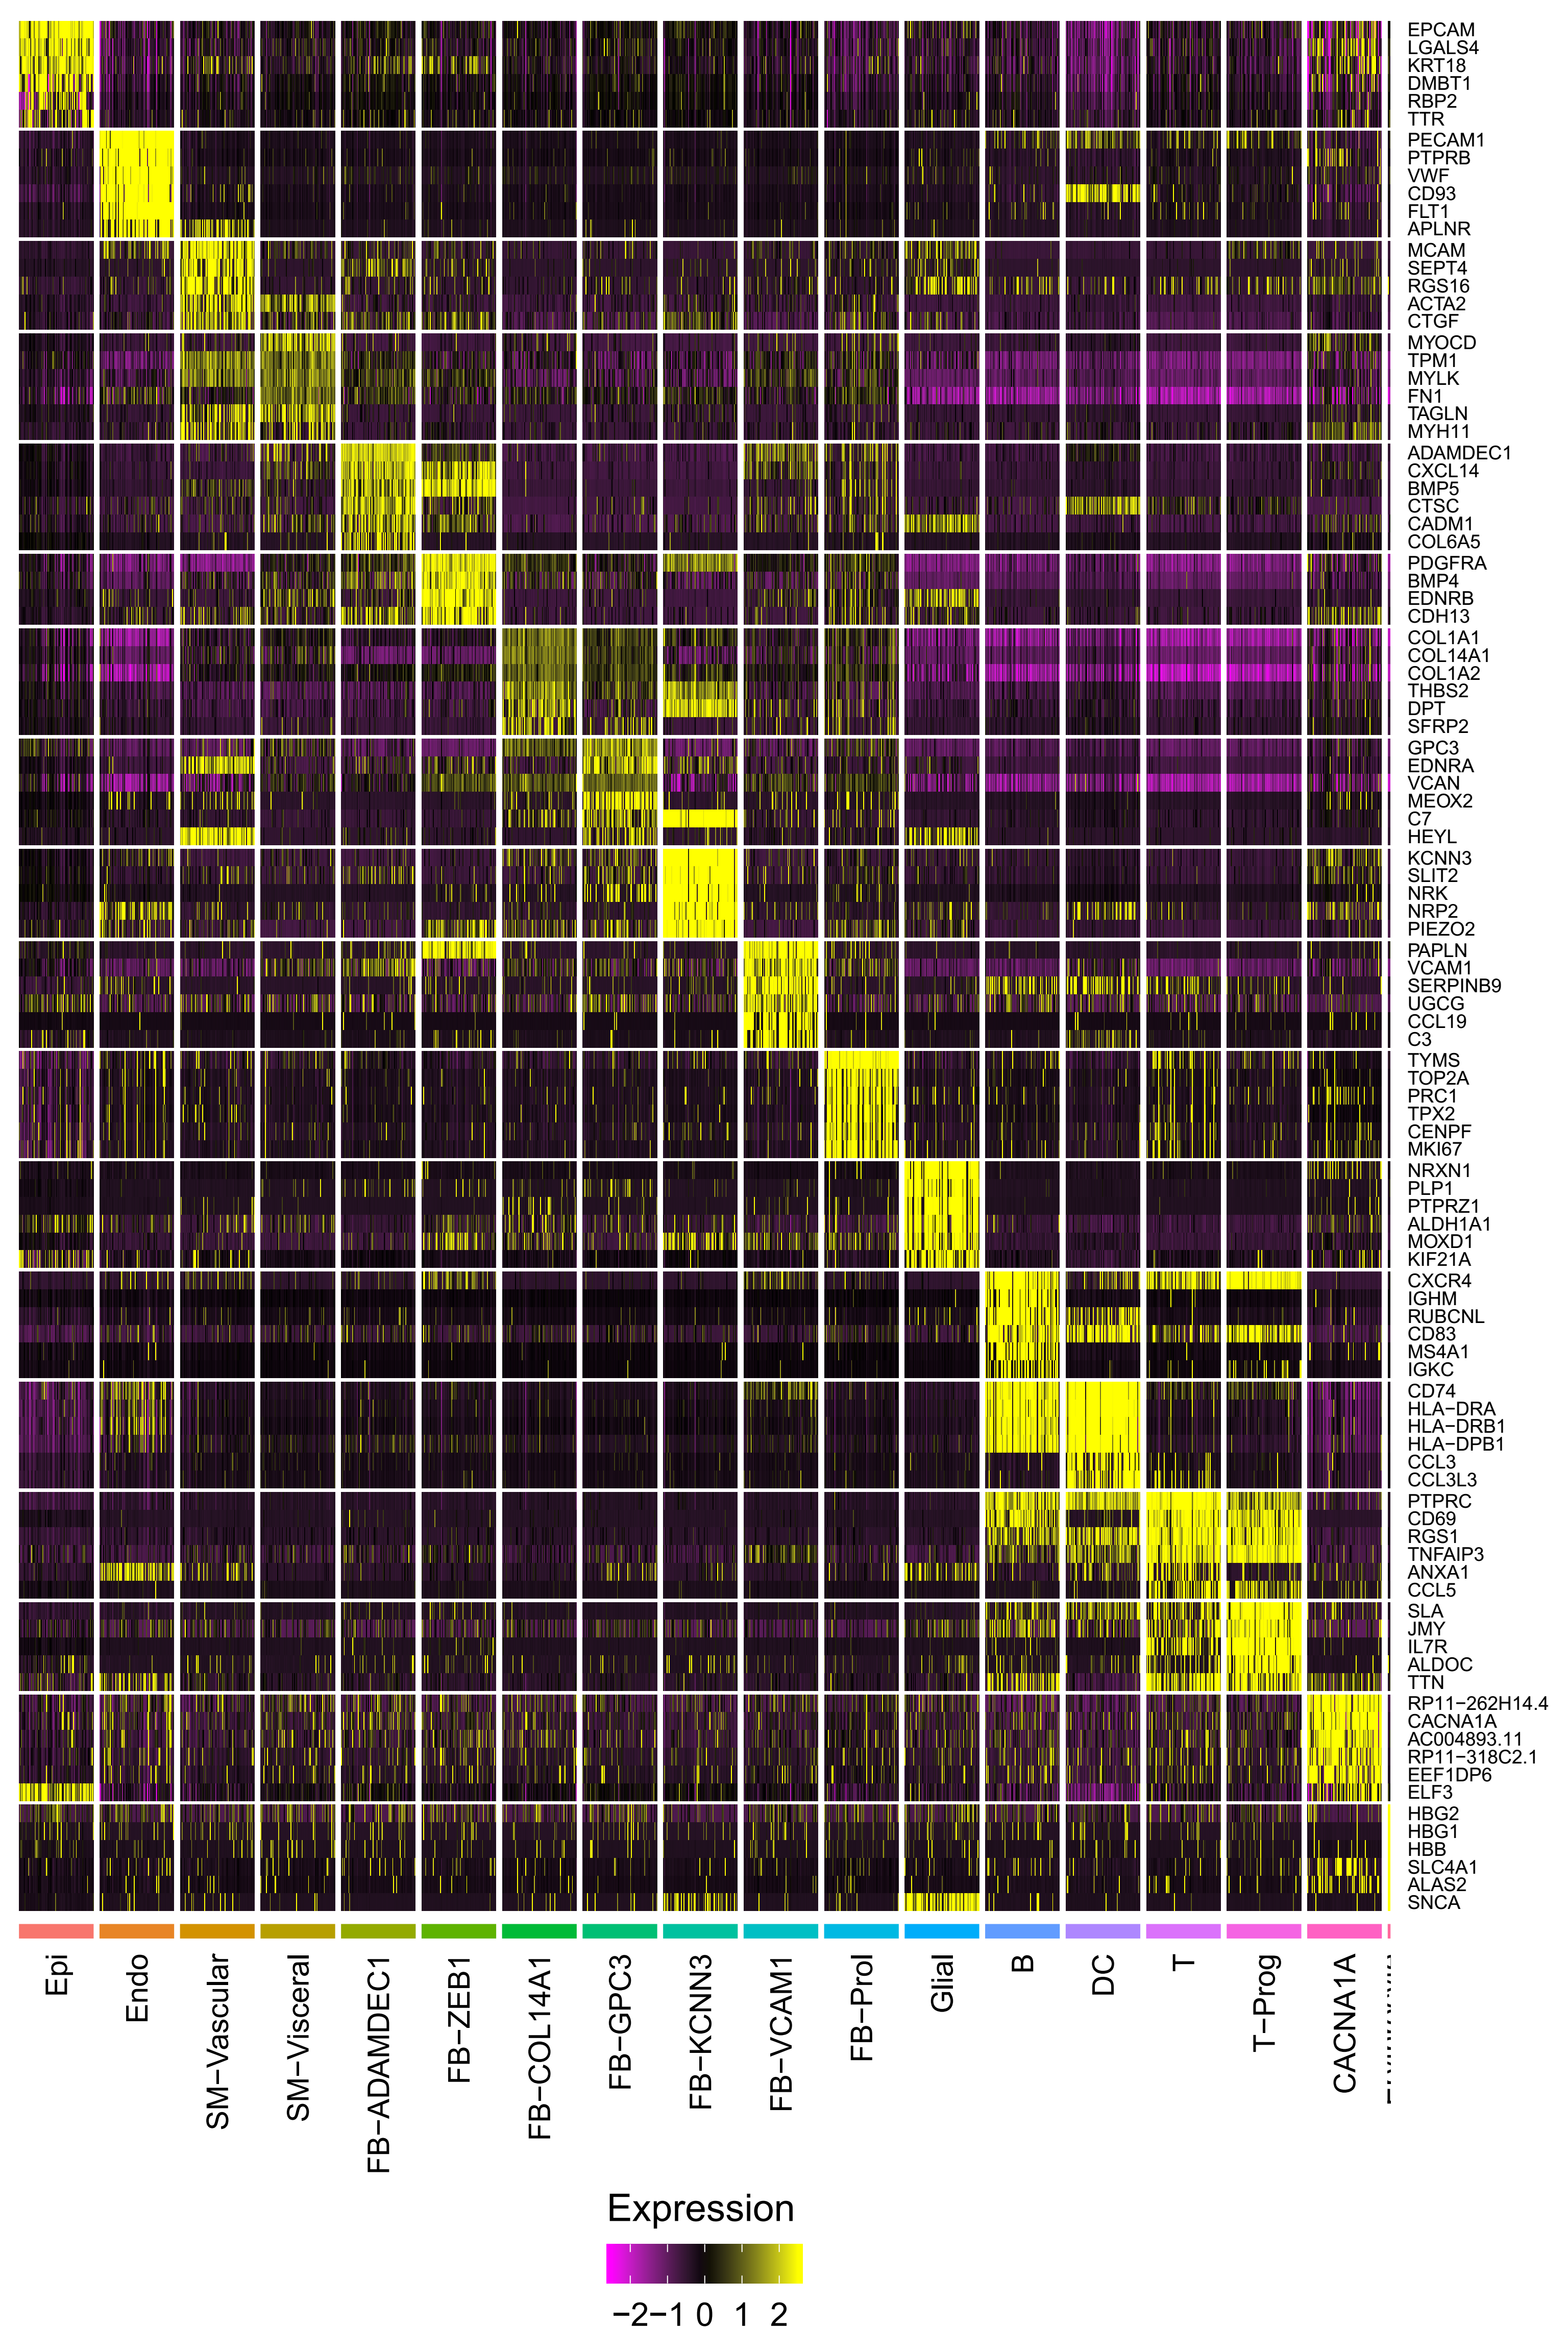
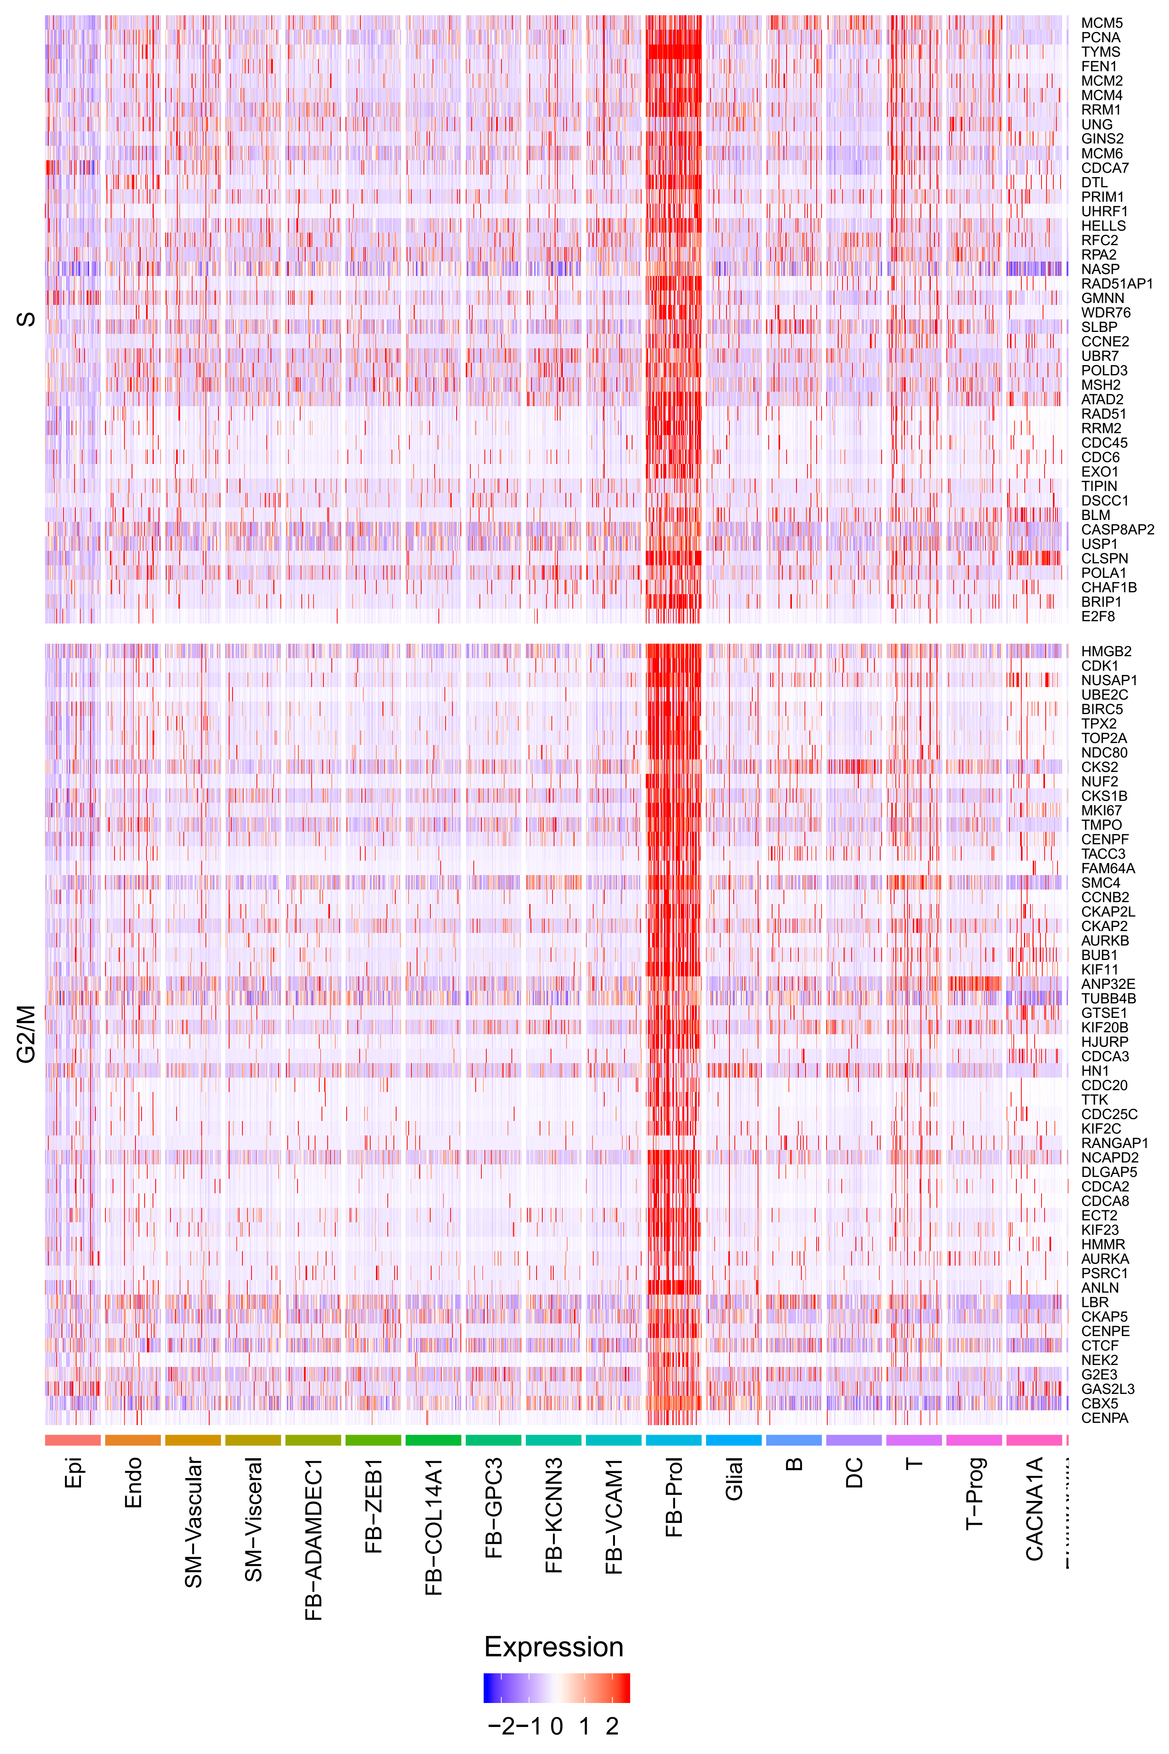
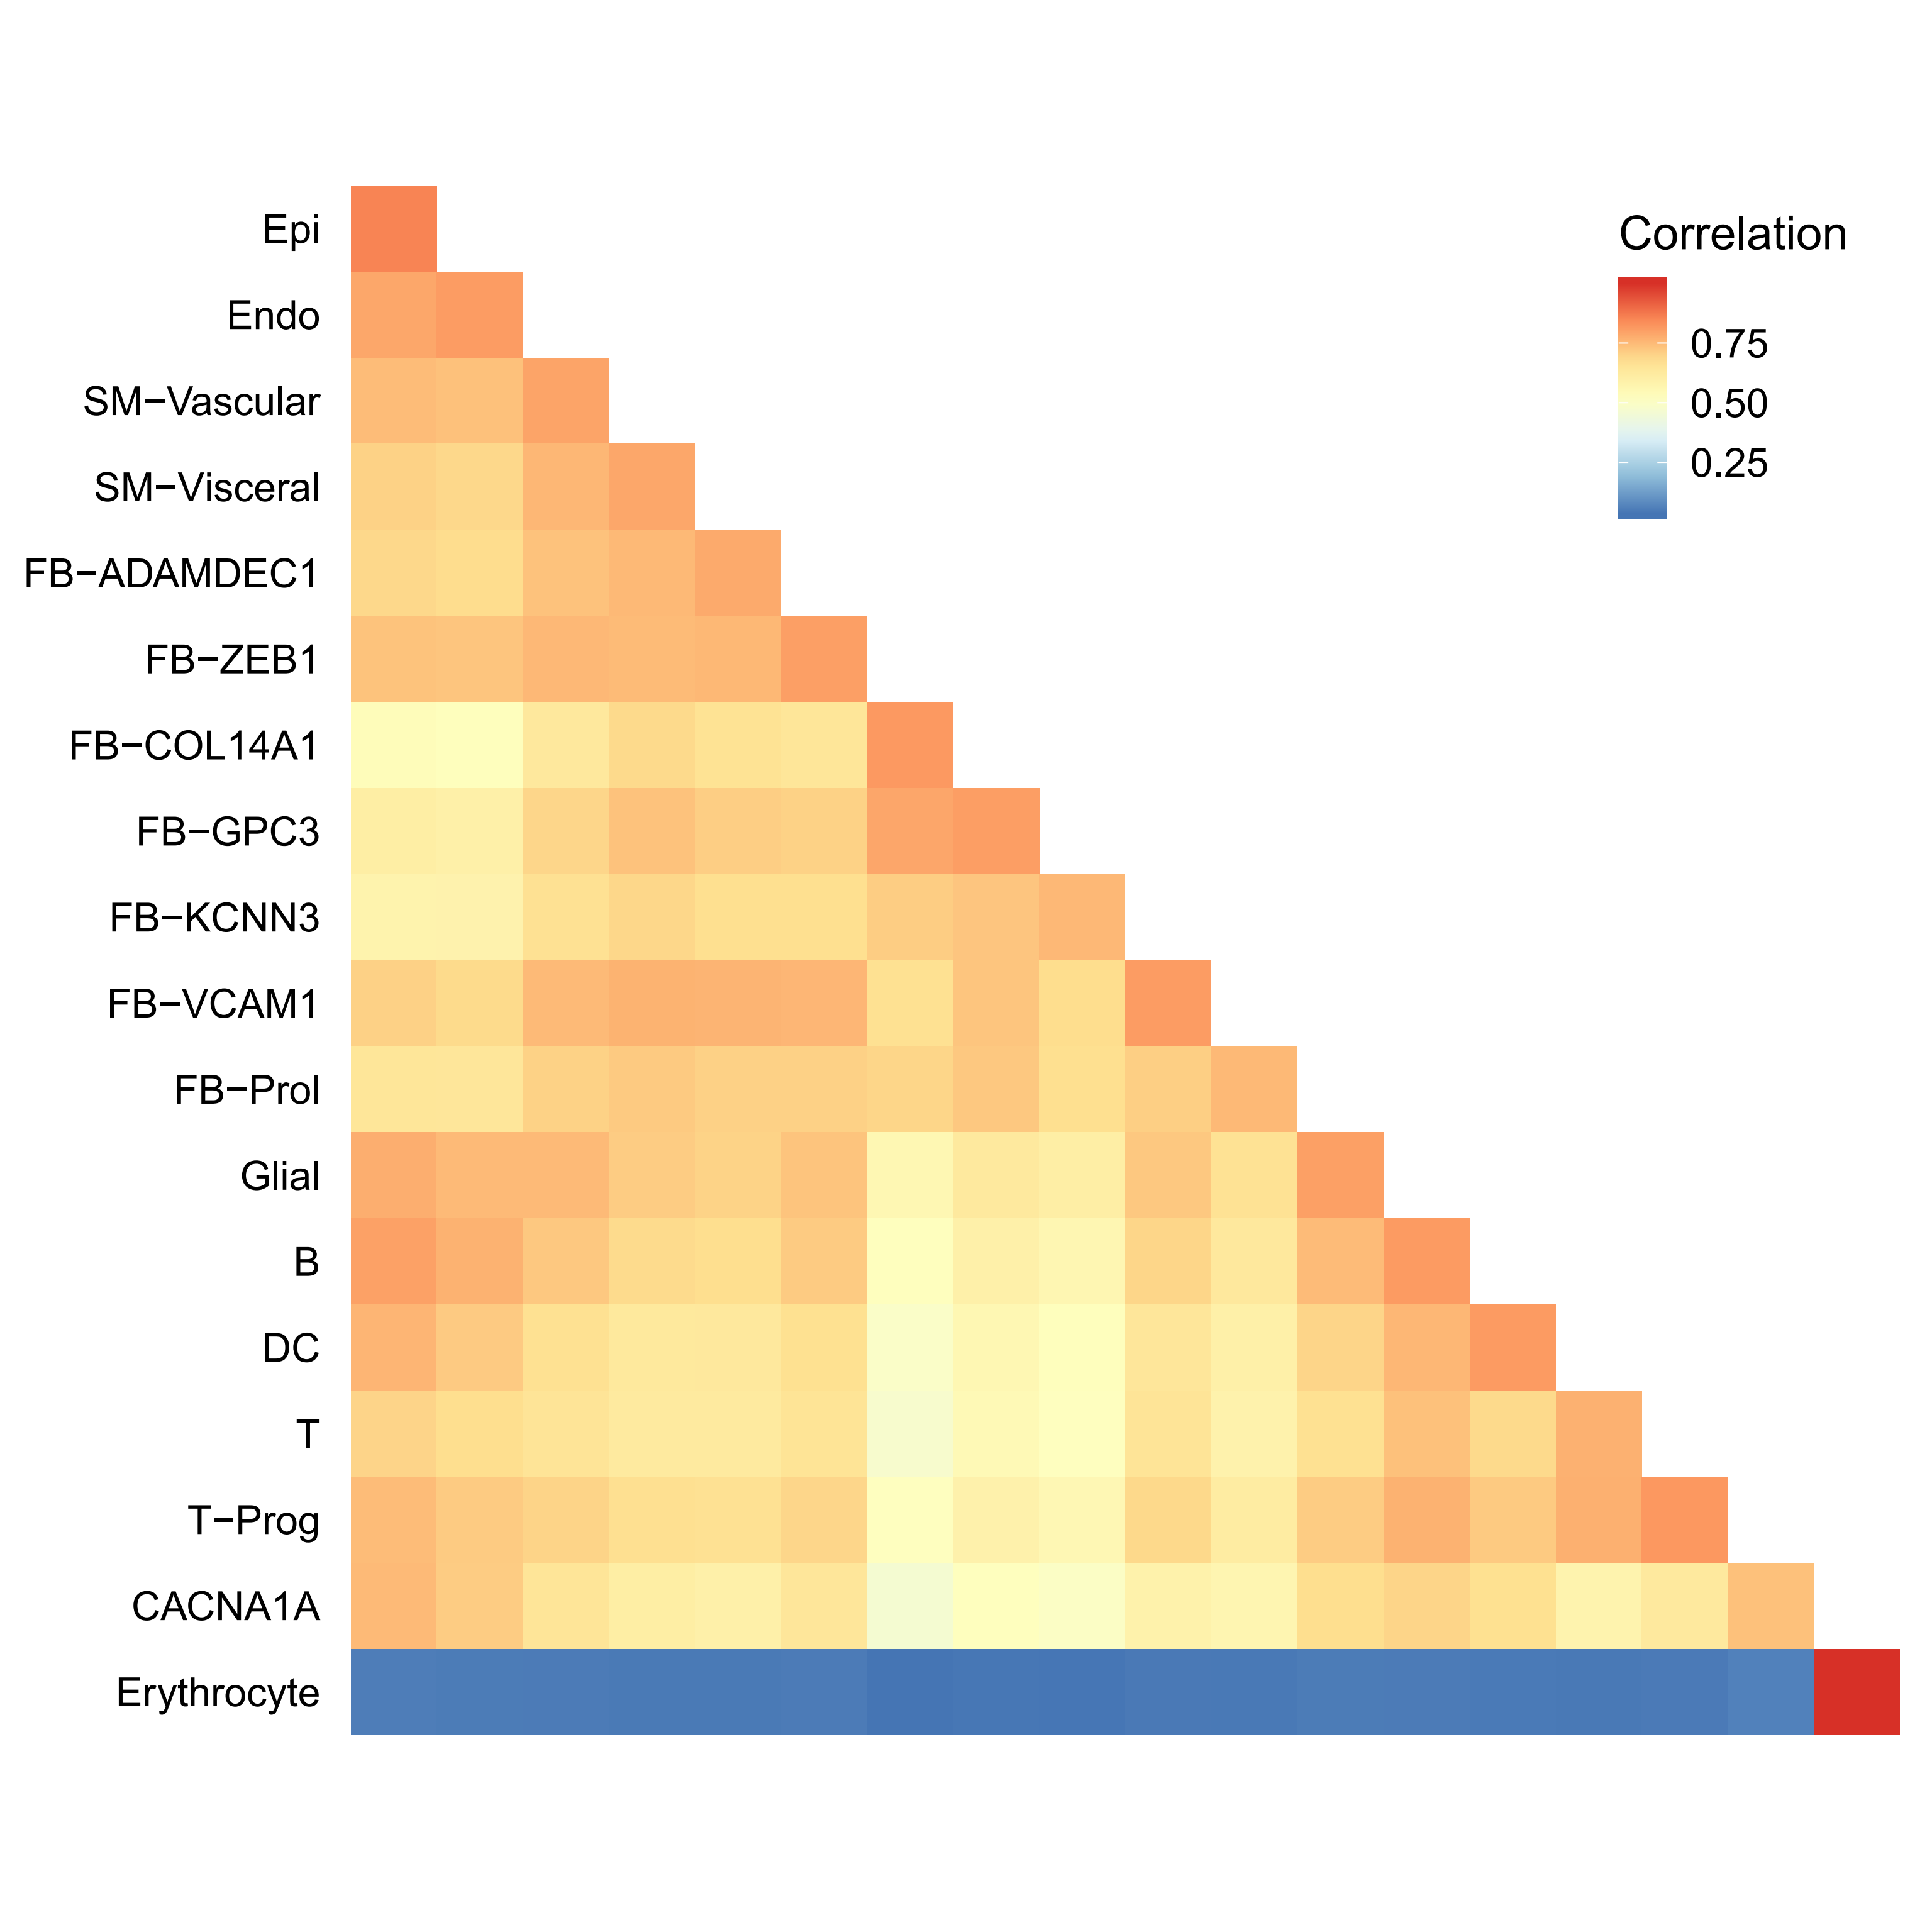
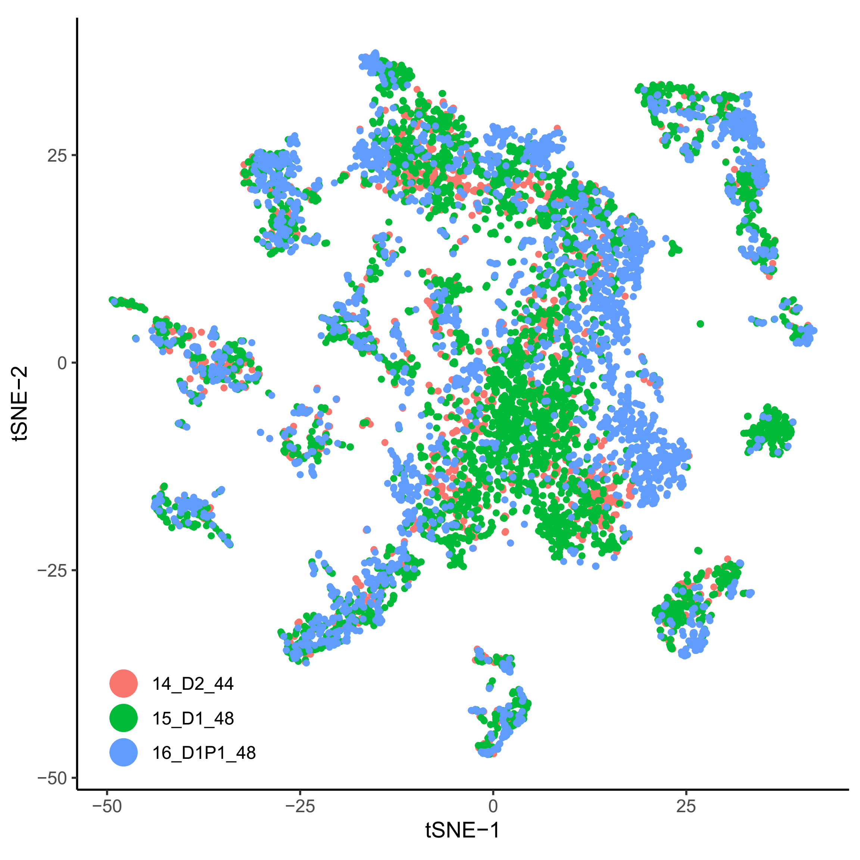
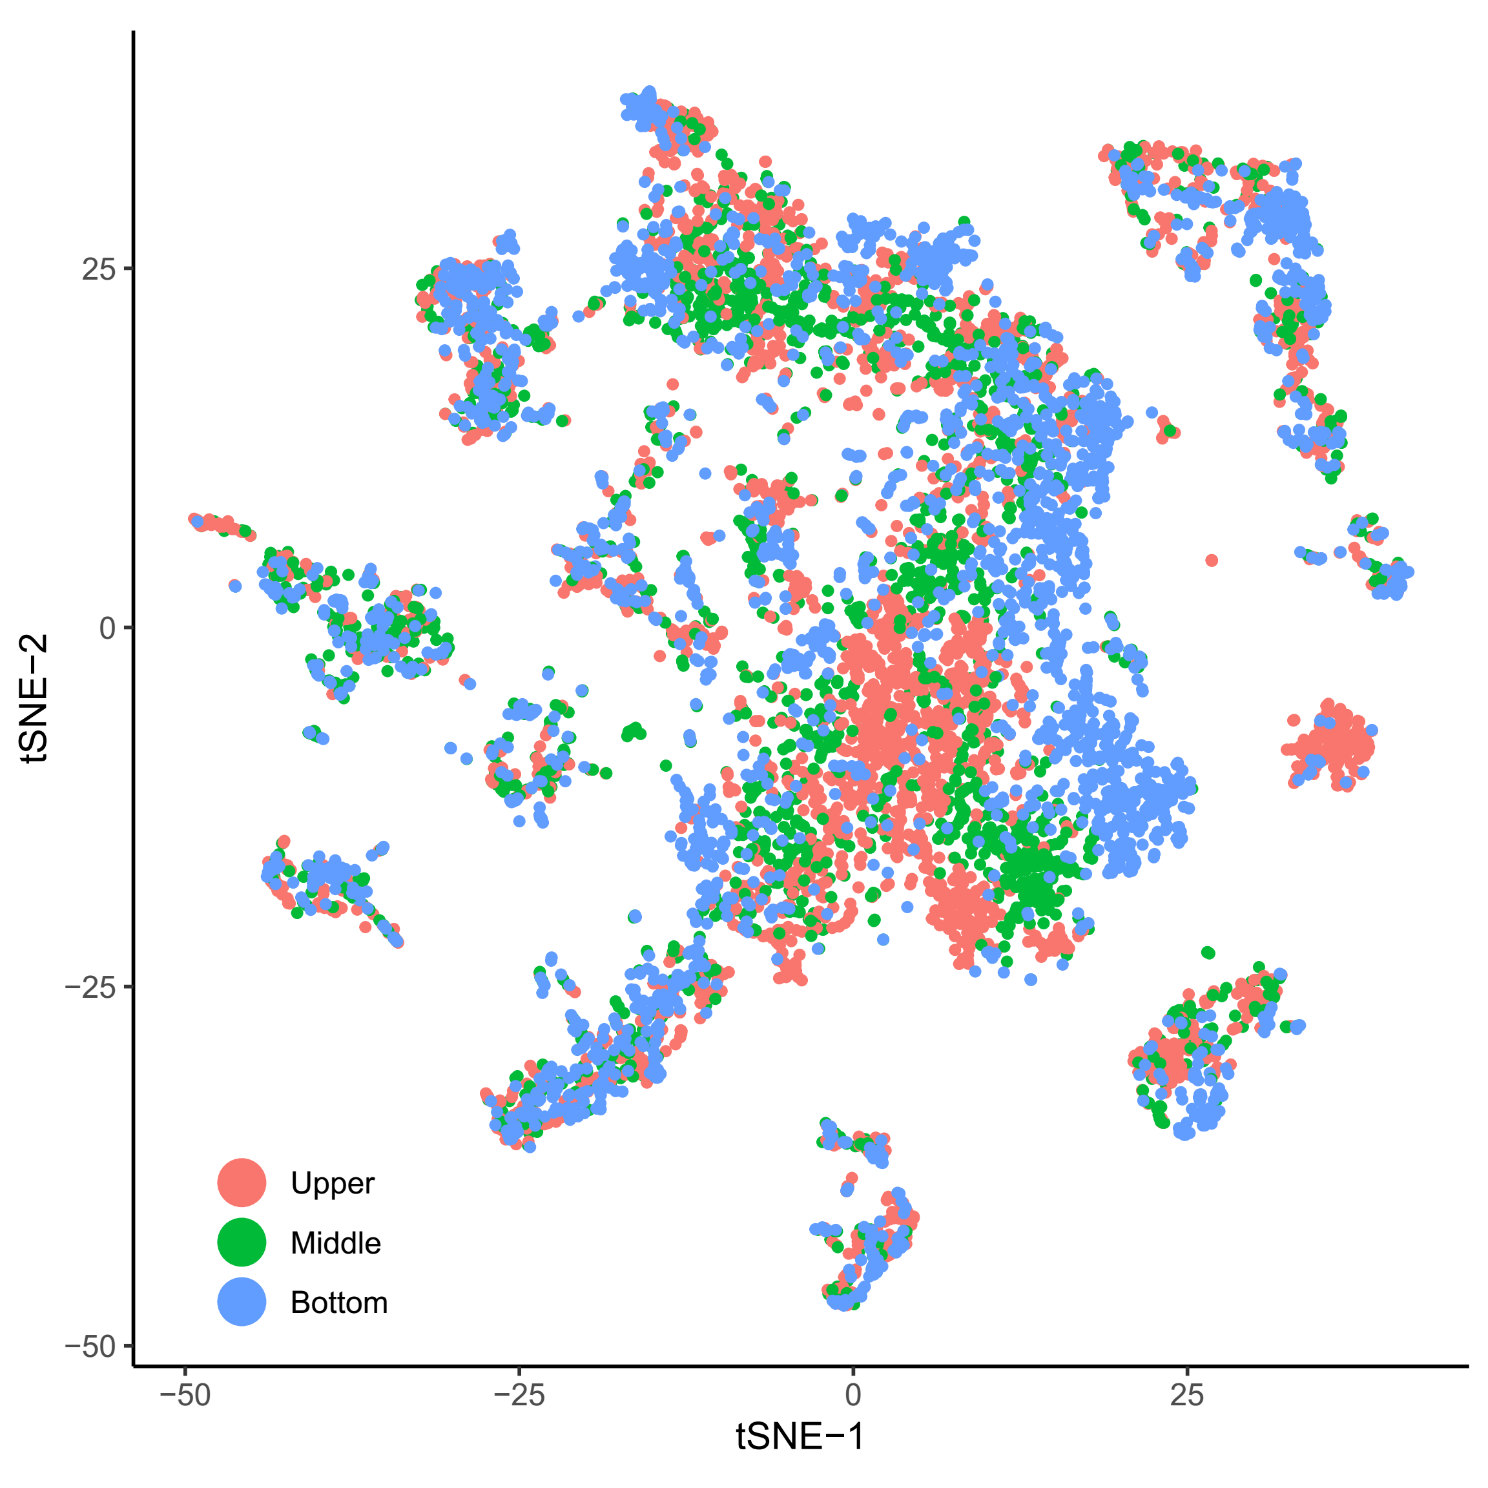
Small intestine (Supp.)

Slide 9
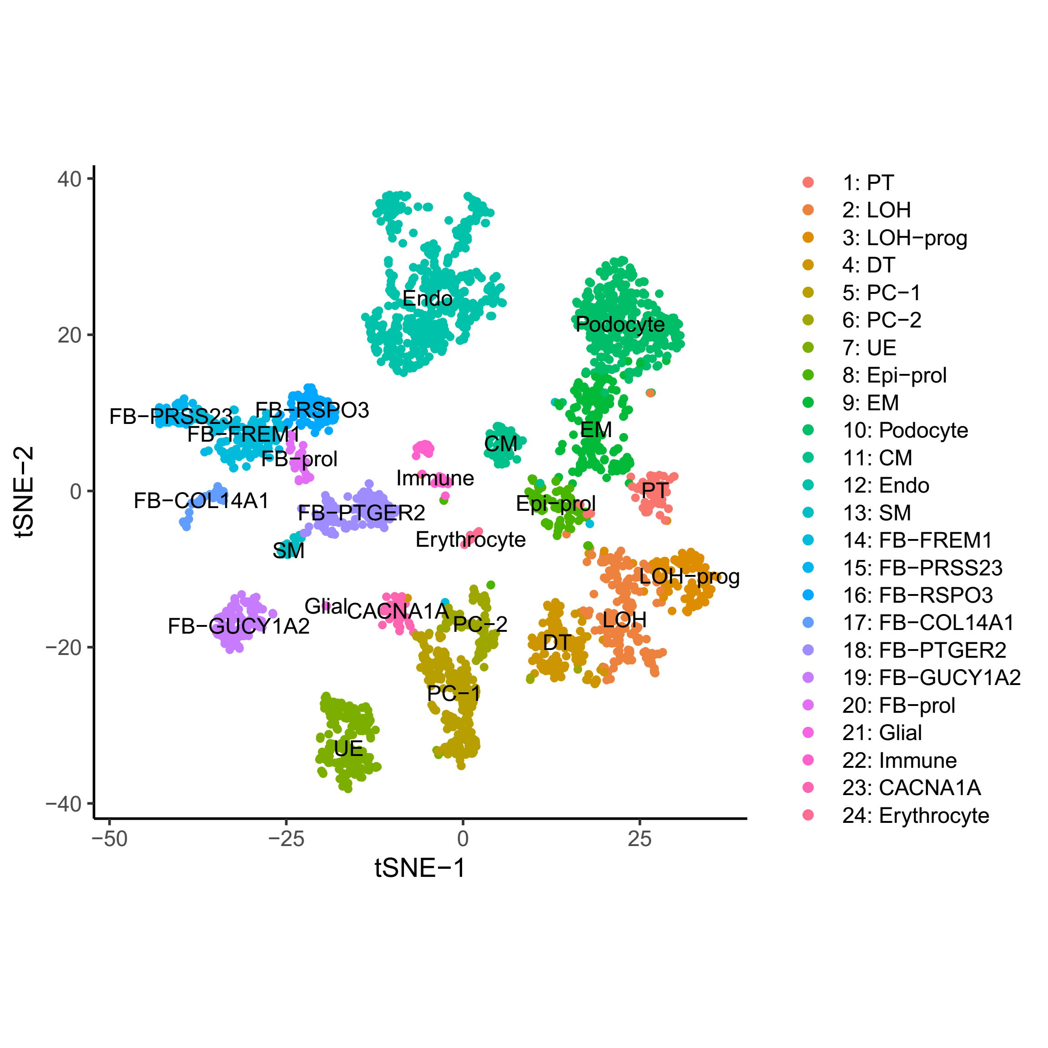
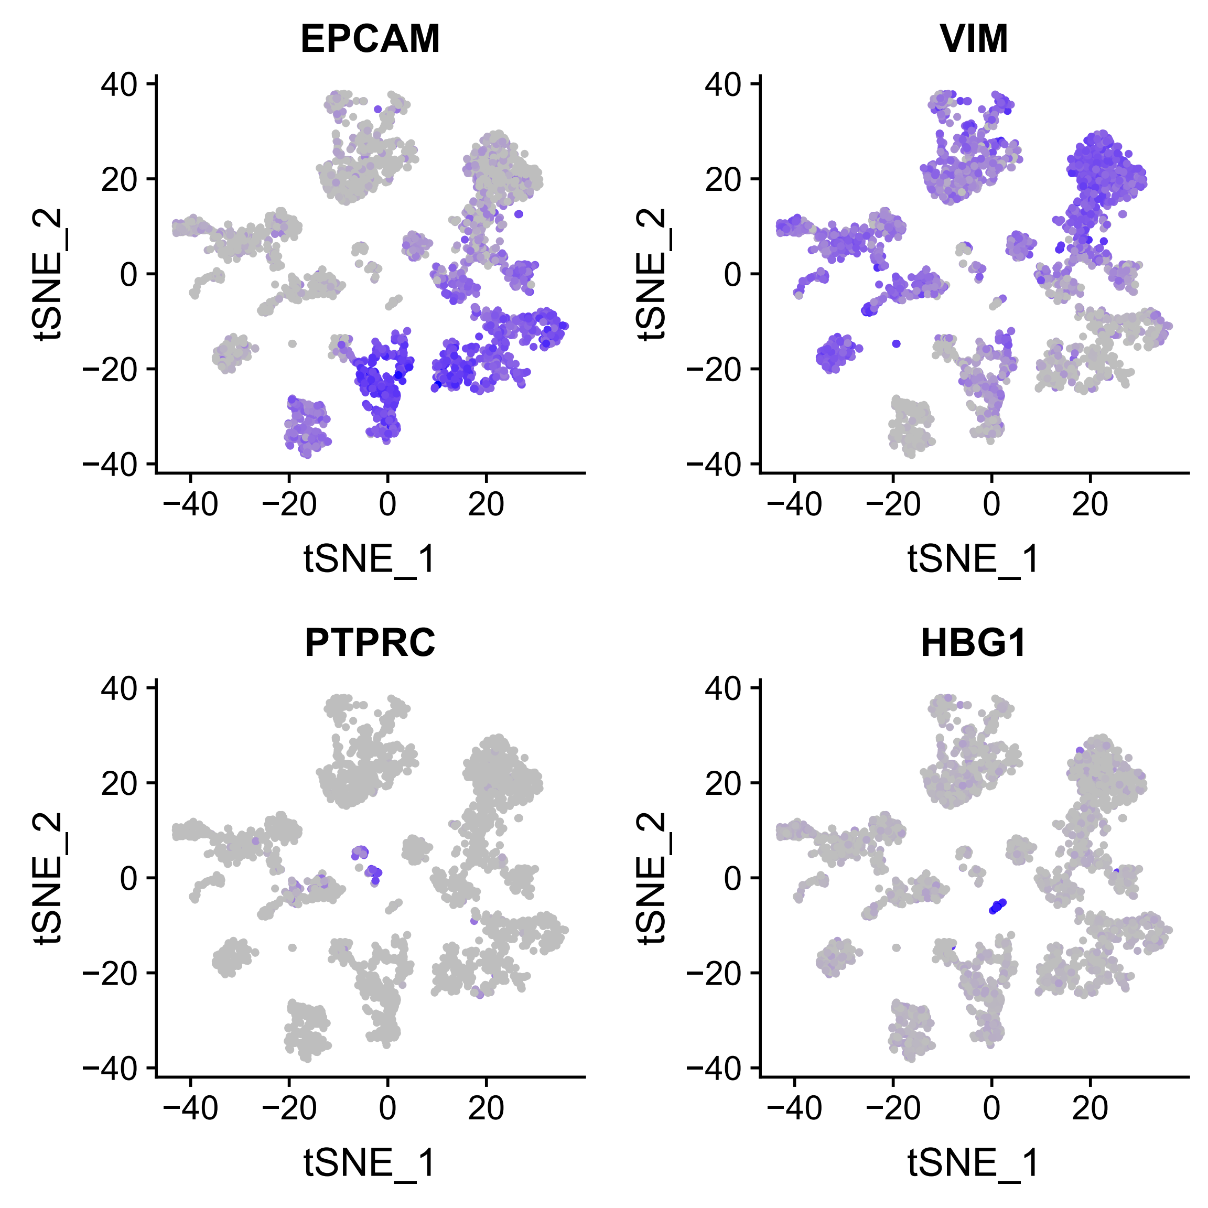
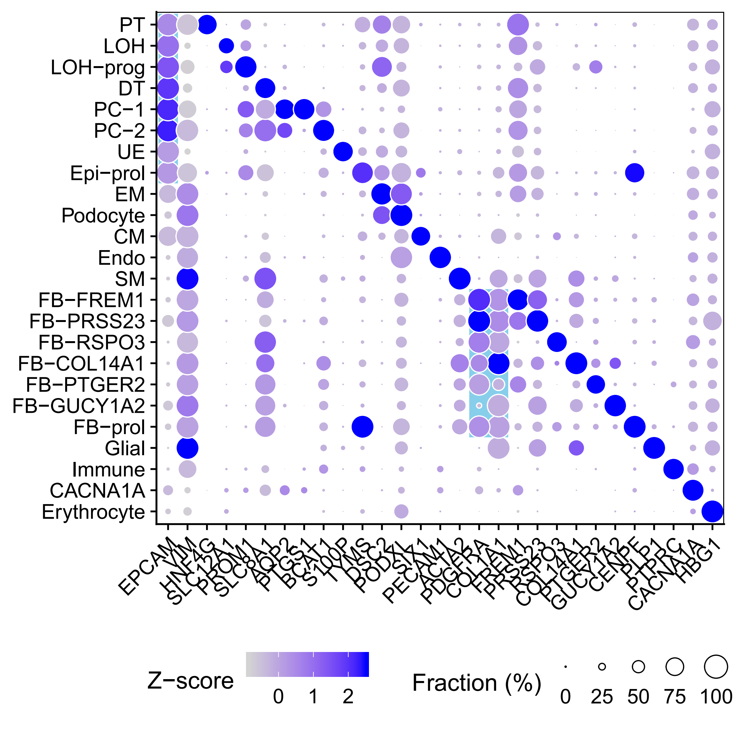
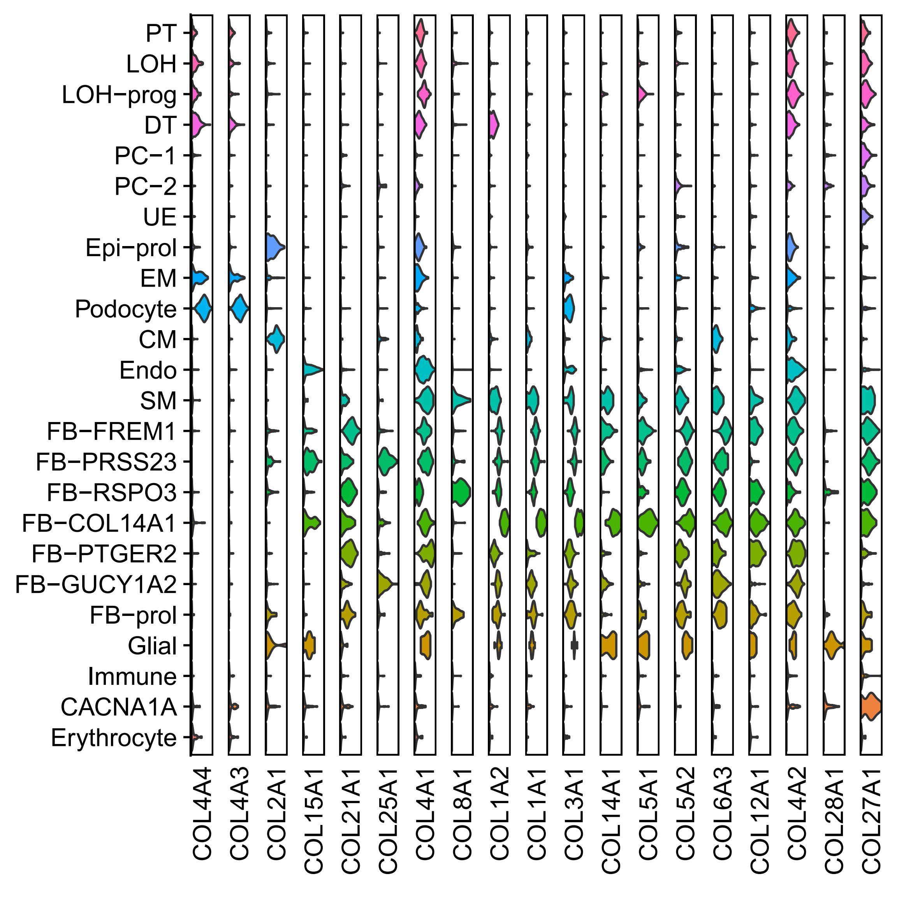
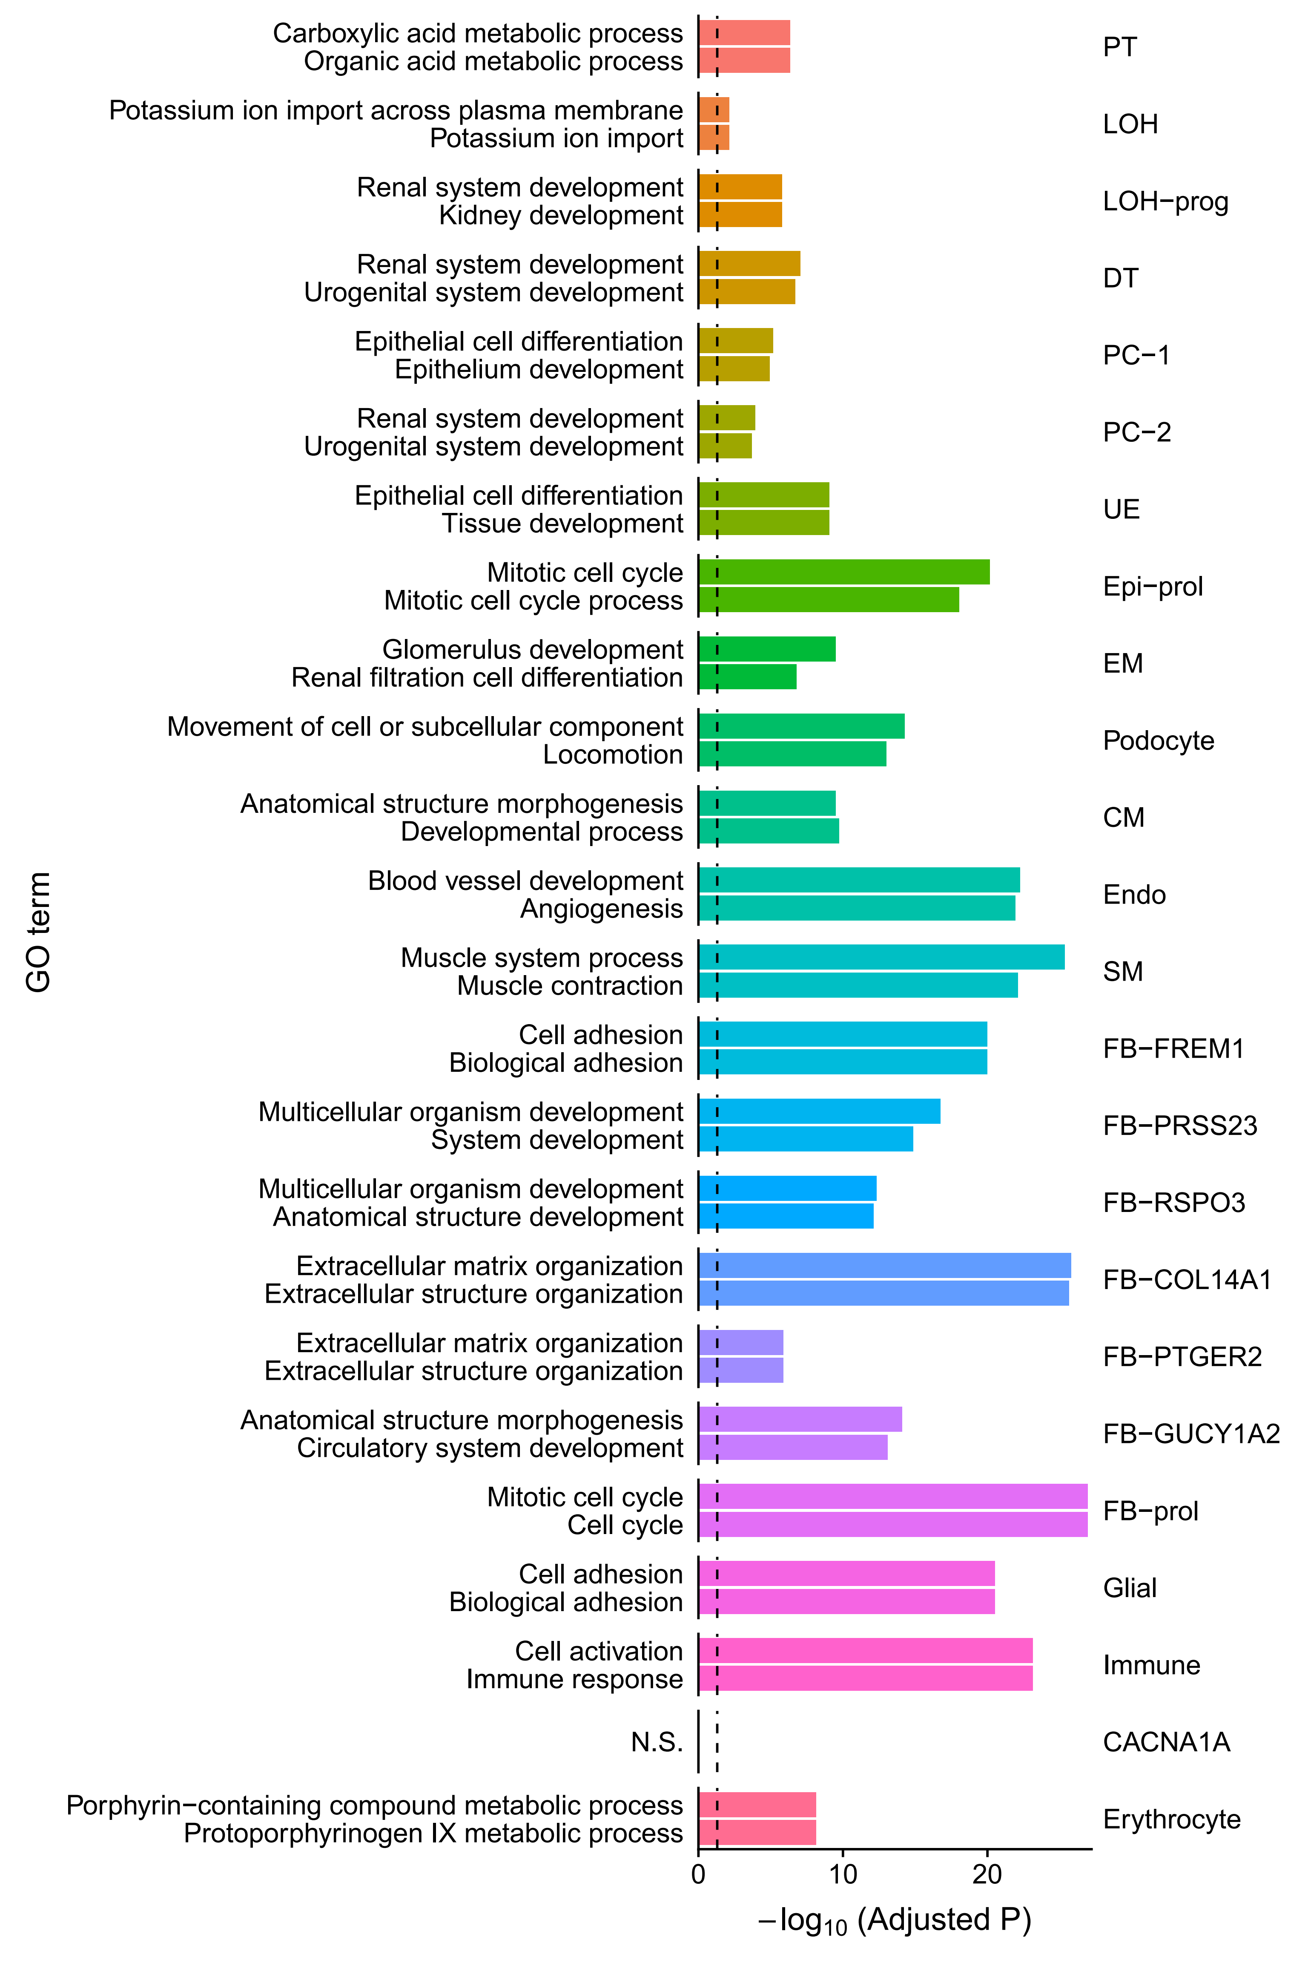
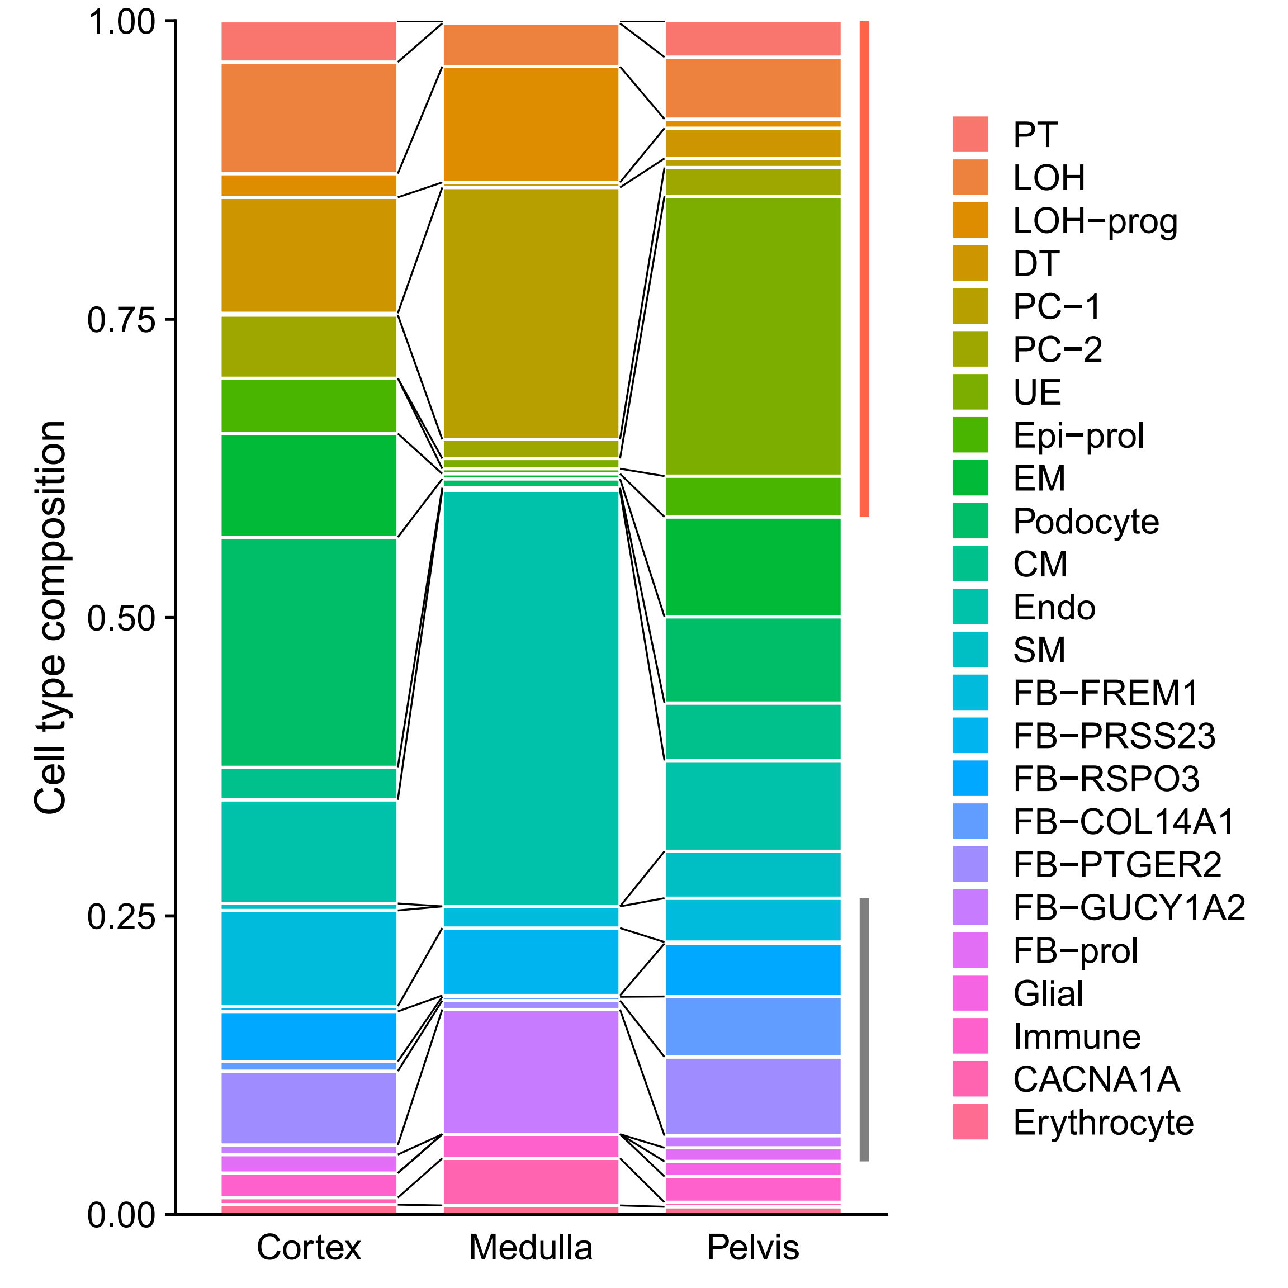
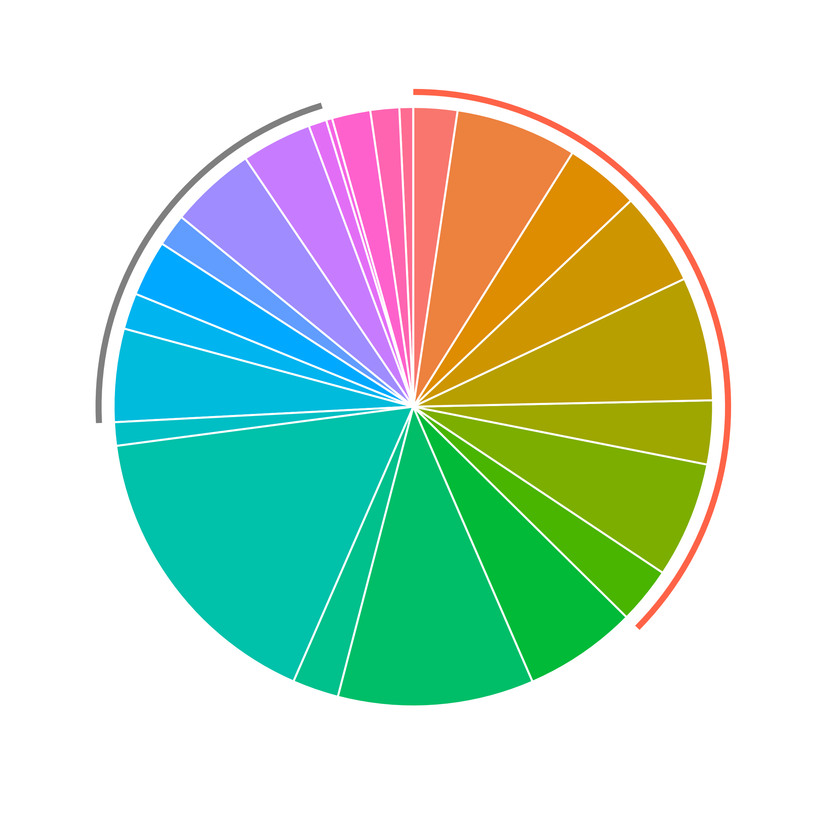
Kidney (3,086 cells)

Slide 10
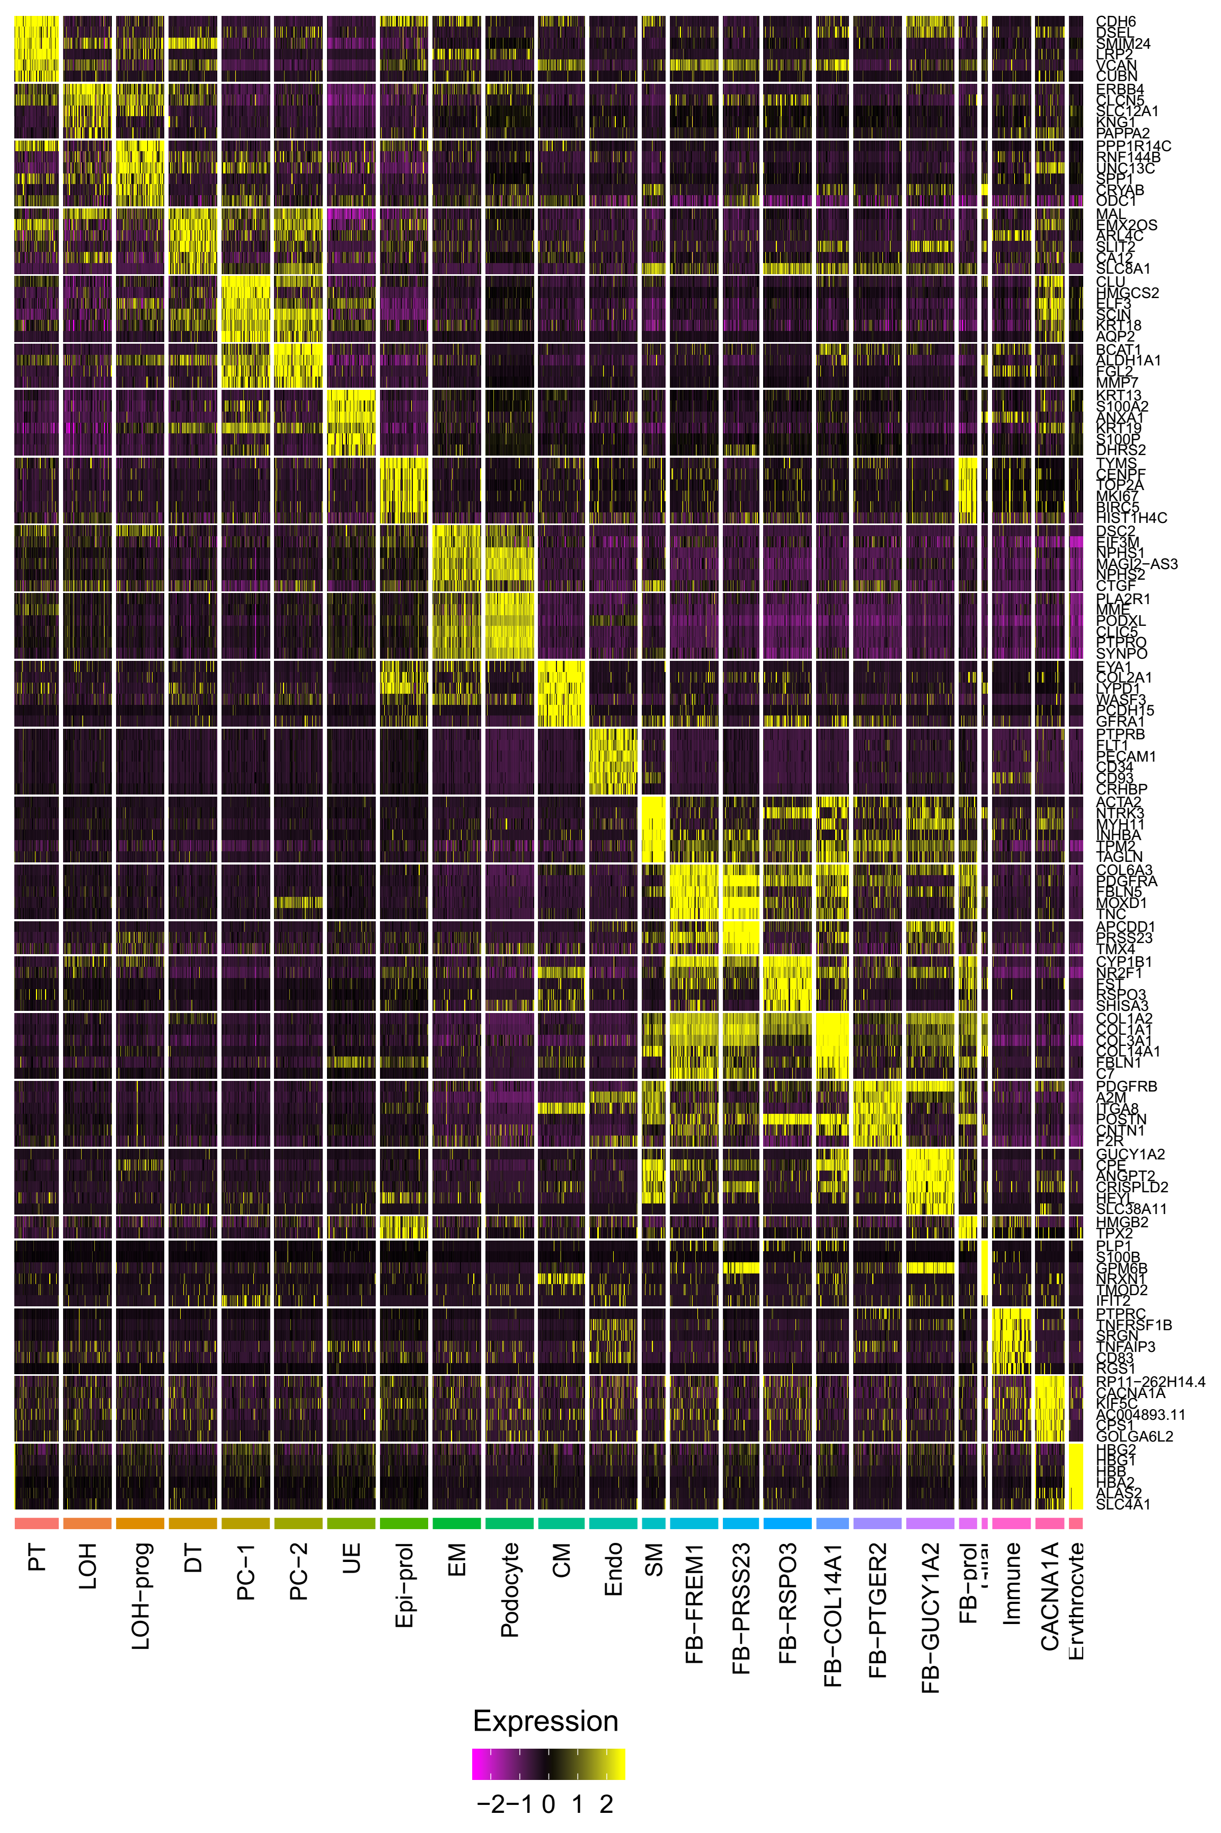
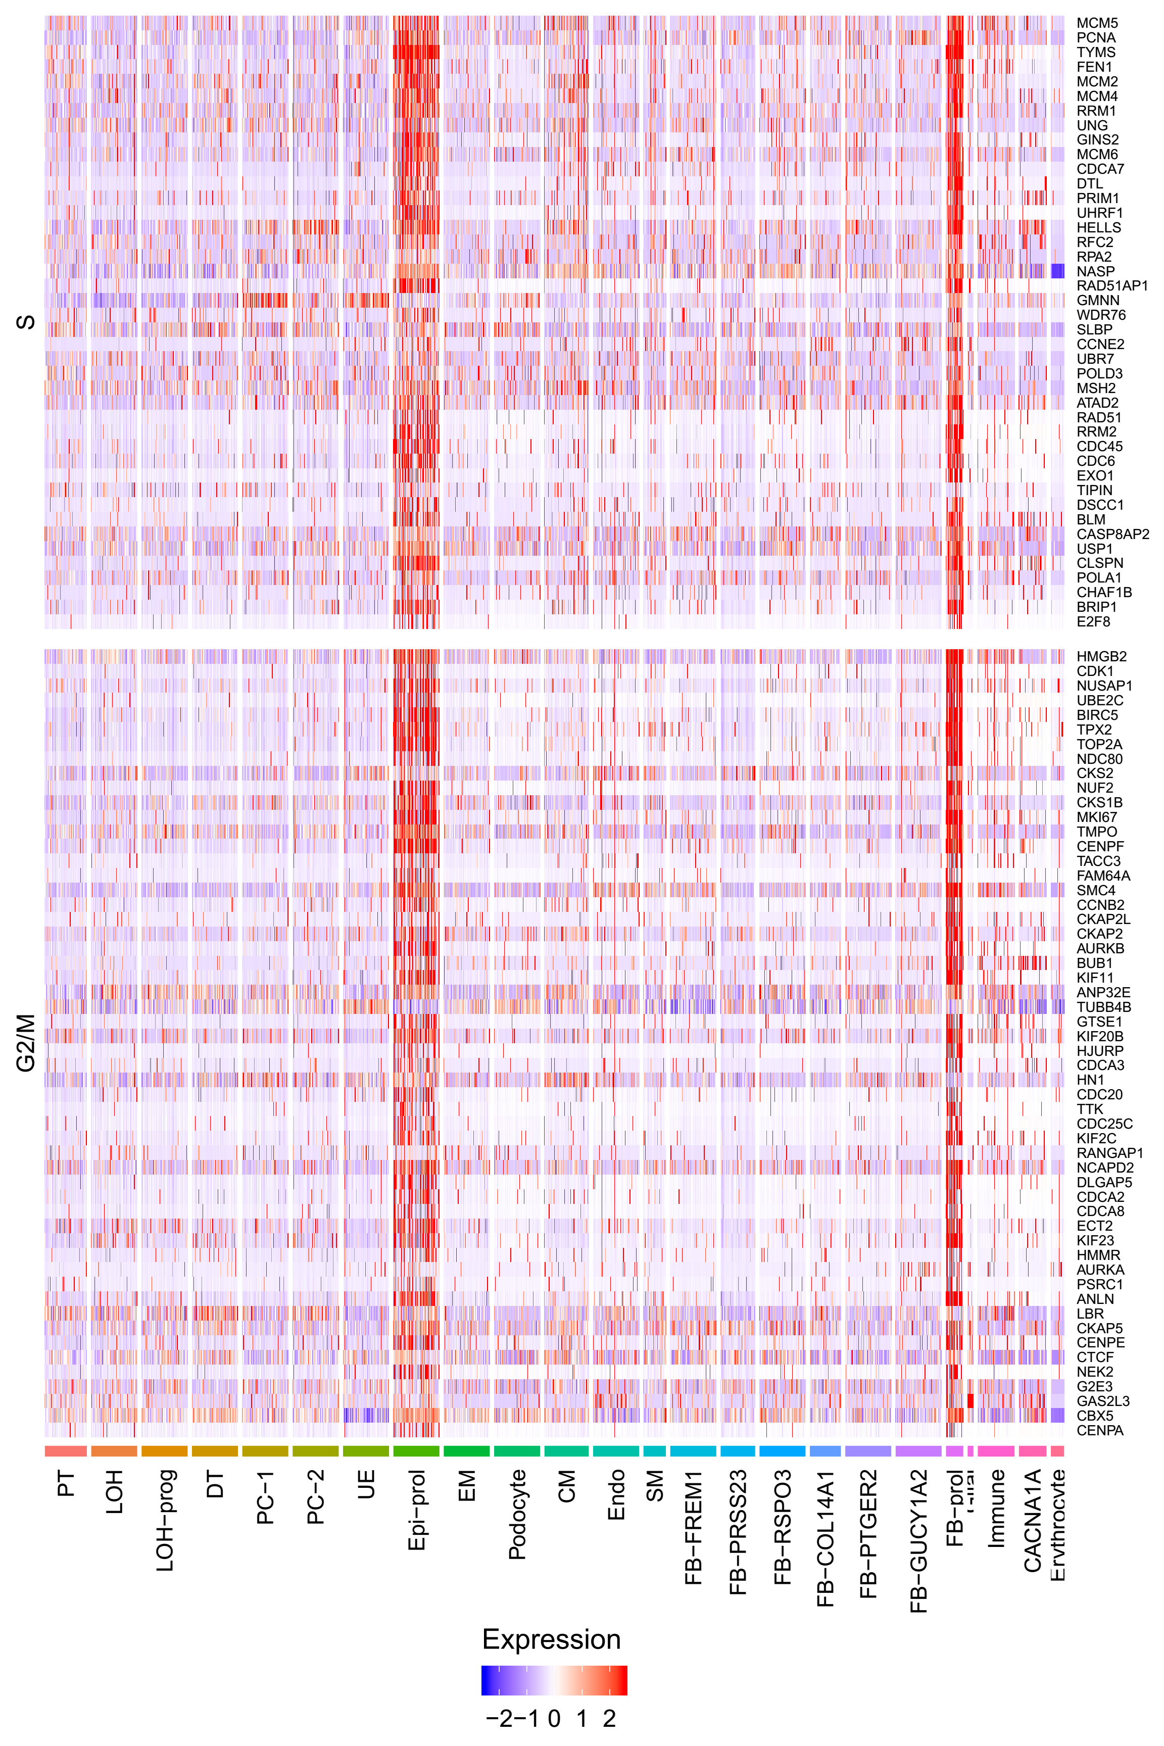
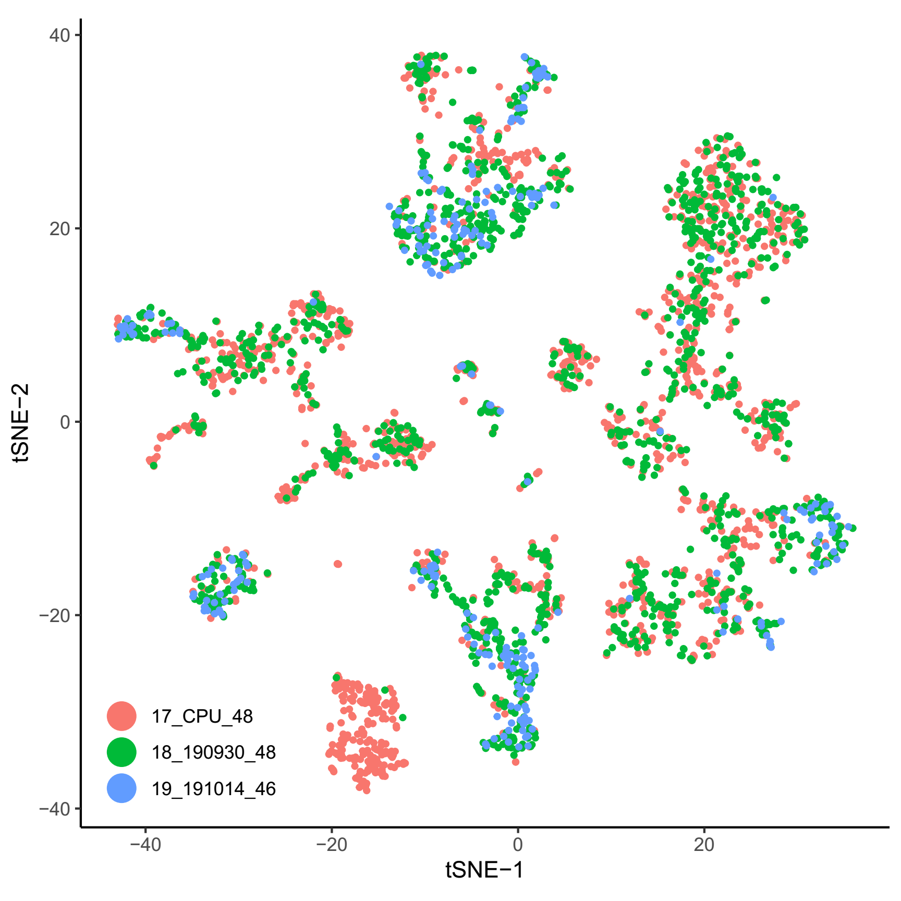
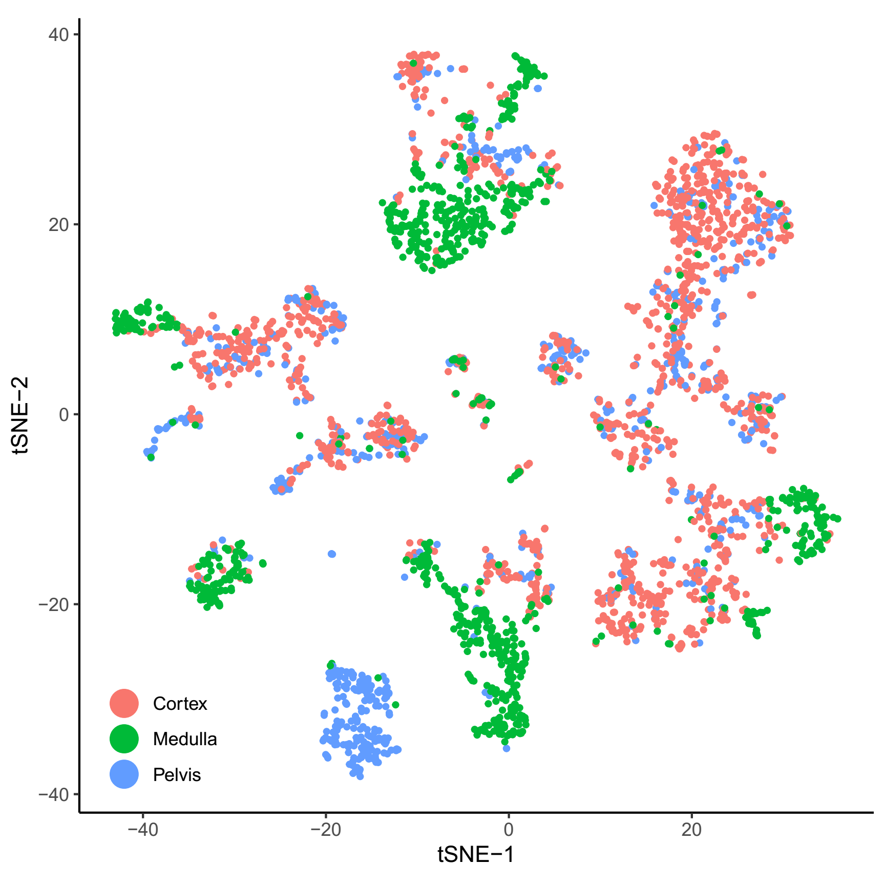
Kidney (Supp.)

Slide 11
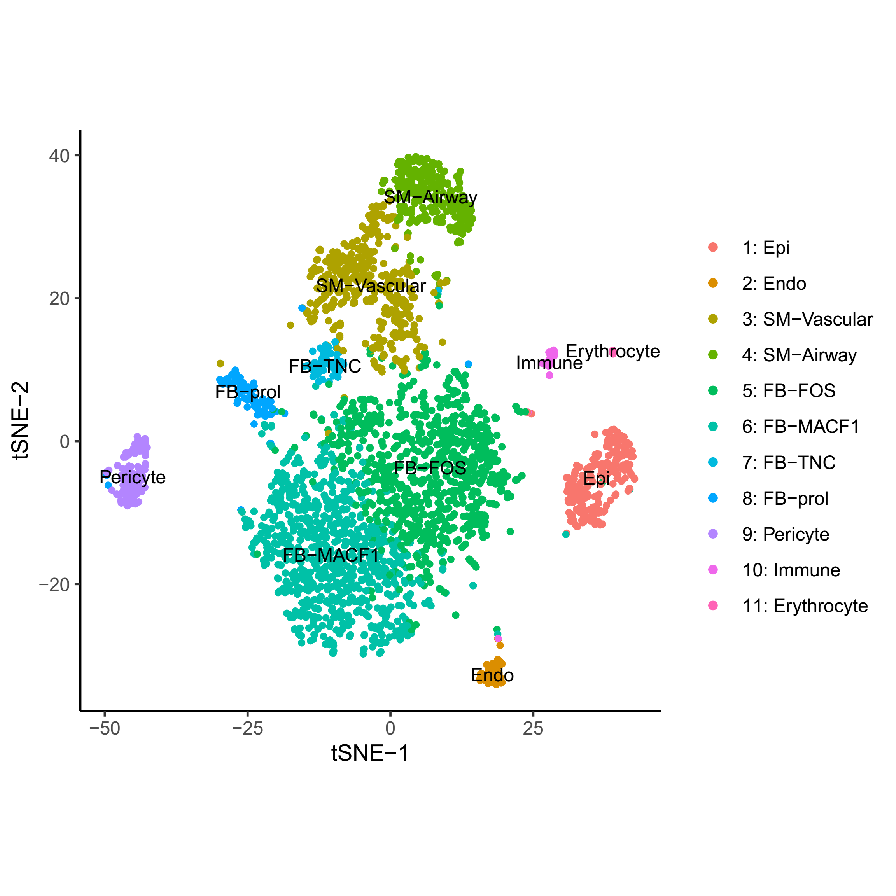
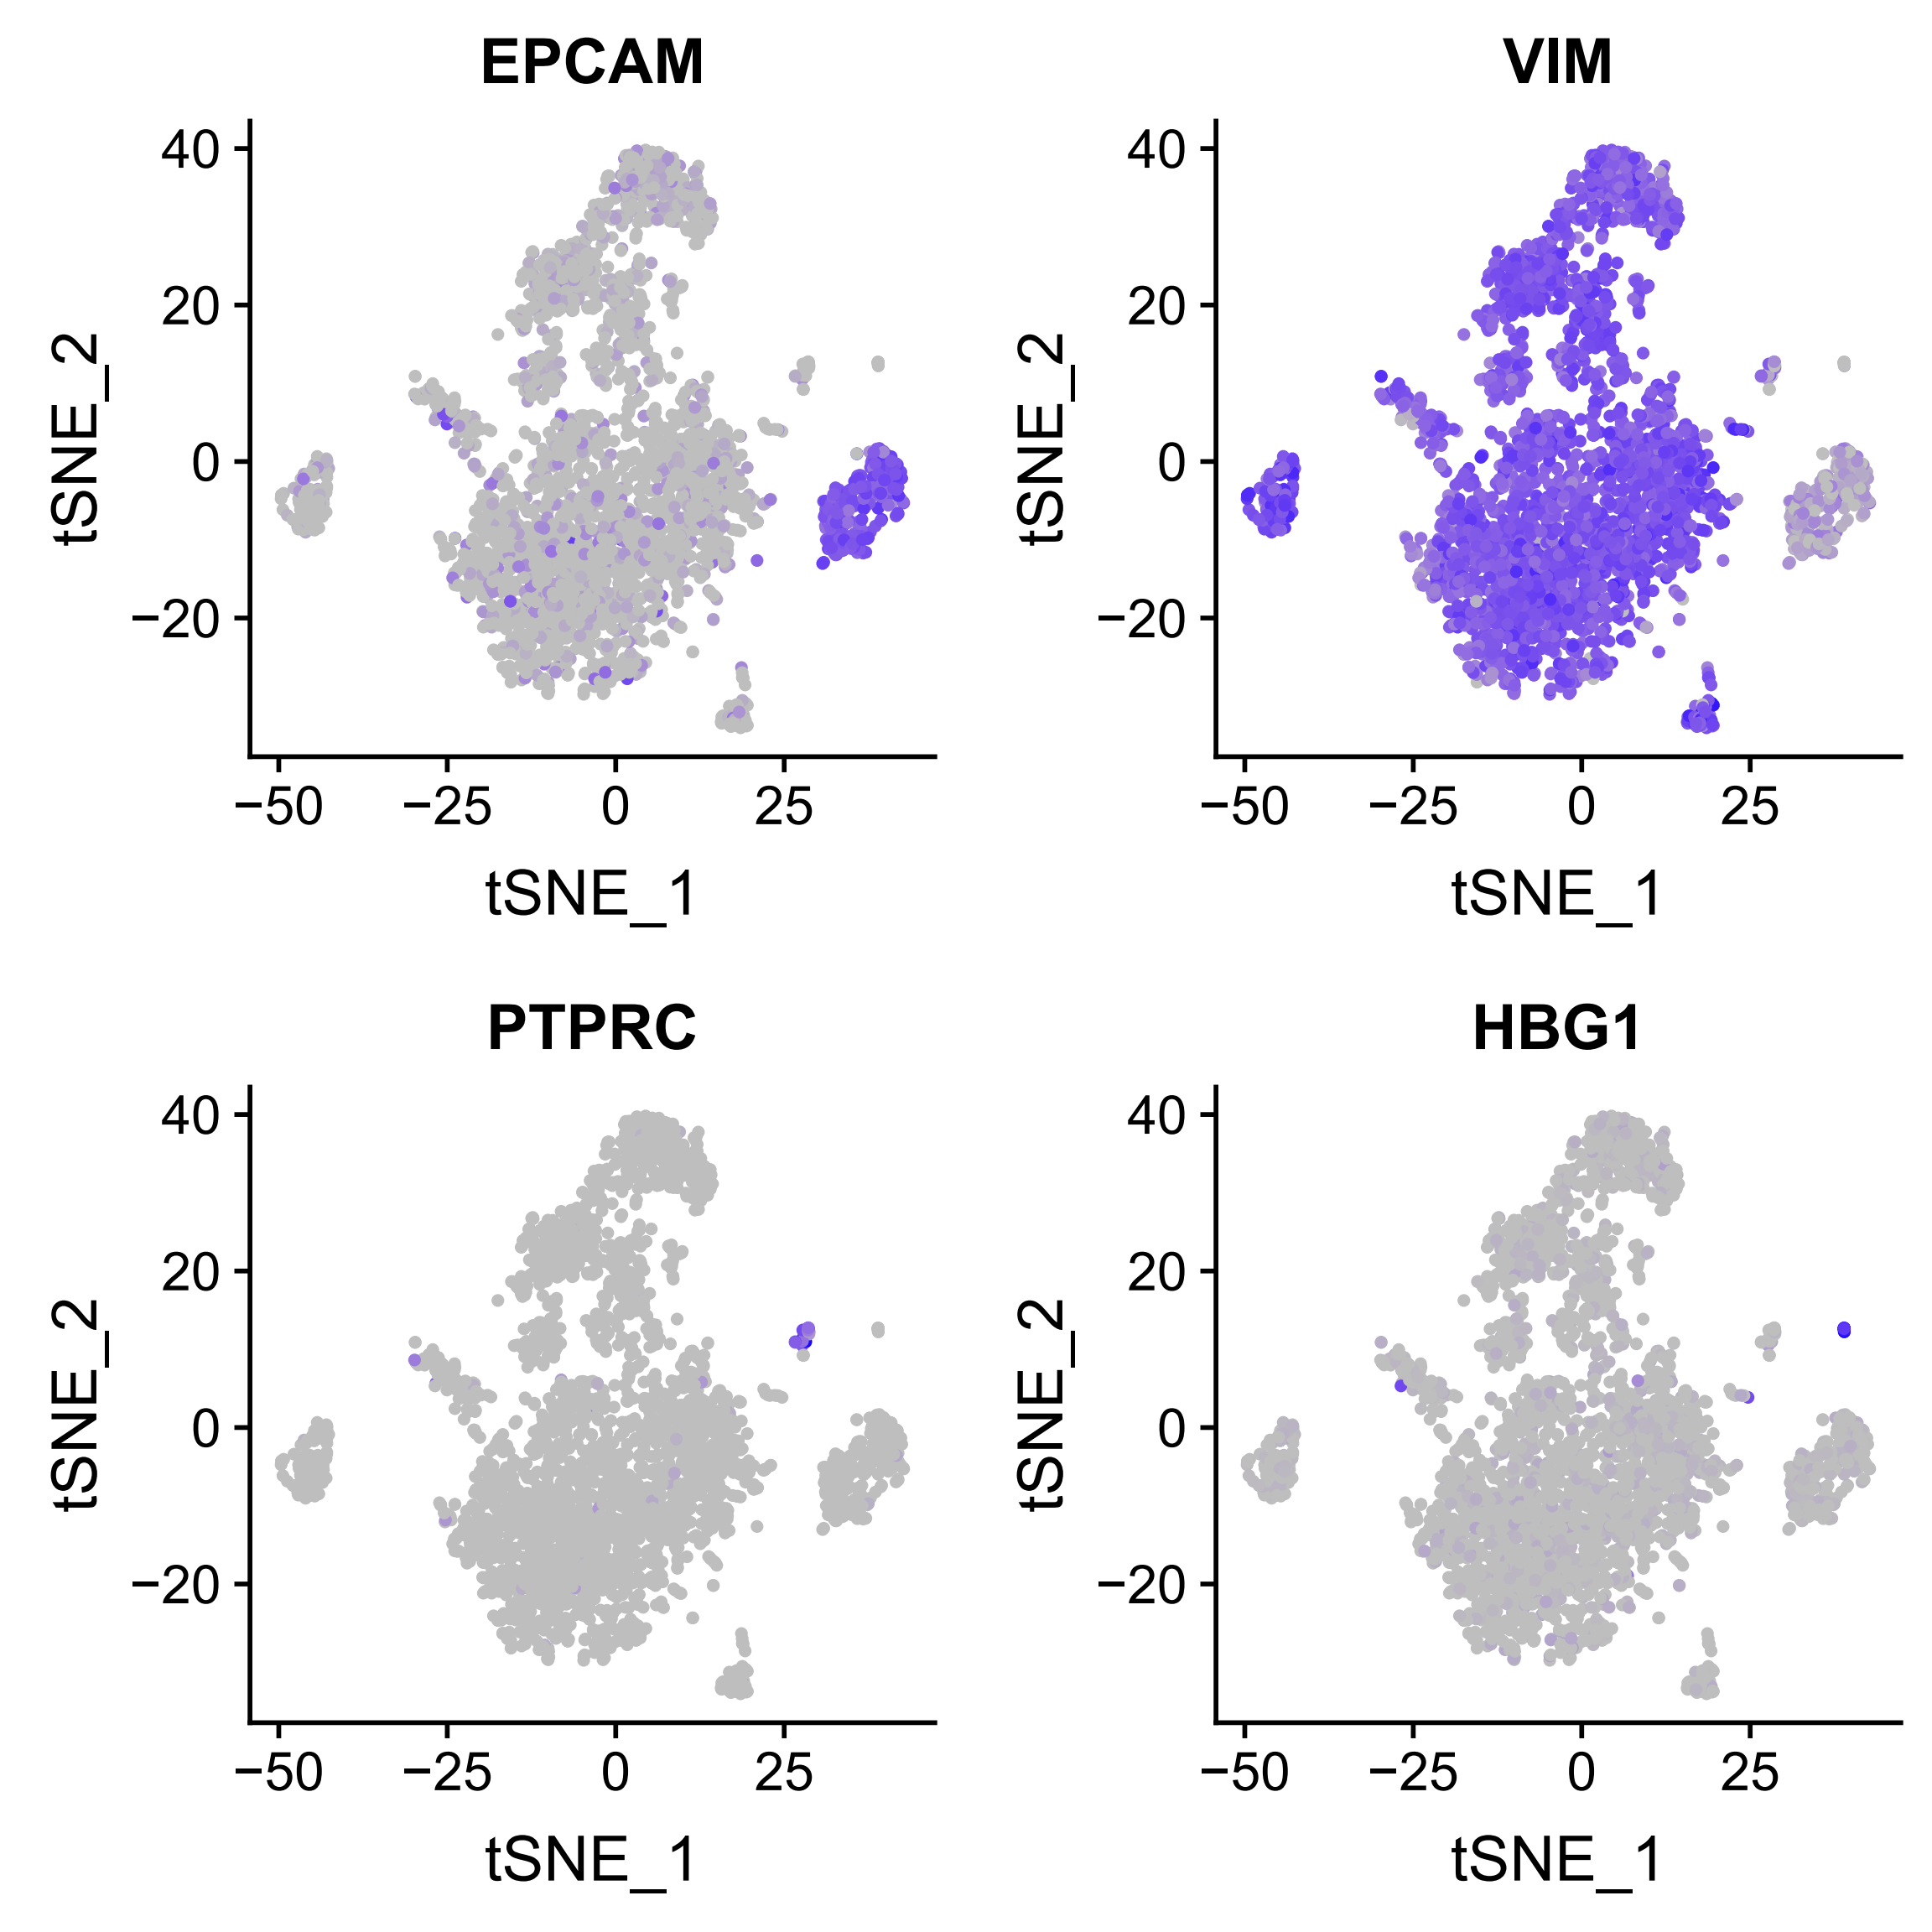
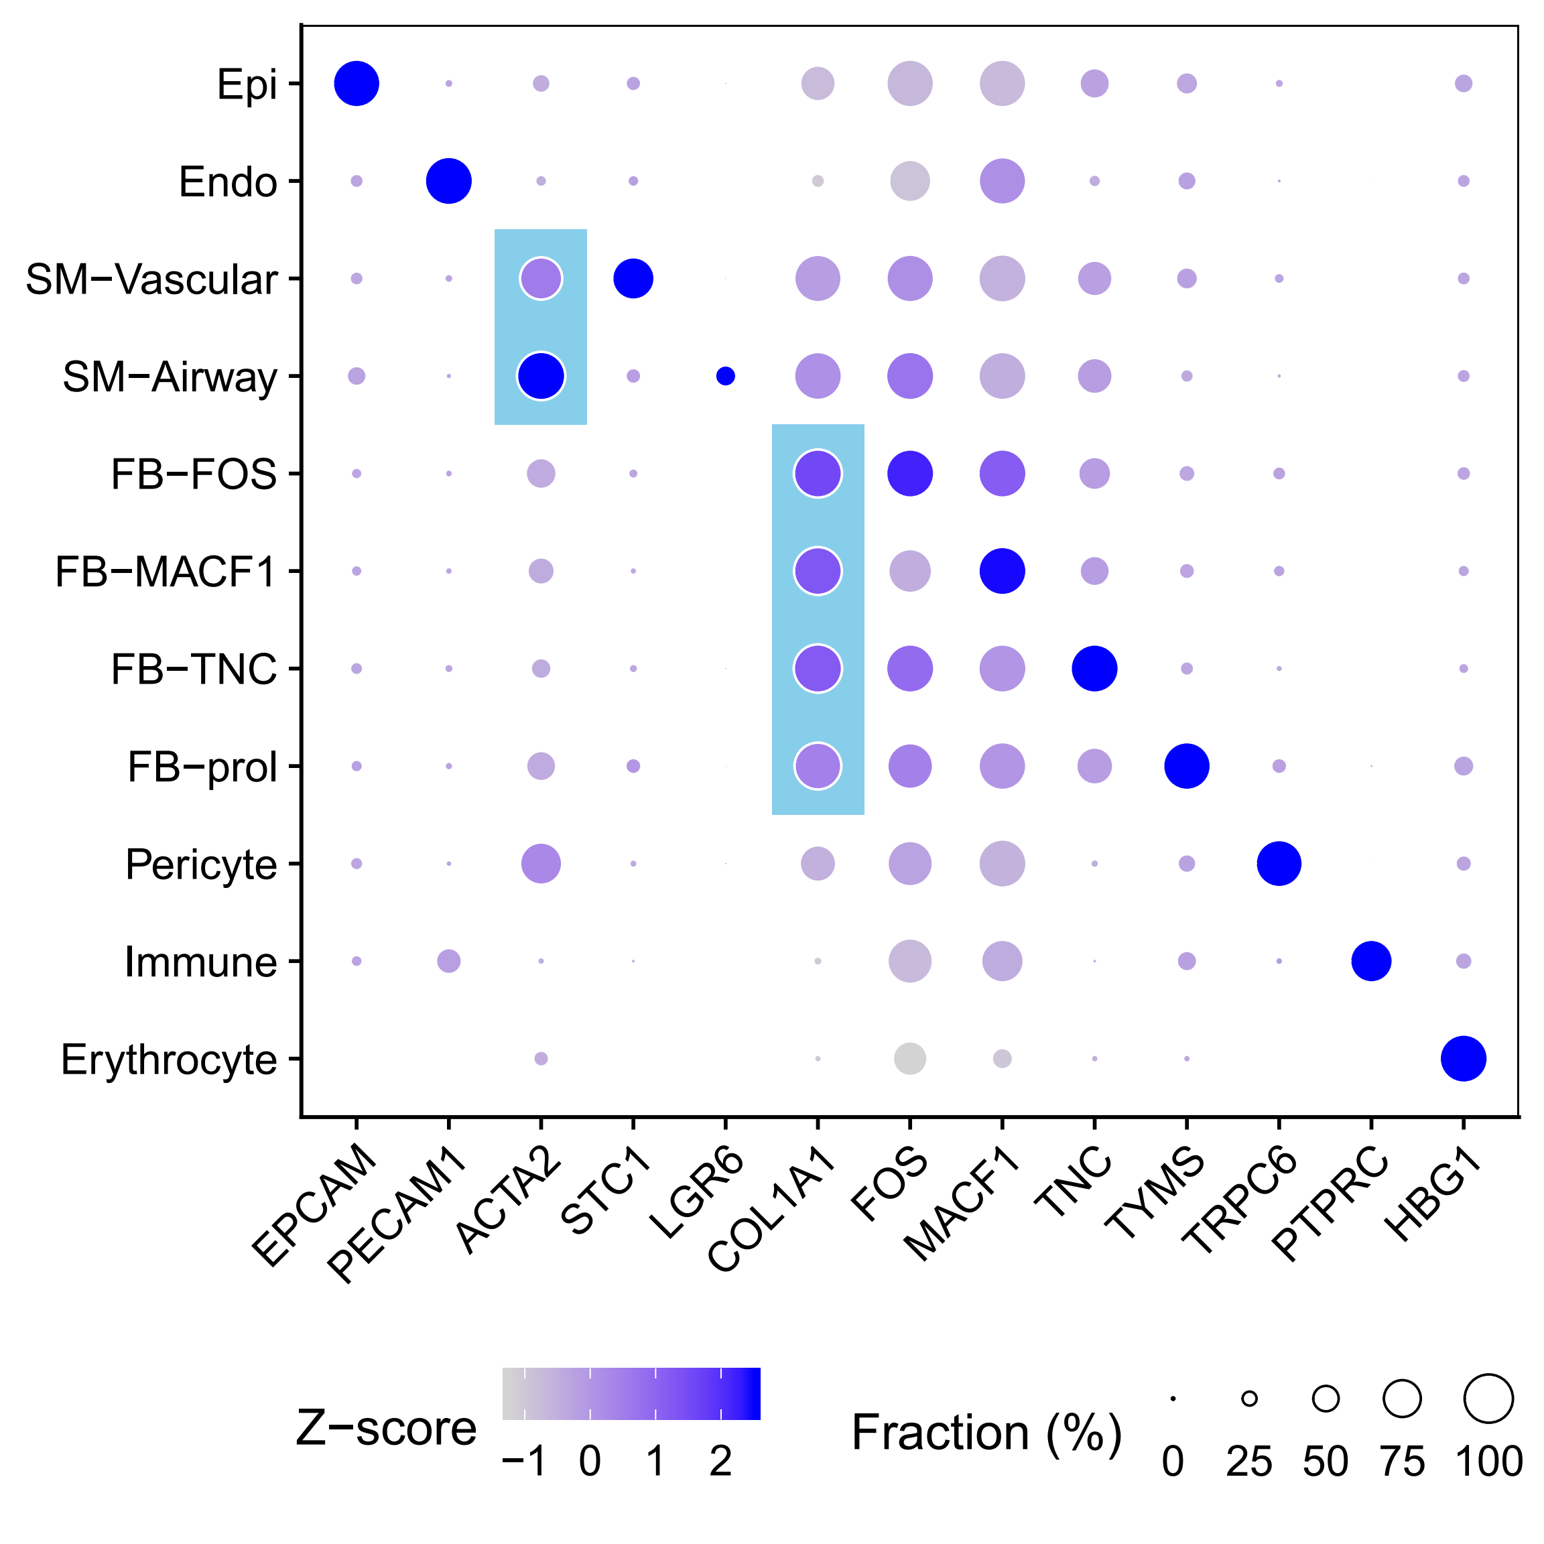
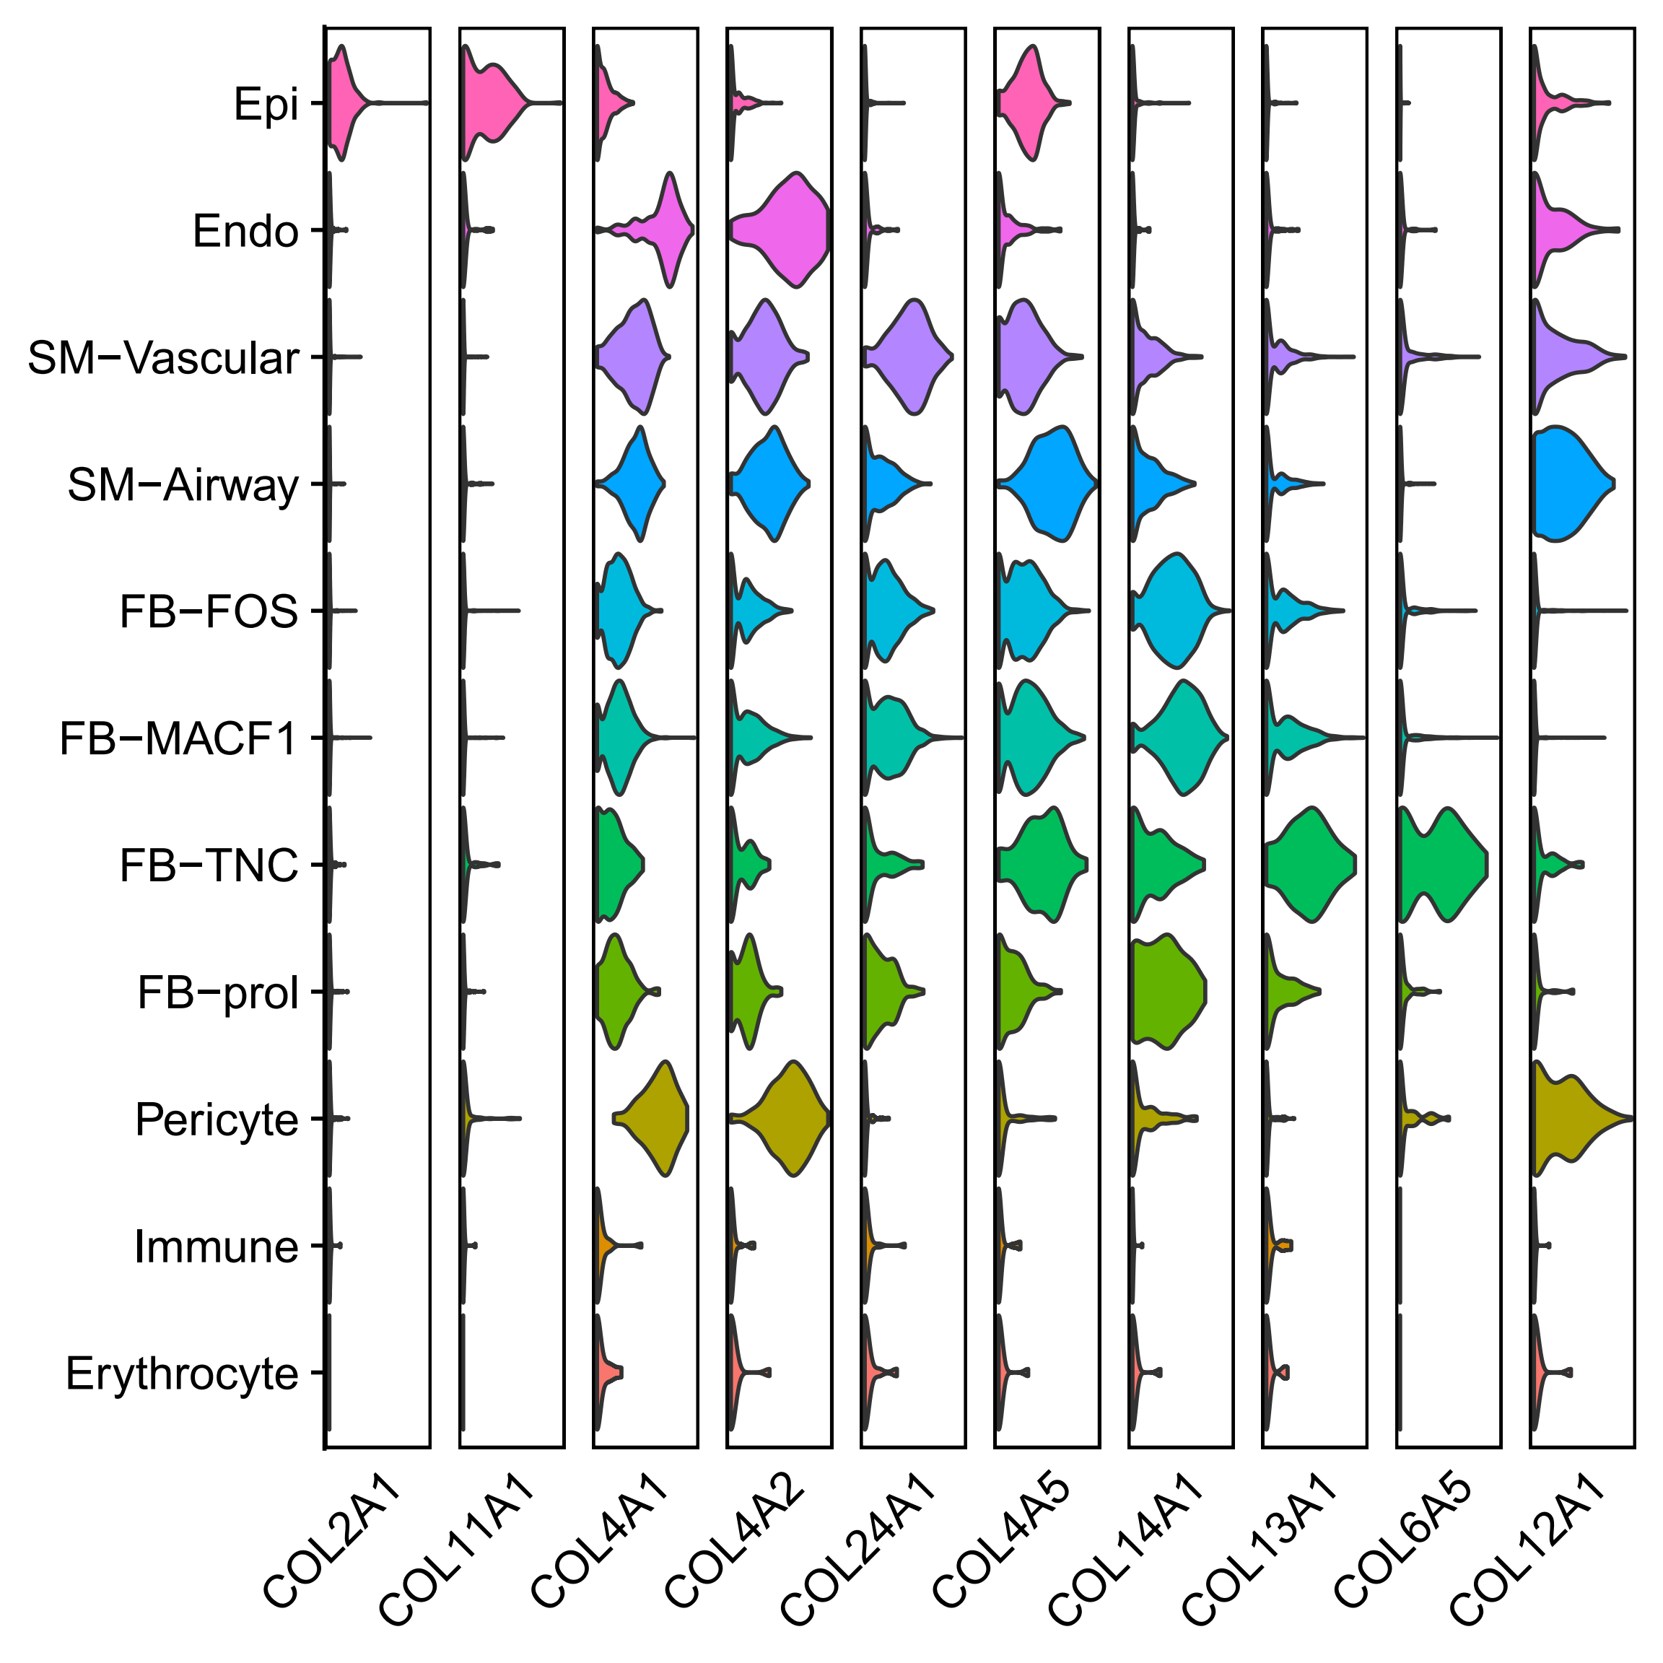
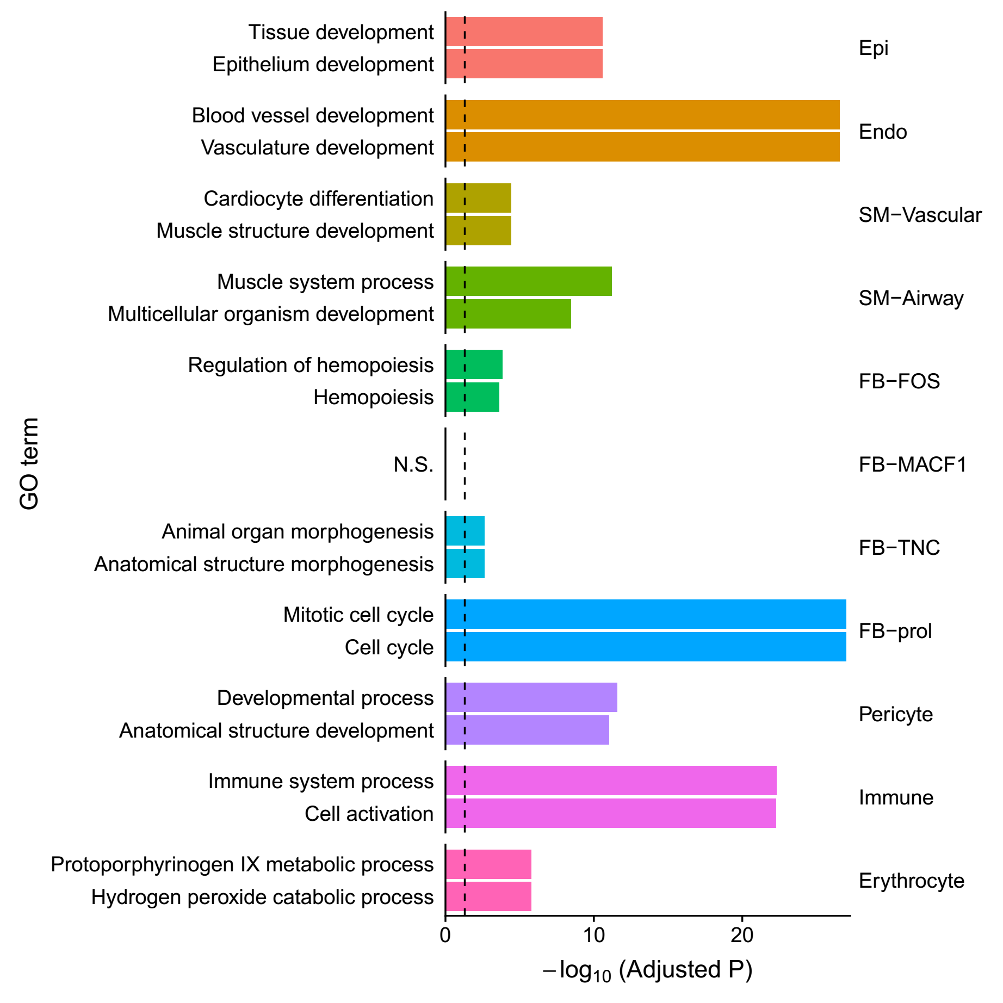
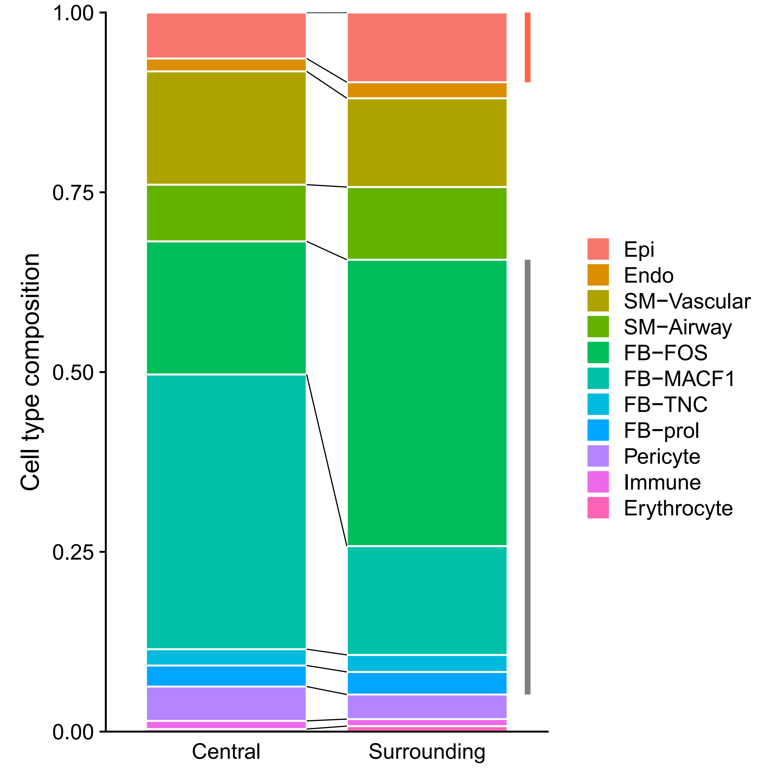

Lung (3,109 cells)
A
B
C
D
E
F

Slide 12




Lung (Supp.)
A
B
C
D

Slide 13




Lung (Supp.)
A
B
C
D

Slide 14







Pancreas (2,266 cells)
A
B
C
D
E
F

Slide 15






Pancreas (Supp.)
Descending vasa recta
Ascending vasa recta

Slide 16








Spleen (847 cells)
Notes:
847

Slide 17



Spleen (Supplementary)

Slide 18







Testis (686 cells)
Notes:
847

Slide 19



Testis (Supp.)
SSC / Diff. ing SPG / Diff. ed SPG
SPC (L1,L2,L3,Z / P,D / P,D,SPC7,S1)
Spermatid
Notes:
pan-germ cell markers DDX4 and MAGEA4
spermatogonia (SPG) 精原细胞
A subset of undifferentiated SPG—called spermatogonial stem cells (SSCs) 精原干细胞
Spermatocytes (SPC) 精母细胞
Spermatid 精子细胞

Slide 20





Testis (Supp.)

Slide 21
Gene module pipeline
Gene correlation
Hierarchy clustering
Cutting tree
Cell subsampling
Filtering
Gene module
500 cells
Spearman
Average
Dynamic cut
≥10 genes

Slide 22

1. Remove size effect

Slide 23


2. Gene correlation
Choose the good correlation method (Pearson, Spearman and bicor)

Slide 24


3. Handle zero
Choose the strategy for zero

Slide 25




4. Hierarchy clustering
Choose the method for clustering (average and ward.D2)

Slide 26





5. Cutting the tree
Choose the method for module detection

Slide 27

Module map within cell types
0.13 0.09 0.25 0.15 0.14
Notes:
TF scattered

Slide 28

Module map within cell types
0.13 0.09 0.25 0.15 0.14

Slide 29





Module map within cell types

Slide 30

Module map within cell types
The most significant gene modules (min.avgExpr = 5, min.avgCor = 0.1)

Slide 31






Module map within cell types
FB-ADAM28 M202 (17 genes)

Slide 32






Module map within cell types
FB-ADAM28 M23 (71 genes)

Slide 33






Module map within cell types
FB-ADAM28 M137 (29 genes)
P = 0.00035

Slide 34

Module map within cell types

Slide 35

Module map within cell types

Slide 36


Module map across cell types

Slide 37


Module map
Expression
Module

Slide 38




Module map

Slide 39
Thanks

